Slide 1
Futures Markets and
Risk Management
17
Bodie, Kane, and Marcus
Essentials of Investments Tenth Edition

Slide 2
17.1 Futures Contract
Forward Contract
Arrangement calling for future delivery of asset at agreed-upon price
Basics
Futures price
Agreed-upon price paid on futures contract at maturity
Long position
Trader who commits to purchasing asset
Short position
Trader who commits to delivering asset

Slide 3
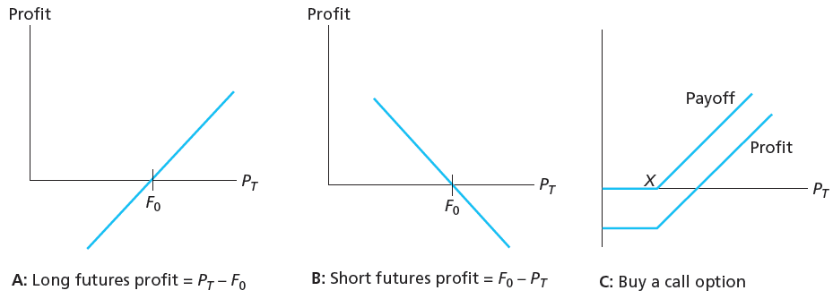
Figure 17.2 Profits to Buyers/Sellers of Futures and Options

Slide 4
17.1 Futures Contracts
Existing Contracts
Single stock futures
Futures contract on shares of individual company

Slide 5
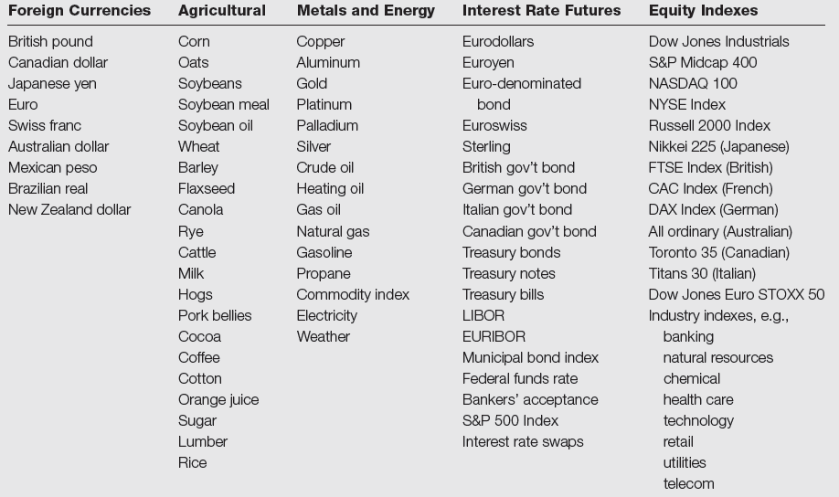
Table 17.1 Samples of Futures Contracts

Slide 6
17.2 Trading Mechanics
Clearinghouse and Open Interest
Clearinghouse
Facilitates trading; may be intermediary between two traders
Closing out positions
Reversing trade
Take or make delivery
Most trades reversed and do not involve actual delivery
Open interest
Opened contracts not offset with reversing trade

Slide 7
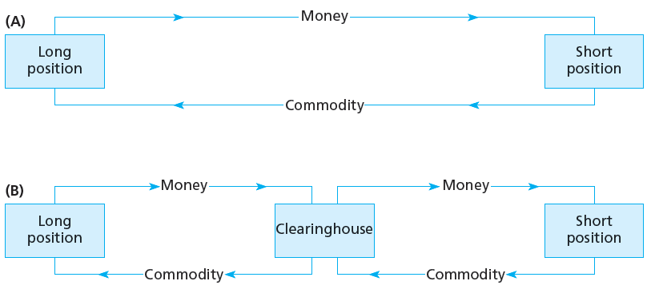
Figure 17.3 Trading with and without Clearinghouse

Slide 8
17.2 Trading Mechanics
Marking to Market and Margin Account
Marking to Market
Daily settlement of obligations on futures positions
Maintenance Origin
Value below which trader’s margin may not fall; triggers margin call
Convergence Property
Convergence of futures prices/spot prices at maturity of futures contract

Slide 9
17.2 Trading Mechanics
Cash versus Actual Delivery
Cash settlement
Cash value of underlying asset delivered to satisfy contract

Slide 10
17.2 Trading Mechanics
Cash versus Actual Delivery
Regulations
Regulated by Commodity Futures Trading Committee (CFTC)
Exchange can set limits on one-day price changes
Taxation
Paid at year-end on cumulative profits/losses regardless of whether position is closed

Slide 11
17.3 Futures Market Strategies
Trading Strategies
Speculation
Short if you believe price will fall
Long if you believe price will rise
Hedging
Long: Endowment fund will purchase stock in 3 months; manager buys futures now to protect against rise in price
Short: Hedge fund invests in long-term bonds; manager worries interest rates may increase and sells futures

Slide 12
Why Hedge?
The value of the firm may not be independent of financial decisions because
Shareholders might be unaware of the firm’s risks.
Shareholders might not be able to identify the correct number of futures contracts necessary to hedge.
Shareholders might have higher transaction costs of hedging than the firm.
There may be tax advantages to a firm hedging.
Hedging reduces bankruptcy costs.
Managers may be reducing their own risk.
Hedging may send a positive signal to creditors.
Dealers hedge their market-making activities in derivatives.

Slide 13
Why Hedge? (continued)
Reasons not to hedge
Hedging can give a misleading impression of the amount of risk reduced
Hedging eliminates the opportunity to take advantage of favorable market conditions
There is no such thing as a hedge. Any hedge is an act of taking a position that an adverse market movement will occur. This, itself, is a form of speculation.
© 2015 Cengage Learning. All Rights Reserved. May not be scanned, copied or duplicated, or posted to a publicly accessible website, in whole or in part.

Slide 14
Hedging Concepts
Short Hedge and Long Hedge
Short (long) hedge implies a short (long) position in futures
Short hedges can occur because the hedger owns an asset and plans to sell it later.
Long hedges can occur because the hedger plans to purchase an asset later.
An anticipatory hedge is a hedge of a transaction that is expected to occur in the future.
© 2015 Cengage Learning. All Rights Reserved. May not be scanned, copied or duplicated, or posted to a publicly accessible website, in whole or in part.

Slide 15
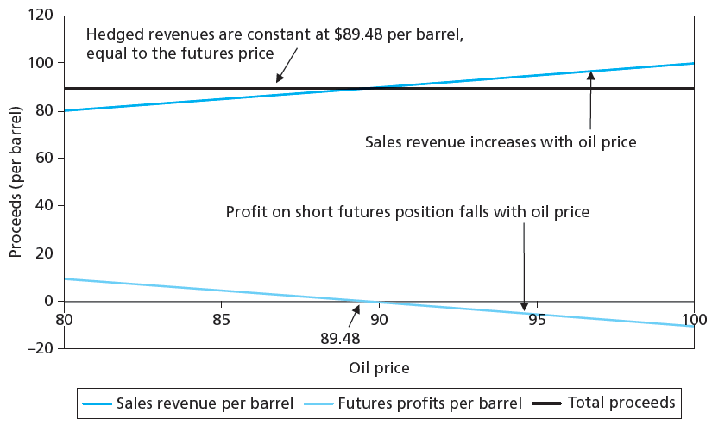
Figure 17.4 Hedging Revenues Using Futures

Slide 16
17.3 Futures Market Strategies
Basis and Hedging
Basis
Difference between futures price and spot price
Basis risk
Risk attributable to uncertain movements in spread between futures price and spot price
Spread (futures)
Taking long position in futures contract of one maturity and short position in another, in same commodity

Slide 17
Hedging Concepts (continued)
The Basis
Basis = futures price-spot price.
Hedging and the Basis
Π (short hedge) = S_{T} – S₀ (from spot market) – (f_{T} – f₀) (from futures market)
Π (long hedge) = –S_{T} + S₀ (from spot market) + (f_{T} – f₀) (from futures market)
If hedge is closed prior to expiration,
Π (short hedge) = S_{t} – S₀ – (f_{t} – f₀)
If hedge is held to expiration, S_{t} = S_{T} = f_{T} = f_{t}.
© 2015 Cengage Learning. All Rights Reserved. May not be scanned, copied or duplicated, or posted to a publicly accessible website, in whole or in part.

Slide 18
Hedging Concepts (continued)
The Basis (continued)
Example: March 30. Spot gold $1,387.15. June futures $1,388.60. Buy spot, sell futures. Note: b₀ = 1,387.15 − 1,388.60 = −1.45. If held to expiration, profit should be change in basis or 1.45.
At expiration, let S_{T} = $1,408.50. Sell gold in spot for $1,408.50, a profit of 21.35. Buy back futures at $1,408.50, a profit of −19.90. Net gain =1.45 or $145 on 100 oz. of gold.
© 2015 Cengage Learning. All Rights Reserved. May not be scanned, copied or duplicated, or posted to a publicly accessible website, in whole or in part.

Slide 19
Hedging Concepts (continued)
The Basis (continued)
Example: (continued)
Instead, close out prior to expiration when S_{t} = $1,377.52 and f_{t} = $1,378.63.
Profit on spot = −9.63. Profit on futures = 9.97.
Net gain = 0.34 or $34 on 100 oz.
Note that change in basis was b_{t} − b₀ or −1.11 − (−1.45) = 0.34.
In forward markets, the hedge is customized so there is no basis risk.
© 2015 Cengage Learning. All Rights Reserved. May not be scanned, copied or duplicated, or posted to a publicly accessible website, in whole or in part.

Slide 20
17.4 Futures Prices
Spot-Futures Parity Theorem
Purchase commodity now, store to T
Simultaneously take short position in futures
“All-in cost” of purchasing commodity and storing it (including cost of funds) must equal futures price to prevent arbitrage

Slide 21
17.4 Futures Prices
No-Arbitrage Condition
Strategy: Cost 0 initially, cash flow at T must = 0, therefore:
F₀ – S₀(1 + r_{f})^{T} = 0
F₀ = S₀ (1 + r_{f})^{T}
Futures price = Spot price – Cost of carry
Action | Initial Cash Flow | Cash Flow at T
1. Borrow S₀ | S₀ | -S₀(1+r_{f})^{T}
2. Buy spot for S₀ | -S₀ | S_{T}
3. Sell futures short | 0 | F₀ - S_{T}
Total | 0 | F₀ - S₀(1 + r_{f})^{T}

Slide 22
17.4 Futures Prices
No-Arbitrage Condition
Strategies have same cash flows at same time, T
F₀/(1 + r_{f})^{T} = S₀
F₀ = S₀(1 + r_{f})^{T}
Futures price = Spot price - Cost of carry
 | Action | Initial Flows | Flows at T
Strategy A: | Buy gold | −S₀ | S_{T}
Strategy B: | Long Futures | 0 | S_{T} − F₀
 | Invest in bills: F₀/(1 + r_{f})^{T} | −F₀/(1 + r_{f})^{T} | F₀
 | Total for B | −F₀/(1 + r_{f})^{T} | S_{T}

Slide 23
Figure 17.5 S&P 500 Monthly Dividend Yield
F₀ = S₀(1 + r_{f} -d)^{T}

Slide 24
Figure 17.6 Gold Futures Prices

Slide 25
17.5 Financial Futures
Stock-Index Futures
Available on domestic and international stocks
Several advantages over direct stock purchase
Lower transaction costs
Easier to implement timing/allocation strategies

Slide 26
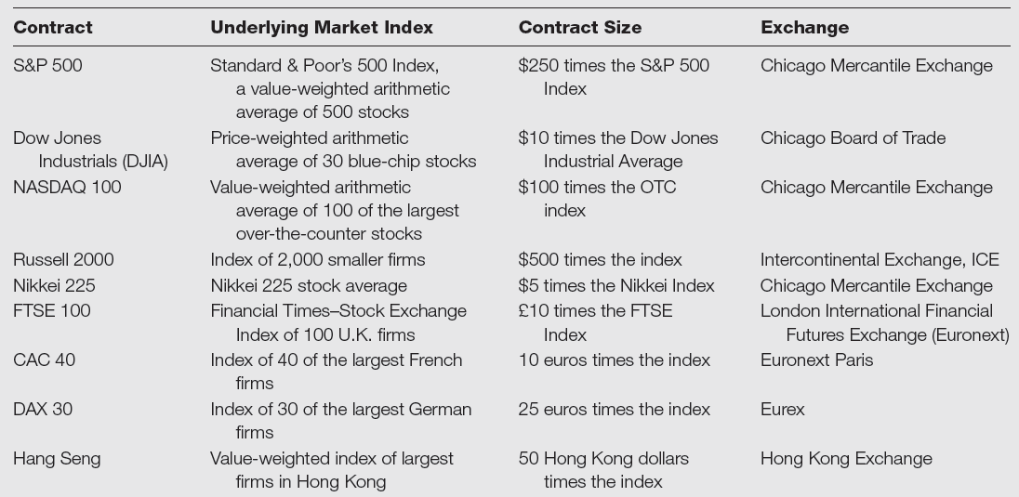
Table 17.2 Stock Index Futures

Slide 27
Table 17.3 Correlations among Indexes
Correlations among major U.S. Stock Indexes, 2006-11

Slide 28
17.5 Financial Futures
Creating Synthetic Stock Positions
Synthetic stock purchase
Purchase of stock-index futures instead of actual shares
Allows frequent trading at low cost
Useful for foreign investments
Classic market-timing strategy: Switch between Treasury bills and stocks based on market conditions
Cheaper to buy Treasury bills then shift stock market exposure by buying and selling stock-index futures

Slide 29
Chapter 16- Black-Scholes Option Valuation
Put-Call Parity Relationship
Relationship between put and call prices
S₀ = C –P + Xe^{-rT}
S₀ = C – P +PV(dividends) + Xe^{-rT}

Slide 30
17.5 Financial Futures
Index Arbitrage
Exploiting mispricing between underlying stocks and futures index contract
Futures price too high
Short futures; buy underlying stocks
Futures price too low
Long futures; sell underlying stocks

Slide 31
17.5 Financial Futures
Index Arbitrage
Difficult to do in practice
Transaction costs often too large
Trades must be done simultaneously
SuperDot system assists in rapid trade execution
ETFs available on indexes

Slide 32
17.5 Financial Futures
Foreign Currency
Forward contracts
Currency markets largest in world
Available from large banks
Used extensively to hedge foreign currency transactions
Futures contracts available for major currencies at CME, the LIFFE, etc.
March, June, September, December delivery contracts available

Slide 33
17.5 Financial Futures
Interest Rate Futures
Major contracts include contracts on Eurodollars, Treasury bills, Treasury notes, and Treasury bonds
Some foreign interest rate contracts are also available
Short position in contracts will benefit if interest rates increase
Long position benefits if interest rates fall

Slide 34
17.5 Financial Futures
Interest Rate Futures
Hedging with futures often requires cross-hedge
Hedging spot position with a futures contract that has different underlying asset
Example: Hedge corporate bond by selling Treasury-bond futures

Slide 35
17.6 Swaps
Interest rate swaps
One pays the other a fixed rate of interest in exchange for a variable rate of interest
No principal exchanged

Slide 36
17.6 Swaps
Currency Swaps
Two parties agree to swap principal and interest payments at a fixed exchange rate
Firm may borrow money in whatever currency has lowest interest rate and then swap payments into currency preferred

