Slide 1
Chapter 12
Estimating the Cost of Capital

Slide 2
Chapter Outline
12.1 The Equity Cost of Capital
12.2 The Market Portfolio
12.3 Beta Estimation
12.4 The Debt Cost of Capital
12.5 A Project’s Cost of Capital
12.6 Project Risk Characteristics and Financing
12.7 Final Thoughts on Using the CAPM

Slide 3
Learning Objectives
Estimate a company’s cost of capital using the CAPM equation for the Security Market Line.
Describe the market portfolio and how it is constructed in practice.
Discuss the attributes of a value-weighted portfolio.
Describe common proxies for the market return and the risk-free rate.

Slide 4
Learning Objectives
Define alpha and beta and explain how they are generally estimated.
Compare the use of average return versus beta and the SML to estimate cost of equity capital.
Estimate the cost of debt, given a company’s yield to maturity, probability of default, and expected loss rate.

Slide 5
Learning Objectives
Discuss the difference between the yield to maturity and the cost of debt when there is low versus high default risk.
Calculate the cost of debt given a company’s debt beta, the risk free rate, and the market risk premium.
Illustrate the use of comparable companies’ unlevered betas or unlevered cost of capital to estimate project cost of capital.

Slide 6
Learning Objectives
Discuss the advantages of using several companies’ betas to estimate a project beta.
Define operating leverage and discuss its influence on project risk.
Calculate the weighted average cost of capital.
Discuss strengths and weaknesses of the CAPM.

Slide 7
12.1 The Equity Cost of Capital
The Capital Asset Pricing Model (CAPM) is a practical way to estimate.
The cost of capital of any investment opportunity equals the expected return of available investments with the same beta.
The estimate is provided by the Security Market Line equation:
Risk Premium for Security i

Slide 8
Textbook Example 12.1

Slide 9
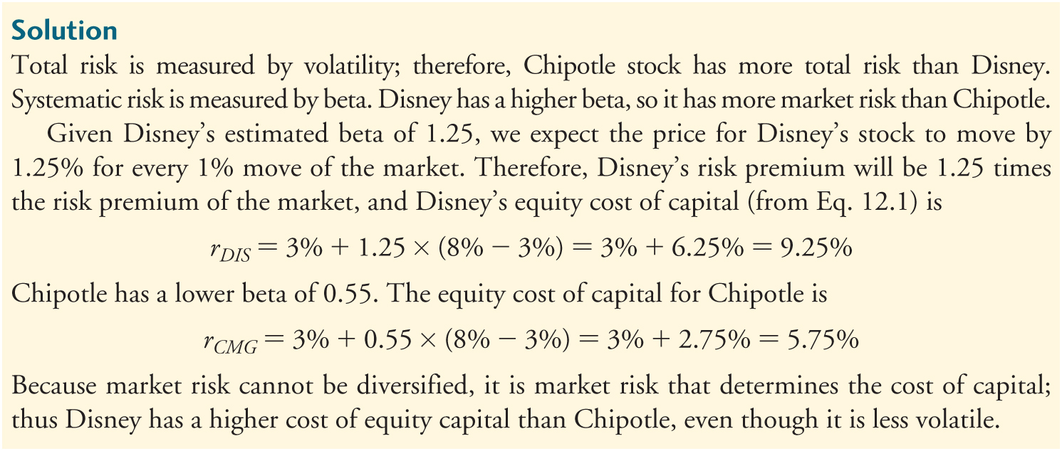
Textbook Example 12.1 (cont'd)

Slide 10
Alternative Example 12.1
Problem
Suppose you estimate that Walmart’s stock has a volatility of 16.1% and a beta of 0.20. A similar process for Johnson & Johnson yields a volatility of 13.7% and a beta of 0.54. Which stock carries more total risk? Which has more market risk? If the risk-free interest rate is 4% and you estimate the market’s expected return to be 12%, calculate the equity cost of capital for Walmart and Johnson & Johnson. Which company has a higher cost of equity capital?

Slide 11
Alternative Example 12.1 (cont'd)
Solution
Total risk is measured by volatility; therefore, Walmart stock has more total risk than Johnson & Johnson. Systematic risk is measured by beta. Johnson & Johnson has a higher beta, so it has more market risk than Walmart. Given Johnson & Johnson’s estimated beta of 0.54, we expect the price for Johnson & Johnson’s stock to move by 0.54% for every 1% move of the market.

Slide 12
Alternative Example 12.1 (cont'd)
Solution (cont’d)
Therefore, Johnson & Johnson’s risk premium will be 0.54 times the risk premium of the market, and Johnson & Johnson’s equity cost of capital (from Eq. 12.1) is
r_{JNJ} = 4% + 0.54 × (12% − 4%) = 4% + 4.32% = 8.32%

Slide 13
Alternative Example 12.1 (cont'd)
Solution (cont’d)
Walmart has a lower beta of 0.20. The equity cost of capital for Walmart is
r_{WMT}= 4% + 0.20 × (12% − 4%) = 4% + 1.6% = 5.6%
Because market risk cannot be diversified, it is market risk that determines the cost of capital; thus, Johnson & Johnson has a higher cost of equity capital than Walmart, even though it is less volatile.

Slide 14
12.2 The Market Portfolio
Constructing the market portfolio
Market Capitalization
The total market value of a firm’s outstanding shares

Slide 15
12.2 The Market Portfolio (cont’d)
Value-Weighted Portfolio
A portfolio in which each security is held in proportion to its market capitalization

Slide 16
Value-Weighted Portfolios
A value-weighted portfolio is an equal-ownership portfolio; it contains an equal fraction of the total number of shares outstanding of each security in the portfolio.
Passive Portfolio
A portfolio that is not rebalanced in response to price changes

Slide 17
Market Indexes
Report the value of a particular portfolio of securities.
Examples
S&P 500
A value-weighted portfolio of the 500 largest U.S. stocks
Wilshire 5000
A value-weighted index of all U.S. stocks listed on the major stock exchanges
Dow Jones Industrial Average (DJIA)
A price weighted portfolio of 30 large industrial stocks

Slide 18
Investing in a Market Index
Index funds – mutual funds that invest in the S&P 500, the Wilshire 5000, or some other index.
Exchange-traded funds (ETFs) – trade directly on an exchange but represent ownership in a portfolio of stocks.
Example: SPDRS (Standard and Poor’s Depository Receipts) represent ownership in the S&P 500

Slide 19
12.2 The Market Portfolio (cont’d)
Most practitioners use the S&P 500 as the market proxy, even though it is not actually the market portfolio.

Slide 20
The Market Risk Premium
Determining the Risk-Free Rate
The yield on U.S. Treasury securities
Surveys suggest most practitioners use 10- to 30-year treasuries
The Historical Risk Premium
Estimate the risk premium (E[R_{Mkt}]-r_{f}) using the historical average excess return of the market over the risk-free interest rate

Slide 21
Table 12.1 Historical Excess Returns of the S&P 500 Compared to One-Year and Ten-Year U.S. Treasury Securities

Slide 22
The Market Risk Premium (cont’d)
A Fundamental Approach
Using historical data has two drawbacks:
Standard errors of the estimates are large
Backward looking, so may not represent current expectations.
One alternative is to solve for the discount rate that is consistent with the current level of the index.

Slide 23
12.3 Beta Estimation
Estimating Beta from Historical Returns
Recall, beta is the expected percent change in the excess return of the security for a 1% change in the excess return of the market portfolio.
Consider Cisco Systems stock and how it changes with the market portfolio.

Slide 24
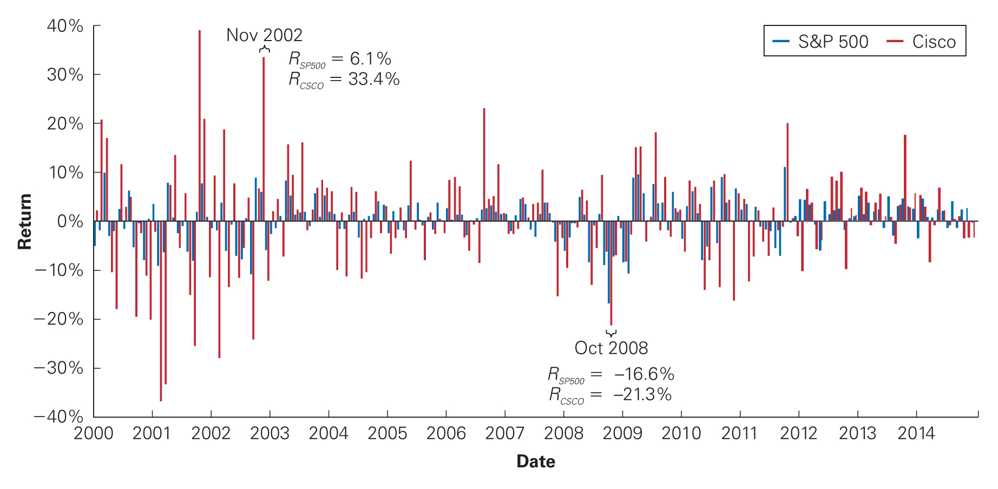
Figure 12.1 Monthly Returns for Cisco Stock and for the S&P 500, 2000-2015

Slide 25
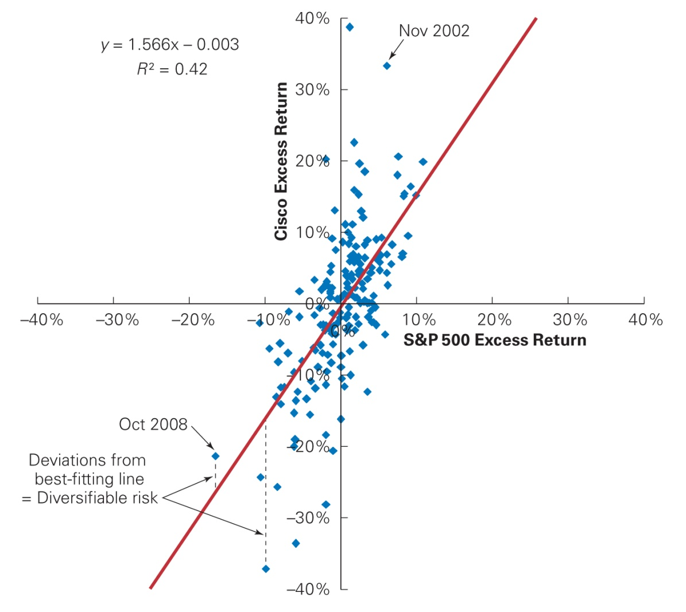
Figure 12.2 Scatterplot of Monthly Excess Returns for Cisco Versus the S&P 500, 2000-2015

Slide 26
12.3 Beta Estimation (cont'd)
Estimating Beta from Historical Returns
As the scatterplot on the previous slide shows, Cisco tends to be up when the market is up, and vice versa.
We can see that a 10% change in the market’s return corresponds to about a 20% change in Cisco’s return.
Thus, Cisco’s return moves about two for one with the overall market, so Cisco’s beta is about 2.

Slide 27
12.3 Beta Estimation (cont'd)
Estimating Beta from Historical Returns
Beta corresponds to the slope of the best-fitting line in the plot of the security’s excess returns versus the market excess return.

Slide 28
Using Linear Regression
Linear Regression
The statistical technique that identifies the best-fitting line through a set of points.
α_{i} is the intercept term of the regression.
β_{i}(R_{Mkt} – r_{f}) represents the sensitivity of the stock to market risk. When the market’s return increases by 1%, the security’s return increases by β_{i}%.
ε_{i} is the error term and represents the deviation from the best-fitting line and is zero on average.

Slide 29
Using Linear Regression (cont'd)
Linear Regression
Since E[ε_{i}] = 0:
α_{i} represents a risk-adjusted performance measure for the historical returns.
If α_{i} is positive, the stock has performed better than predicted by the CAPM.
If α_{i} is negative, the stock’s historical return is below the SML.

Slide 30
Using Linear Regression (cont'd)
Linear Regression
Given data for r_{f} , R_{i} , and R_{Mkt} , statistical packages for linear regression can estimate β_{i}.
A regression for Cisco using the monthly returns for 2000–2015 indicates the estimated beta is 1.57.
The estimate of Cisco’s alpha from the regression is not significantly different from zero.

Slide 31
Textbook Example 12.2

Slide 32
Alternative Example 12.2
Problem
Suppose you have estimated Tikyberd’s beta to be 0.8 with a 95% confidence interval of 0.65 to 0.95.
Assuming the risk-free rate is 2% and the market is expected to return 12%, what range would you estimate for Tikyberd’s equity cost of capital?
Solution
Based on the 95% confidence interval for Tikyberd’s beta, the equity cost of capital is expected to fall between 8.5% and 11.5%.

Slide 33
12.4 The Debt Cost of Capital
Debt Yields Versus Returns
Yield to maturity is the IRR an investor will earn from holding the bond to maturity and receiving its promised payments.
If there is little risk the firm will default, yield to maturity is a reasonable estimate of investors’ expected rate of return.
If there is significant risk of default, yield to maturity will overstate investors’ expected return.

Slide 34
12.4 The Debt Cost of Capital (cont’d)
Consider a one-year bond with YTM of y. For each $1 invested in the bond today, the issuer promises to pay $(1 + y) in one year.
Suppose the bond will default with probability p, in which case bond holders receive only
$(1 + y - L), where L is the expected loss per $1 of debt in the event of default.

Slide 35
12.4 The Debt Cost of Capital (cont’d)
So the expected return of the bond is
r_{d} = (1 - p)y + p(y - L) = y - pL
= Yield to Maturity – Prob(default) X Expected Loss Rate
The importance of the adjustment depends on the riskiness of the bond.

Slide 36
Table 12.2 Annual Default Rates by Debt Rating (1983–2011)

Slide 37
12.4 The Debt Cost of Capital (cont’d)
The average loss rate for unsecured debt is 60%.
According to Table 12.2, during average times the annual default rate for B-rated bonds is 5.5%.
So the expected return to B-rated bondholders during average times is 0.055 X 0.60=3.3% below the bond’s quoted yield.

Slide 38
12.4 The Debt Cost of Capital (cont’d)
Debt Betas
Alternatively, we can estimate the debt cost of capital using the CAPM.
Debt betas are difficult to estimate because corporate bonds are traded infrequently.
Chapter 21 shows a method for estimating debt betas.
One approximation is to use estimates of betas of bond indices by rating category.

Slide 39
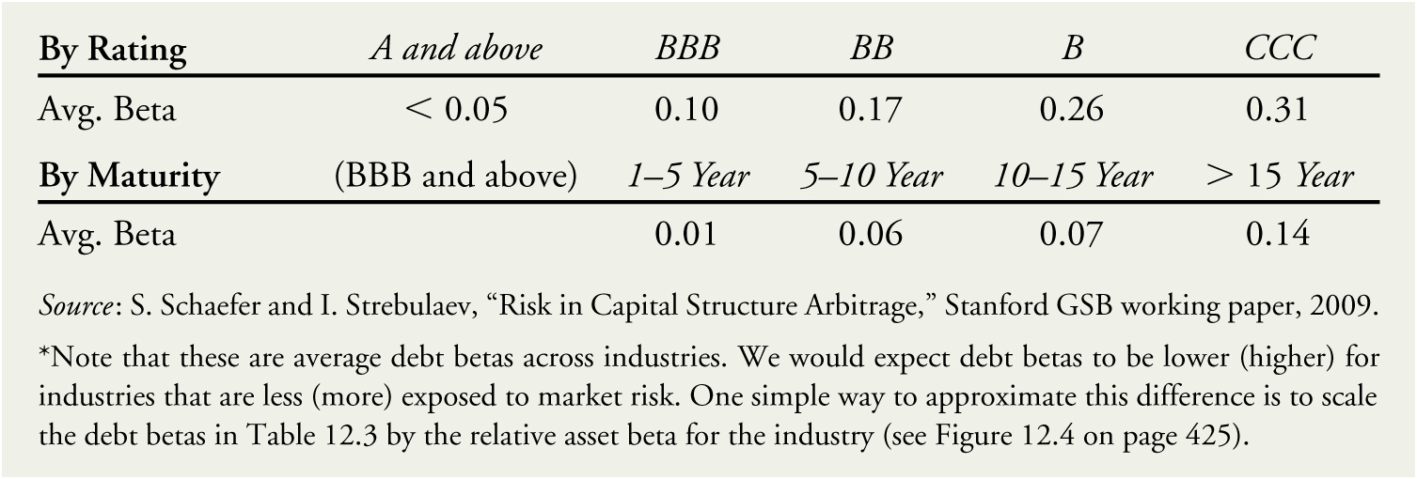
Table 12.3 Average Debt Betas by Rating and Maturity*

Slide 40
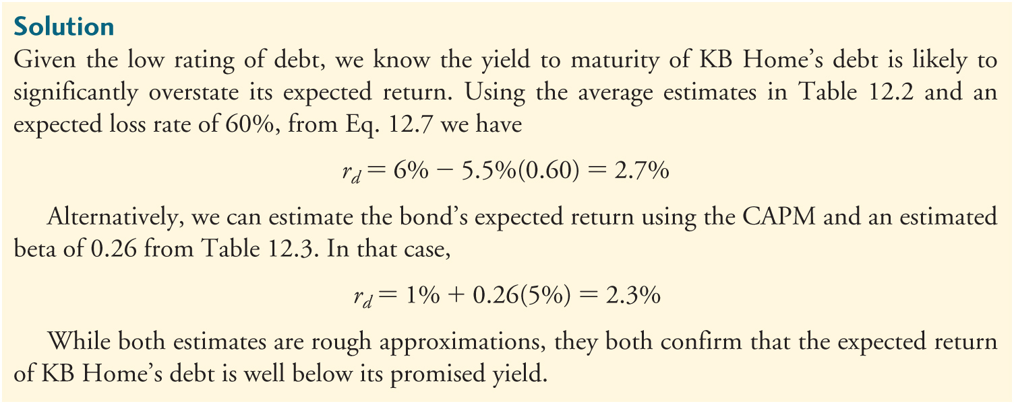
Textbook Example 12.3

Slide 41
Alternative Example 12.3
Problem
In early 2013, auto parts retailer Autozone had outstanding 10-year bonds with a yield to maturity of 3% and a BBB rating. If corresponding risk-free rates were 1.5% and the market risk premium is 8%, estimate the expected return of Autozone’s debt.
Solution
Using the average estimates in Table 12.2 and an expected loss rate of 60%, from Eq. 12.7 we have
r_{d} = 3% - 0.5%(0.60) = 2.7%

Slide 42
Alternative Example 12.3 (cont’d)
Solution
Alternatively, we can estimate the bond’s expected return using the CAPM and an estimated beta of 0.10 from Table 12.3.
In that case, r_{d} = 1.5% + 0.10(8%) = 2.3%
Both estimates are rough approximations and they both suggest that the expected return of Autozone’s debt is below its yield-to-maturity of 3%.

Slide 43
12.5 A Project’s Cost of Capital
All-equity comparables
Find an all-equity financed firm in a single line of business that is comparable to the project.
Use the comparable firm’s equity beta and cost of capital as estimates.
Levered firms as comparables

Slide 44
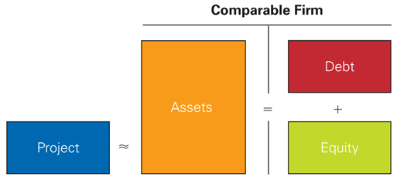
Figure 12.3 Using a Levered Firm as a Comparable for a Project’s Risk

Slide 45
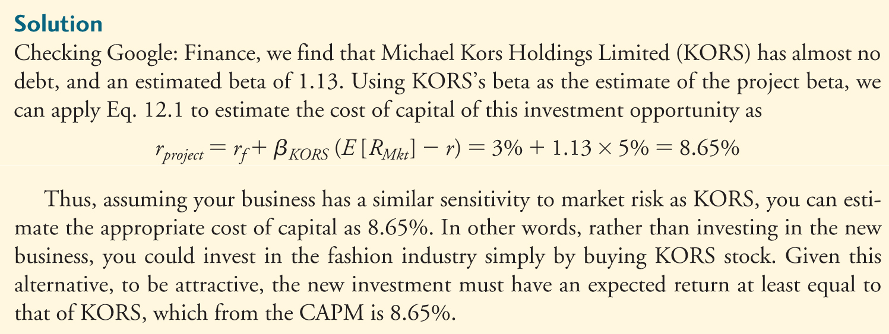
Textbook Example 12.4

Slide 46
12.5 A Project’s Cost of Capital (cont’d)
Asset (unlevered) cost of capital
Expected return required by investors to hold the firm’s underlying assets.
Weighted average of the firm’s equity and debt costs of capital
Asset (unlevered) beta

Slide 47
Textbook Example 12.5

Slide 48
Textbook Example 12.5 (cont’d)

Slide 49
Cash and Net Debt
Some firms maintain high cash balances.
Cash is a risk-free asset that reduces the average risk of the firm’s assets.
Because the risk of the firm’s enterprise value is what we’re concerned with, leverage should be measured in terms of net debt.
Net Debt = Debt – Excess Cash and short-term investments

Slide 50
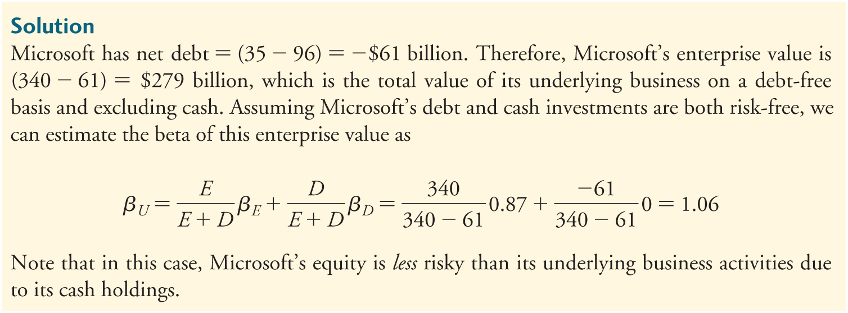
Textbook Example 12.6

Slide 51
Alternative Example 12.6
Problem
Apple’s market capitalization in mid-2016 was $484 billion, and its beta was 1.03. At that same time, the company had $25 billion in cash and $69 billion in debt.
Based on this data, estimate the beta of Apple’s underlying business enterprise.
Solution

Slide 52
Industry Asset Betas
We can combine estimates of asset betas for multiple firms in the same industry.
Doing this will reduce the estimation error of the estimated beta for the project.

Slide 53
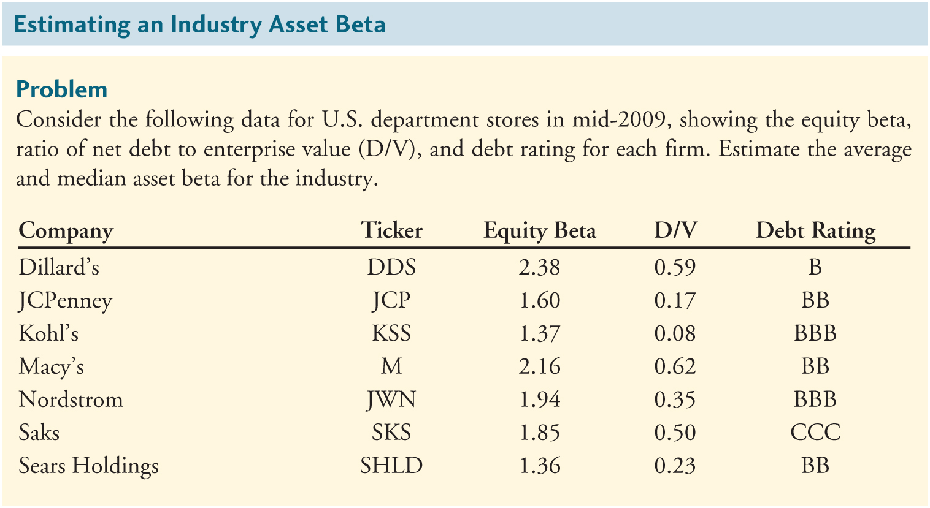
Textbook Example 12.7

Slide 54
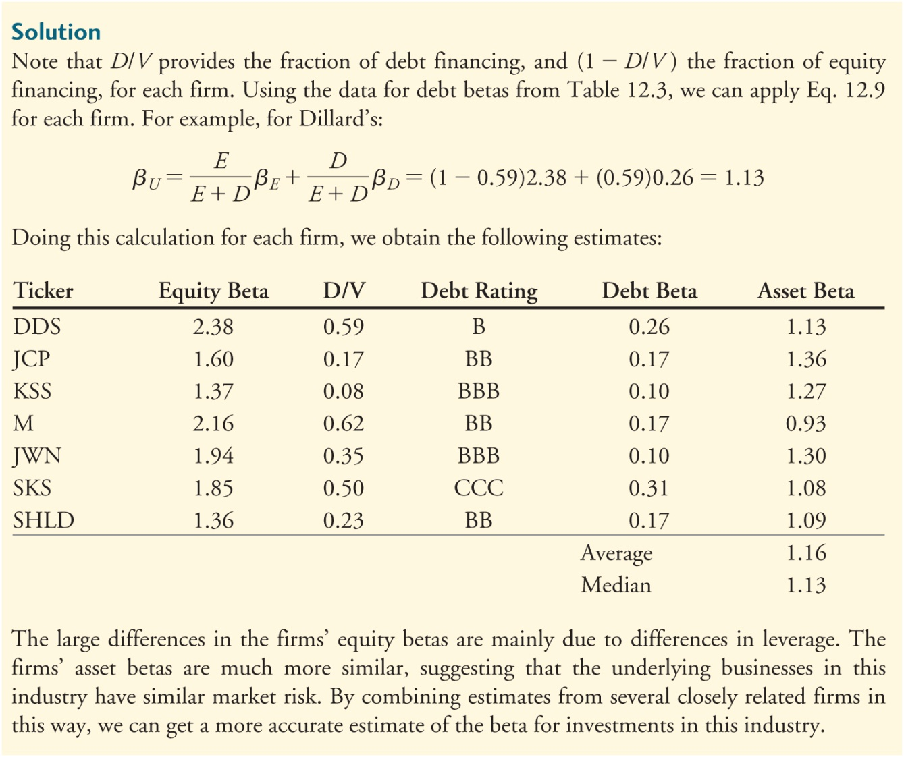
Textbook Example 12.7 (cont’d)

Slide 55
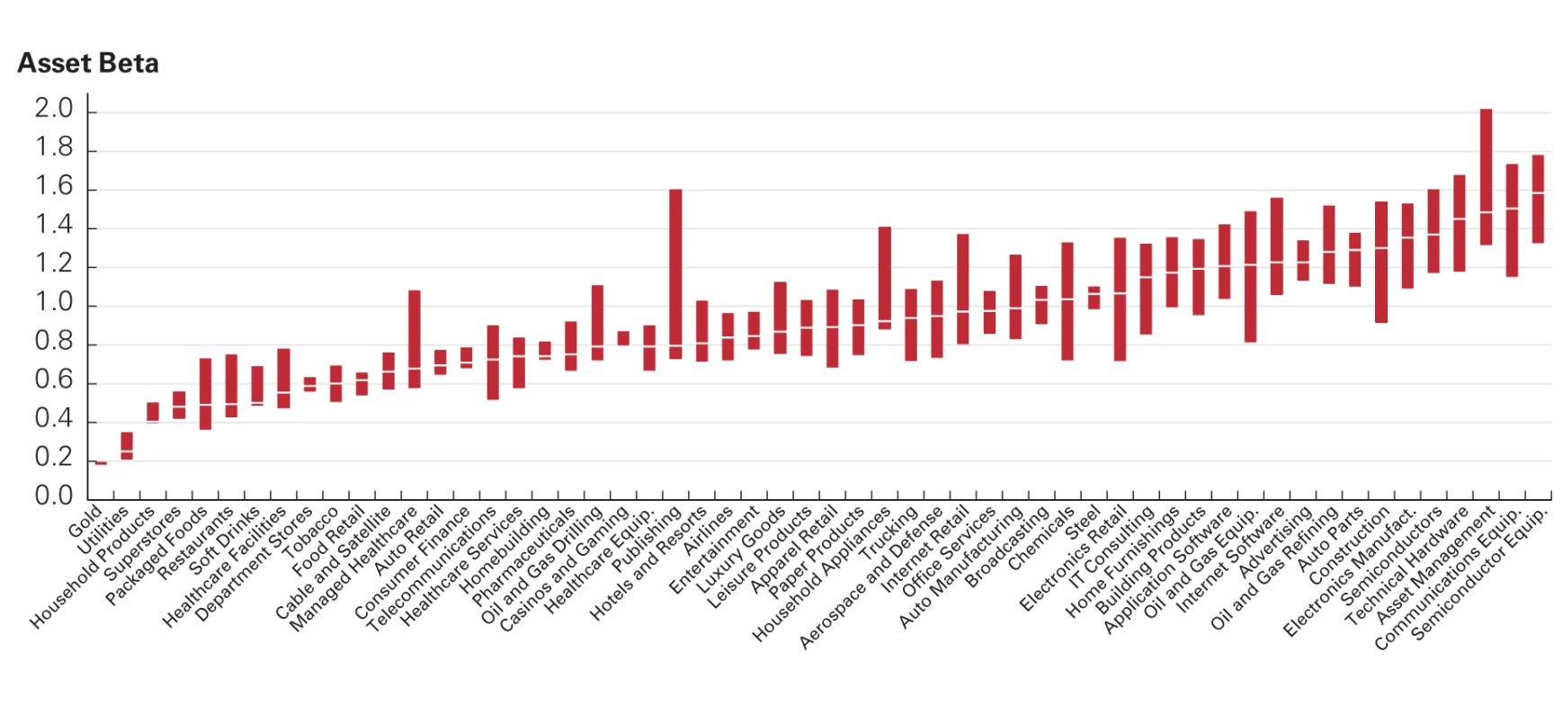
Figure 12.4 Industry Asset Betas (2016)
Source: Author calculations based on data from CapitalIQ.

Slide 56
12.6 Project Risk Characteristics and Financing
Differences in Project Risk
Firm asset betas reflect market risk of the average project in a firm.
Individual projects may be more or less sensitive to market risk.

Slide 57
12.6 Project Risk Characteristics and Financing (cont’d)
For example, 3M has both healthcare and computer display and graphics divisions.
3M’s own asset beta represents an average of the risk of these and 3M’s other divisions.
Financial managers in multidivisional firms should evaluate projects based on asset betas of firms in a similar line of business.

Slide 58
12.6 Project Risk Characteristics and Financing (cont’d)
Another factor that can affect market risk of a project is its degree of operating leverage.
Operating leverage is the relative proportion of fixed versus variable costs.
A higher proportion of fixed costs increases the sensitivity of the project’s cash flows to market risk.
The project’s beta will be higher.
A higher cost of capital should be assigned.

Slide 59
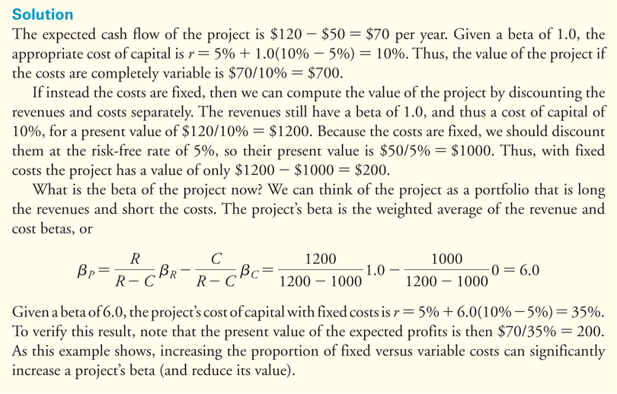
Textbook Example 12.8

Slide 60
Financing and the Weighted Average Cost of Capital
How might the project’s cost of capital change if the firm uses leverage to finance the project?
Perfect capital markets
In perfect capital markets, choice of financing does not affect cost of capital or project NPV.
Taxes – A Big Imperfection
When interest payments on debt are tax deductible, the net cost to the firm is given by
Effective after-tax interest rate = r(1 - τ_{C})

Slide 61
The Weighted Average Cost of Capital
Weighted Average Cost of Capital (WACC)
Given a target leverage ratio,

Slide 62
The Weighted Average Cost of Capital (cont’d)
How does r_{wacc} compare with r_{U}?
Unlevered cost of capital (or pretax WACC)
Expected return investors will earn by holding the firm’s assets
In a world with taxes, it can be used to evaluate an all-equity project with the same risk as the firm.
In a world with taxes, WACC is less than the expected return of the firm’s assets.
With taxes, WACC can be used to evaluate a project with the same risk and the same financing as the firm.

Slide 63
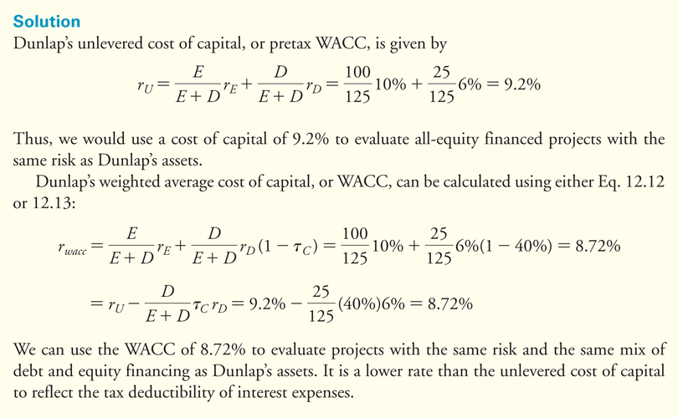
Textbook Example 12.9

Slide 64
Alternative Example 12.9
Problem
Cavo Corp’s equity cost of capital is 15%, and its debt cost of capital is 7%.
The corporate tax rate is 34%.
The firm has $100 million in debt outstanding and a market capitalization of $250 million.
What is Cabo’s unlevered cost of capital?
What is Cavo’s weighted average cost of capital?
Solution
Cavo’s unlevered cost of capital is

Slide 65
Alternative Example 12.9 (cont’d)
Solution
What is Cavo’s weighted average cost of capital?
Cavo’s WACC is
Or

Slide 66
12.7 Final Thoughts on Using the CAPM
There are a large number of assumptions made in the estimation of cost of capital using the CAPM.
How reliable are the results?

Slide 67
12.7 Final Thoughts on Using the CAPM (cont’d)
The types of approximation are no different from those made throughout the capital budgeting process. Errors in cost of capital estimation are not likely to make a large difference in NPV estimates.
CAPM is practical, easy to implement, and robust.
CAPM imposes a disciplined approach to cost of capital estimation that is difficult to manipulate.
CAPM requires managers to think about risk in the correct way.

Slide 68
Discussion of Data Case Key Topic
In January 2013, Walt Disney Company’s bond rating was A. How would your estimate of the company’s cost of debt change if their bond rating was B or below? Would the yields you observe on the FINRA website be different?

Slide 69
Chapter Quiz
What inputs do we need to estimate a firm’s equity cost of capital using the CAPM?
How do you determine the weight of a stock in the market portfolio?
How can you estimate the market risk premium?
How can you estimate a stock’s beta from historical returns?

Slide 70
Chapter Quiz
Why does the yield to maturity of a firm’s debt generally overestimate its debt cost of capital?
Describe two methods that can be used to estimate a firm’s debt cost of capital.
What data can we use to estimate the beta of a project?
Why does the equity beta of a levered firm differ from the beta of its assets?

Slide 71
Chapter Quiz
Why might projects within the same firm have different costs of capital?
Even if the CAPM is not perfect, why might we continue to use it in corporate finance?

Slide 72
Chapter 12
Appendix

Slide 73
Practical Considerations When Forecasting Beta
12A.1 Time Horizon
For stocks, common practice is to use at least two years of weekly return data or five years of monthly return data.
12A.2 The Market Proxy
In practice the S&P 500 is used as the market proxy. Other proxies include the NYSE Composite Index and the Wilshire 5000.

Slide 74
Practical Considerations When Forecasting Beta (cont’d)
12A.3 Beta Variation and Extrapolation
Betas vary over time, so many practitioners prefer to use average industry betas rather than individual stock betas.
In addition, evidence suggests that betas tend to regress toward the average beta of 1.0 over time.

Slide 75
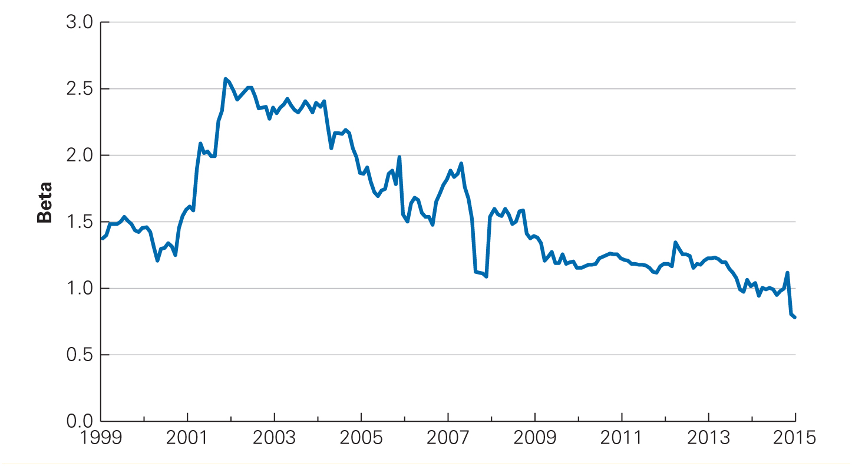
Figure 12A.1 Estimated Betas for Cisco Systems, 1999–2015

Slide 76
Practical Considerations When Forecasting Beta (cont’d)
Beta Extrapolation
Adjusted Betas
Table 12A.1 Estimation Methodologies Used by Selected Data Providers

Slide 77
Practical Considerations When Forecasting Beta (cont’d)
12A.4 Outliers
The beta estimates obtained from linear regression can be very sensitive to outliers, which are returns of unusually large magnitude.

Slide 78
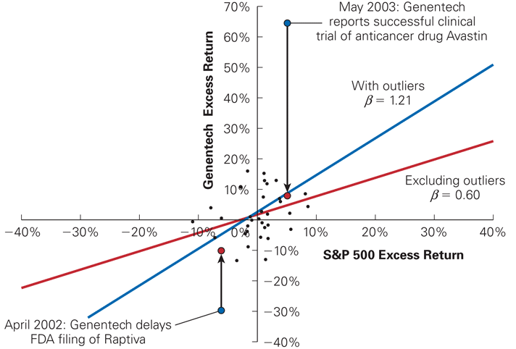
Figure 12A.2 Beta Estimation with and without Outliers for Genentech Using Monthly Returns for 2002–2004

Slide 79
Practical Considerations When Forecasting Beta (cont’d)
12A.5 Other Considerations
Changes in the environment of the firm may cause the future to differ from the past.
Many practitioners analyze additional information in addition to past returns.

Slide 80
Discussion of Data Case Key Topic
Plot the Disney and S&P 500 returns using an X-Y scatter plot in Excel. (Note: Y is Disney’s returns, and X is the S&P returns.)
Are there any outliers? If so, how can you adjust your beta calculation to reduce their impact?
Adjust Disney’s beta under the assumption that it will trend toward 1 over time.

