Slide 1
Chapter 5
Interest Rates

Slide 2
Chapter Outline
5.1 Interest Rate Quotes and Adjustments
5.2 Application: Discount Rates and Loans
5.3 The Determinants of Interest Rates
5.4 The Opportunity Cost of Capital

Slide 3
Learning Objectives
Understand the different ways interest rates are quoted
Use quoted rates to calculate loan payments and balances
Know how inflation, expectations, and risk combine to determine interest rates
See the link between interest rates in the market and a firm’s opportunity cost of capital

Slide 4
5.1 Interest Rate Quotes and Adjustments
To understand interest rates, it’s important to think of interest rates as a price—the price of using money. When you borrow money to buy a car, you are using the bank’s money now to get the car and paying the money back over time. The interest rate on your loan is the price you pay to be able to convert your future loan payments into a car today.

Slide 5
5.1 Interest Rate Quotes and Adjustments
The Effective Annual Rate
An EAR of 5%, a $100 investment grows to:
$100 × (1 + r) = $100 × (1.05) = $105
After two years it will grow to:
$100 × (1 + r)² = $100 × (1.05)² = $110.25

Slide 6
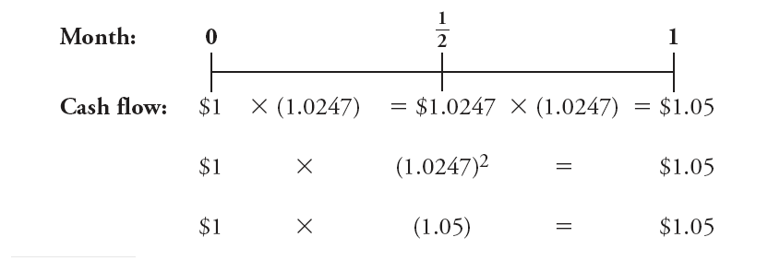
5.1 Interest Rate Quotes and Adjustments
Adjusting the Discount Rate to Different Time Periods
In general, by raising the interest rate factor (1 + r) to the appropriate power, we can compute an equivalent interest rate for a longer (or shorter) time period:
(1 + r)^{0.5} = (1.06)^{0.5} = $1.0296, so a monthly rate of 6%, is equivalent to a rate of 2.96% every half of a month.
$1 × (1.0296) = $1.0296, × (1.0296) = $1.06
$1 × (1.0296)² = $1.06
$1 × (1.06) = $1.06

Slide 7
Adjusting the Discount Rate to Different Time Periods
We can convert a discount rate of r for one period to an equivalent discount rate for n periods using the following formula:
Equivalent n-Period Discount Rate = (1 + r)^{n} – 1
(Eq. 5.1)

Slide 8
Example 5.1 Personal Finance Valuing Monthly Cash Flows
Problem:
Suppose your bank account pays interest monthly with an effective annual rate of 6%. What amount of interest will you earn each month?
If you have no money in the bank today, how much will you need to save at the end of each month to accumulate $100,000 in 10 years?

Slide 9
Example 5.1 Personal Finance Valuing Monthly Cash Flows
Solution
Plan:
We can use Eq. 5.1 to convert the EAR to a monthly rate, answering the first part of the question.
The second part of the question is a future value of annuity question. It is asking how big a monthly annuity we would have to deposit in order to end up with $100,000 in 10 years. However, in order to do this problem, we need to write the timeline in terms of monthly periods because our cash flows (deposits) will be monthly:

Slide 10
Example 5.1 Personal Finance Valuing Monthly Cash Flows
Plan (cont’d):
That is, we can view the savings plan as a monthly annuity with 10 × 12 = 120 monthly payments. We have the future value of the annuity ($100,000), the length of time (120 months), and we will have the monthly interest rate from the first part of the question. We can then use the future value of annuity formula (Eq. 4.6) to solve for the monthly deposit

Slide 11
Example 5.1 Personal Finance Valuing Monthly Cash Flows
Execute:
From Eq. 5.1, a 6% EAR is equivalent to earning (1.06)^{1/12} – 1 = 0.4868% per month. The exponent in this equation is 1/12 because the period is 1/12th of a year (a month).

Slide 12
Example 5.1 Personal Finance Valuing Monthly Cash Flows
Execute (cont’d):
To determine the amount to save each month to reach the goal of $100,000 in 120 months, we must determine the amount C of the monthly payment that will have a future value of $100,000 in 120 months, given an interest rate of 0.4868% per month. Now that we have all of the inputs in terms of months (monthly payment, monthly interest rate, and total number of months), we use the future value of annuity formula from Chapter 4 to solve this problem:

Slide 13
Example 5.1 Personal Finance Valuing Monthly Cash Flows
Execute (cont’d):
We solve for the payment C using the equivalent monthly interest rate r = 0.4868%, and n = 120 months:

Slide 14
Example 5.1 Personal Finance Valuing Monthly Cash Flows
Execute (cont’d):
We can also compute this result using a financial calculator:
Given: | 120 | 0.4868 | 0 |  | 100,000
Solve for: |  |  |  | -615.47
Excel Formula: =PMT(RATE,NPER,PV,FV)=PMT(.004868,120,0,100000)

Slide 15
Example 5.1 Personal Finance Valuing Monthly Cash Flows
Evaluate:
Thus, if we save $615.47 per month and we earn interest monthly at an effective annual rate of 6%, we will have $100,000 in 10 years. Notice that the timing in the annuity formula must be consistent for all of the inputs. In this case, we had a monthly deposit, so we needed to convert our interest rate to a monthly interest rate and then use total number of months (120) instead of years.

Slide 16
Annual Percentage Rates
The APR is a way of quoting the actual interest earned each compounding period:
(Eq. 5.2)

Slide 17
Converting an APR to an EAR
Once we have computed the interest earned per compounding period from Eq. (5.2), we can compute the equivalent interest rate for any other time interval using Eq. (5.1).
(Eq. 5.3)

Slide 18
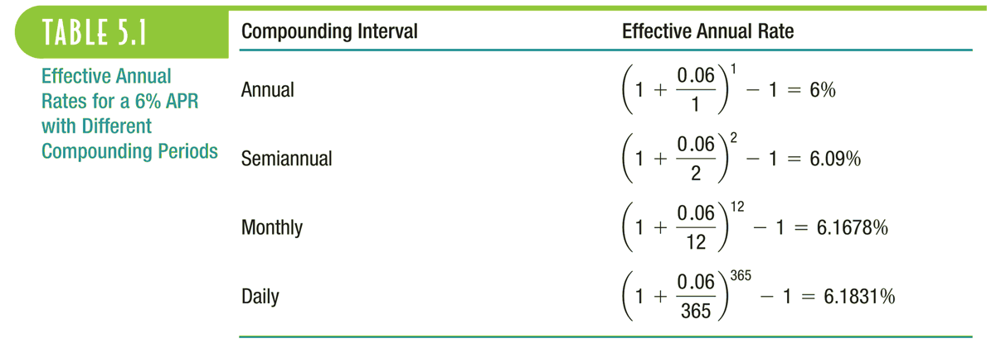
Table 5.1 Effective Annual Rates for a 6% APR with Different Compounding Periods

Slide 19
Example 5.2 Converting the APR to a Discount Rate
Problem:
Your firm is purchasing a new telephone system that will last for four years. You can purchase the system for an upfront cost of $150,000, or you can lease the system from the manufacturer for $4,000 paid at the end of each month. The lease price is offered for a 48-month lease with no early termination—you cannot end the lease early. Your firm can borrow at an interest rate of 6% APR with monthly compounding. Should you purchase the system outright or pay $4,000 per month?

Slide 20
Example 5.2 Converting the APR to a Discount Rate
Solution:
Plan:
The cost of leasing the system is a 48-month annuity of $4,000 per month:

Slide 21
Example 5.2 Converting the APR to a Discount Rate
Plan (cont’d):
We can compute the present value of the lease cash flows using the annuity formula, but first we need to compute the discount rate that corresponds to a period length of one month. To do so, we convert the borrowing cost of 6% APR with monthly compounding to a monthly discount rate using Eq. 5.2. Once we have a monthly rate, we can use the present value of annuity formula (Eq. 4.5) to compute the present value of the monthly payments and compare it to the cost of buying the system.

Slide 22
Example 5.2 Converting the APR to a Discount Rate
Execute:
As Eq. 5.2 shows, the 6% APR with monthly compounding really means 6%/12=0.5% every month. The 12 comes from the fact that there are 12 monthly compounding periods per year. Now that we have the true rate corresponding to the stated APR, we can use that discount rate in the annuity formula (Eq. 4.6) to compute the present value of the monthly payments:

Slide 23
Example 5.2 Converting the APR to a Discount Rate
Execute (cont’d):
Using a financial calculator or Excel:
Given: | 48 | 0.5 |  | -4,000 | 0
Solve for: |  |  | 170,321.27
Excel Formula: =PV(RATE,NPER, PMT, FV) = PV(0.005,48,-4000,0)

Slide 24
Example 5.2 Converting the APR to a Discount Rate
Evaluate:
Thus paying $4,000 per month for 48 months is equivalent to paying a present value of $170,321.27 today. This cost is $170,321.27 – $150,000 = $20,321.27 higher than the cost of purchasing the system, so it is better to pay $150,000 for the system rather than lease it. One way to interpret this result is as follows: At a 6% APR with monthly compounding, by promising to repay $4,000 per month your firm can borrow $170,321 today. With this loan it could purchase the phone system and have an additional $20,321 to use for other purposes.

Slide 25
Example 5.2a Computing a Loan APR
Problem:
What is the APR on a five year car loan of $24,500 with monthly payments of $500.

Slide 26
Example 5.2a Computing a Loan APR
Solution:
Plan:
The problem is asking us to find an interest rate. We can use the financial calculator to solve for the interest rate, using the following inputs: PV = $24,500, PMT = -$500 and N = 5 x 12 = 60. When we then solve for I/Y, our answer will be the monthly rate. So, we will need to multiply by 12 to get the annual rate.

Slide 27
Example 5.2a Computing a Loan APR
Execute:
The answer is the monthly rate, so we must multiply by 12 for the annual percentage rate: 12 X .6896 = 8.27%
Given: | 60 |  | 24,500.00 | -500.00 | 0
Solve for: |  | .6896

Slide 28
Example 5.2a Computing a Loan APR
Evaluate:
Thus, the effective interest rate we would pay on this loan annually is 8.27%.

Slide 29
5.2 Application: Discount Rates and Loans
We have explained how to compute the discount rate from an interest rate quote, let’s apply the concept to solve two common financial problems: calculating a loan payment and calculating the remaining balance on a loan.

Slide 30
5.2 Application: Discount Rates and Loans
Computing Loan Payments
Consider the timeline for a $30,000 car loan with these terms: 6.75% APR for 60 months

Slide 31
5.2 Application: Discount Rates and Loans
We can use Eq. 4.10 to find C (note that 0.0675/12 = 0.005625)
Alternatively, we can solve for the payment C using a financial calculator or a spreadsheet:
Given: | 60 | 0.5625 | 30000 |  | 0
Solve for: |  |  |  | -590.50
Excel Formula: =PMT(RATE,NPER, PV, FV) = PMT(0.005625,60,30000,0)

Slide 32
Figure 5.1 Amortizing Loan

Slide 33
Example 5.3 Personal Finance Computing the Outstanding Loan Balance
Problem:
Let’s say that you are now 3 years into a $30,000 car loan (at 6.75% APR, originally for 60 months) and you decide to sell the car. When you sell the car, you will need to pay whatever the remaining balance is on your car loan. After 36 months of payments, how much do you still owe on your car loan?

Slide 34
Example 5.3 Personal Finance Computing the Outstanding Loan Balance
Solution:
Plan:
We have already determined that the monthly payments on the loan are $590.50. The remaining balance on the loan is the present value of the remaining 2 years, or 24 months, of payments. Thus, we can just use the annuity formula with the monthly rate of 0.5625%, a monthly payment of $590.50, and 24 months remaining.

Slide 35
Example 5.3 Personal Finance Computing the Outstanding Loan Balance
Execute:
Thus, after 3 years, you owe $13,222.32 on the loan

Slide 36
Example 5.3 Personal Finance Computing the Outstanding Loan Balance
Execute:
Using a financial calculator or Excel:
Given: | 24 | 0.5625 |  | -590.50 | 0
Solve for: |  |  | 13,222.32
Excel Formula: =PV(RATE,NPER, PMT, FV) = PV(0.005625,24,‑590.50,0)

Slide 37
Example 5.3 Personal Finance Computing the Outstanding Loan Balance
Execute:
You could also compute this as the FV of the original loan amount after deducting payments:
Given: | 36 | 0.5625 | 30,000 | -590.50
Solve for: |  |  |  |  | 13,222.41
Excel Formula: =FV(RATE,NPER, PMT, PV) = FV(0.005625,36,‑590.50,30000)

Slide 38
Example 5.3 Personal Finance Computing the Outstanding Loan Balance
Evaluate:
Any time that you want to end the loan, the bank will charge you a lump sum equal to the present value of what it would receive if you continued making your payments as planned. As the second approach shows, the amount you owe can also be thought of as the future value of the original amount borrowed after deducting payments made along the way.

Slide 39
5.3 The Determinants of Interest Rates
Factors that may influence interest rates:
Inflation
Current economic activity
Expectations of future growth

Slide 40
5.3 The Determinants of Interest Rates
Inflation and Real Versus Nominal Rates
Inflation: measures how the purchasing power of a given amount of currency declines due to growing prices
Nominal interest rates: indicates the rate at which your money will grow if invested for a certain period
Real interest rate: the rate of growth of your purchasing power, after adjusting for inflation
Copyright © 2009 Pearson Prentice Hall. All rights reserved.

Slide 41
The Rate of Growth of Purchasing Power
We can calculate the rate of growth of purchasing power as follows:
(Eq. 5.4)

Slide 42
The Real Interest Rate
(Eq. 5.5)

Slide 43
Example 5.4 Calculating the Real Interest Rate
Problem:
In the year 2000, short-term U.S. government bond rates were about 5.8% and the rate of inflation was about 3.4%. In 2003, interest rates were about 1% and inflation was about 1.9%. What was the real interest rate in 2000 and 2003?
Copyright © 2009 Pearson Prentice Hall. All rights reserved.

Slide 44
Example 5.4 Calculating the Real Interest Rate
Solution:
Plan:
The bond rates tell us the nominal rates. Given the nominal rates and inflation for each year, we can use Eq. 5.5 to calculate the real interest rate.
Copyright © 2009 Pearson Prentice Hall. All rights reserved.

Slide 45
Example 5.4 Calculating the Real Interest Rate
Execute:
Thus, the real interest rate in 2000 was:
In 2003, the real interest rate was:

Slide 46
Example 5.4 Calculating the Real Interest Rate
Evaluate:
Note that the real interest rate was negative in 2003, indicating that interest rates were insufficient to keep up with inflation. As a result, investors in U.S. government bonds were able to buy less at the end of the year than they could have purchased at the start of the year.

Slide 47
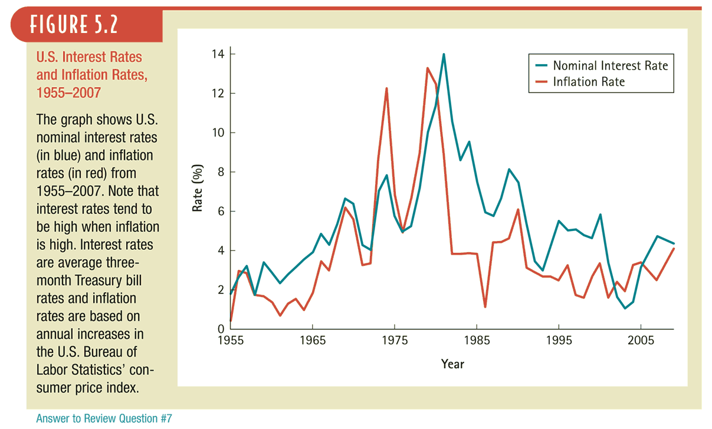
Figure 5.2 U.S. Interest Rates and Inflation Rates, 1955–2007

Slide 48
5.3 The Determinants of Interest Rates
Investment and Interest Rate Policy
When the costs of an investment precede the benefits, an increase in the interest rate will decrease the investment’s NPV. All else equal, higher interest rates will therefore tend to shrink the set of positive-NPV investments available to firms.

Slide 49
5.3 The Determinants of Interest Rates
The Yield Curve and Discount Rates
The relationship between the investment term and the interest rate is called the term structure of interest rates
We can plot this relationship on a graph called the yield curve

Slide 50
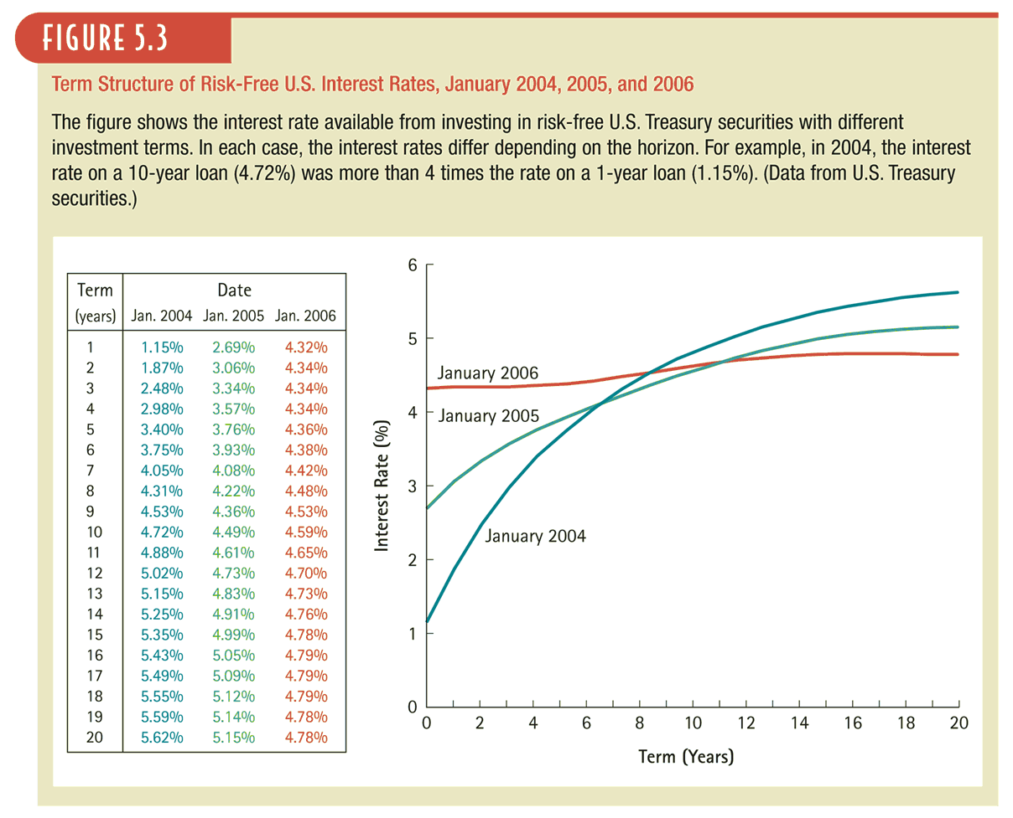
Figure 5.3 Term Structure of Risk-Free U.S. Interest Rates, January 2004, 2005, and 2006

Slide 51
Computing the Present Value of Cash Flows with Different Maturities
A risk-free cash flow of C_{n} received in n years has present value
(Eq. 5.6)
where r_{n} is the risk-free interest rate for an n-year term

Slide 52
Present Value of a Cash Flow Stream Using a Term Structure of Discount Rates
Combining Eq. (5.6) for cash flows in different years leads to the general formula for the present value of a cash flow stream:
(Eq. 5.7)

Slide 53
Example 5.5 Using the Term Structure to Compute Present Values
Problem:
Compute the present value of a risk-free five-year annuity of $1,000 per year, given the yield curve for January 2005 in Figure 5.3.
Copyright © 2009 Pearson Prentice Hall. All rights reserved.

Slide 54
Example 5.5 Using the Term Structure to Compute Present Values
Solution:
Plan:
The timeline of the cash flows of the annuity is:
0
1
2
3
4
5
$1000
$1000
$1000
$1000
$1000
We can use the table next to the yield curve to identify the interest rate corresponding to each length of time: 1, 2, 3, 4 and 5 years. With the cash flows and those interest rates, we can compute the PV

Slide 55
Example 5.5 Using the Term Structure to Compute Present Values
Execute:
From Figure 5.3, we see that the interest rates are: 2.69%, 3.06%, 3.34%, 3.57% and 3.76%, for terms of 1, 2, 3, 4 and 5 years, respectively.
To compute the present value, we discount each cash flow by the corresponding interest rate:

Slide 56
Example 5.5 Using the Term Structure to Compute Present Values
Evaluate:
The yield curve tells us the market interest rate per year for each different maturity. In order to correctly calculate the PV of cash flows from five different maturities, we need to use the five different interest rates corresponding to those maturities. Note that we cannot use the annuity formula here because the discount rates differ for each cash flow.

Slide 57
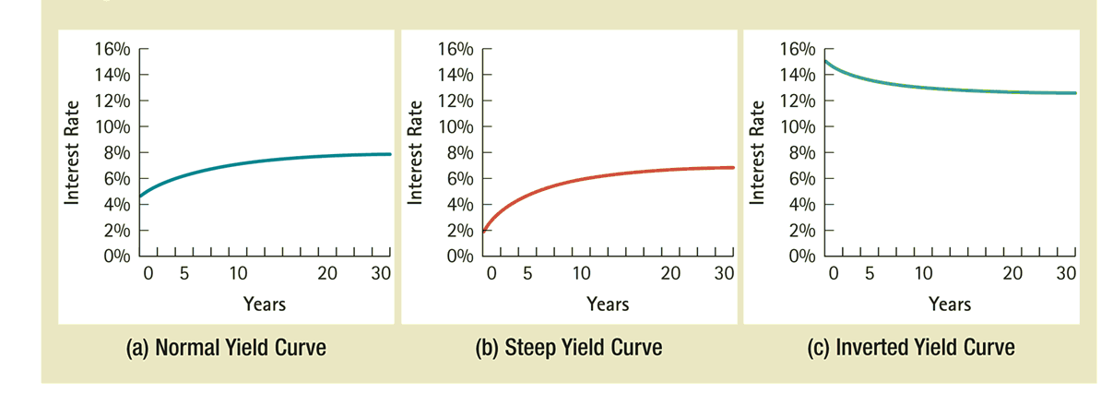
Figure 5.4 Yield Curve Shapes

Slide 58
5.3 The Determinants of Interest Rates
Interest Rate Determination
The Federal Reserve determines very short-term interest rates through its influence on the federal funds rate, which is the rate at which banks can borrow cash reserves on an overnight basis
If interest rates are expected to rise in the future, investors would not want to make long-term investments
If interest rates are expected to rise, long-term interest rates will tend to be higher than short-term rates to attract investors
If interest rates are expected to fall, long-term rates will tend to be lower than short-term rates to attract borrowers.

Slide 59
Figure 5.5 Short-Term versus Long-Term U.S. Interest Rates and Recessions

Slide 60
Example 5.6 Long-Term versus Short-Term Loans
Problem:
You work for a bank that has just made two loans. In one, you loaned $909.09 today in return for $1,000 in one year. In the other, you loaned $909.09 today in return for $15,863.08 in 30 years. The difference between the loan amount and repayment amount is based on an interest rate of 10% per year. Imagine that immediately after you make the loans, news about economic growth is announced that increases inflation expectations so that the market interest rate for loans like these jumps to 11%. Loans make up a major part of a bank’s assets, so you are naturally concerned about the value of these loans. What is the effect of the interest rate change on the value to the bank of the promised repayment of these loans?

Slide 61
Example 5.6 Long-Term versus Short-Term Loans
Solution:
Plan:
Each of these loans has only one repayment cash flow at the end of the loan. They differ only by the time to repayment:
The effect on the value of the future repayment to the bank today is just the PV of the loan repayment, calculated at the new market interest rate.

Slide 62
Example 5.6 Long-Term versus Short-Term Loans
Execute:
For the one-year loan:
For the 30-year loan:

Slide 63
Example 5.6 Long-Term versus Short-Term Loans
Evaluate:
The value of the one-year loan decreased by $909.09 - $900.90 = $8.19, or 0.9%, but the value of the 30-year loan decreased by $909.09 - $692.94 = $216.15, or almost 24%! The small change in market interest rates, compounded over a longer period, resulted in a much larger change in the present value of the loan repayment. You can see why investors and banks view longer-term loans as being riskier than short-term loans!
Copyright © 2009 Pearson Prentice Hall. All rights reserved.

Slide 64
5.4 The Opportunity Cost of Capital
We will base the discount rate that we use to evaluate cash flows on the investor’s opportunity cost of capital (or more simply, the cost of capital), which is the best available expected return offered in the market on an investment of comparable risk and term to the cash flow being discounted.
Copyright © 2009 Pearson Prentice Hall. All rights reserved.

Slide 65
Example 5.7 The Opportunity Cost of Capital
Problem:
Suppose a friend offers to borrow $100 from you today and in return pay you $110 one year from today. Looking in the market for other options for investing your money, you find your best alternative option for investing the $100 that view as equally risky as lending it to your friend. That option has an expected return of 8%. What should you do?
Copyright © 2009 Pearson Prentice Hall. All rights reserved.

Slide 66
Example 5.7 The Opportunity Cost of Capital
Solution:
Plan:
Your decision depends on what the opportunity cost is of lending your money to your friend. If you lend her the $100, then you cannot invest it in the alternative with an 8% expected return. Thus, by making the loan, you are giving-up the opportunity to invest for an 8% expected return. Thus, you can make your decision by using your 8% opportunity cost of capital to value the $110 in one year.
Copyright © 2009 Pearson Prentice Hall. All rights reserved.

Slide 67
Example 5.7 The Opportunity Cost of Capital
Execute:
The value of the $110 in one year is its present value, discounted at 8%:
The $100 loan is worth $101.85 to you today, so you should make the loan.

Slide 68
Example 5.7 The Opportunity Cost of Capital
Evaluate:
The Valuation Principle tells us that we can determine the value of an investment by using market prices to value the benefits net of the costs. As this example shows, market prices determine what our best alternative opportunities are, so that we can decide whether an investment is worth the cost.
Copyright © 2009 Pearson Prentice Hall. All rights reserved.

Slide 69
Chapter Quiz
What is the difference between an EAR and an APR quote?
Why does the part of your loan payment covering interest change over time?
What is the difference between a nominal and real interest rate?
What is the opportunity cost of capital?

