Slide 1
Portfolio Performance Evaluation
18
Bodie, Kane, and Marcus
Essentials of Investments Tenth Edition

Slide 2
18.1 Investment Clients, Service Providers, Objectives of Performance Evaluation
Passive Management
Diversified portfolio with no security mispricing identification
Active Management
Forecasting broad markets and/or identifying mispriced securities to achieve higher returns
Market Timing
Relative performance drives fund movement between risky portfolio and cash

Slide 3
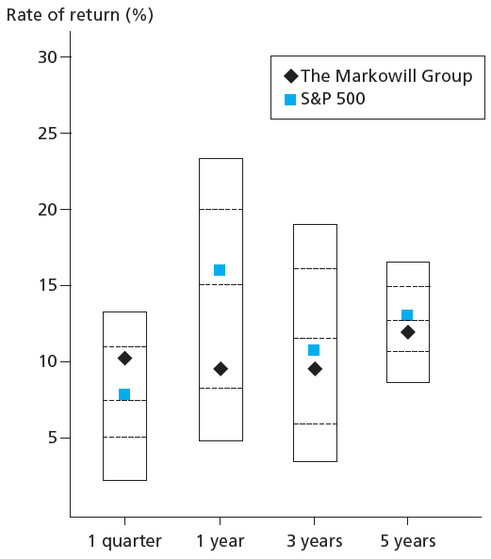
18.1 Investment Clients, Service Providers, Objectives of Performance Evaluation
Comparison Universe:
Set of portfolio managers with similar investment styles used to assess relative performance

Slide 4
18.1 Investment Clients, Service Providers, Objectives of Performance Evaluation
Risk-Adjusted Performance
To measure abnormal performance, must measure normal performance
Single index model can be used
$R_{Pt}=β_{P}R_{Mt}+α_{P}+e_{pt}$
From this the expected return E(R_{P}) can be found
${E(R}_{P})=β_{P}E(R_{Mt})+α_{P}$

Slide 5
18.1 Investment Clients, Service Providers, Objectives of Performance Evaluation
Risk-Adjusted Performance
Variance of market-driven return component
$Var\left(β_{P}R_{Mt}\right)=β_{P}^{2}σ_{M}^{2}$
Variance of return on P
$σ_{P}^{2}=β_{P}^{2}σ_{M}^{2}$ + $σ_{e}^{2}$

Slide 6
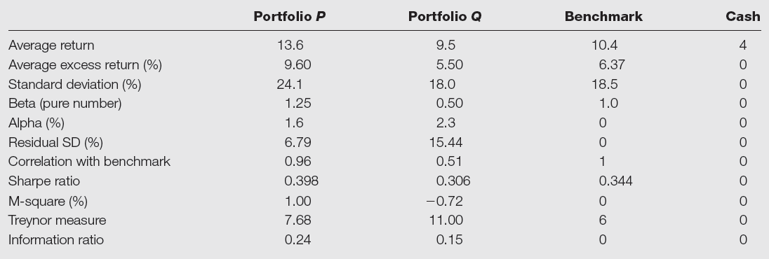
Table 18.1 Performance of Two Managed Portfolios

Slide 7
18.1 Investment Clients, Service Providers, Objectives of Performance Evaluation
Sharpe Ratio
Reward-to-volatility ratio, excess return to standard deviation
$S=\frac{\overline{R}}{σ}$
Used when choosing among competing portfolios that will not be mixed

Slide 8
18.1 Investment Clients, Service Providers, Objectives of Performance Evaluation
M² Measure:
Return difference between managed portfolio leveraged to match volatility of passive index and return on that index

Slide 9
18.1 M² Measure: Example
From Figure 18.1
Suppose that instead of investing all its funds in P, the endowment had invested only 76.76% (σ_{M}/σ_{P}=18.5/24.1) of its funds, with the remainder placed in risk-free assets.

Slide 10
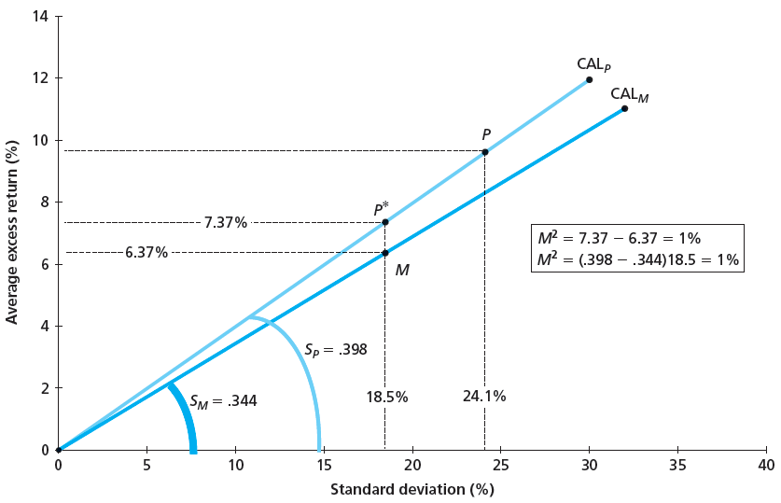
Figure 18.2 M² of Portfolio

Slide 11
18.1 Investment Clients, Service Providers, Objectives of Performance Evaluation
Treynor Measure
Ratio of portfolio excess return to beta
$T=\frac{\overline{R}}{β}$
Used to evaluate portfolio that is part of larger portfolio with different managers
Figure 18.1 Example:

Slide 12
18.1 Investment Clients, Service Providers, Objectives of Performance Evaluation
Information Ratio
Ratio of alpha to standard deviation of diversifiable risk
The Sharpe Ratio of the Optimized Portfolio is then:

Slide 13
18.1 Information Ratio: Example

Slide 14
18.1 Investment Clients, Service Providers, Objectives of Performance Evaluation
Jensen Measure
Alpha of an investment
$α_{P}={\overline{R}}_{P}−β_{P}{\overline{R}}_{M}$
$α_{P}=$ Portfolio alpha
${\overline{R}}_{P}$ = Average excess return on the portfolio
$β_{P}$ = Portfolio beta
${\overline{R}}_{M}$ = Average excess return on the market
Measure of abnormal return
Must establish statistical significance via regression

Slide 15
18.1 Investment Clients, Service Providers, Objectives of Performance Evaluation
Alpha Capture and Transport
Alpha transport
Establishing alpha while using index products to both hedge market exposure and establish exposure to desired sectors
Alpha capture
Construction of positive-alpha portfolio with systematic risk hedged away

Slide 16
Table 18.2 Alpha Capture/Transfer, Healthcare Sector
*If P ’s alpha is negative, then reverse the sign of w_{P} and adjust the signs of w_{M} and w_{F}.

Slide 17
18.1 Investment Clients, Service Providers, Objectives of Performance Evaluation
Evaluation with Multi-Index Model
Use multi-index model such as Fama-French to establish expected return
$R_{Pt}=β_{P}R_{Mt}+{{β_{SMB}r_{SMBt}+β_{HML}r_{HMLt}+α}_{P}+e}_{pt}$
$R_{Pt}=β_{P}{\overline{R}}_{Mt}+{β_{SMB}{\overline{r}}_{SMBt}+β_{HML}{\overline{r}}_{HMLt}+α}_{P}$
This allows estimation of alpha

Slide 18
18.2 Style Analysis
Introduced by William Sharpe
1992 study of mutual fund performance shows 91.5% of variation in return could be explained by the funds’ asset allocations to bills, bonds and stocks
Later studies show that > 90% of the variation in return could be explained by the funds’ allocation to a broader range of asset classes

Slide 19
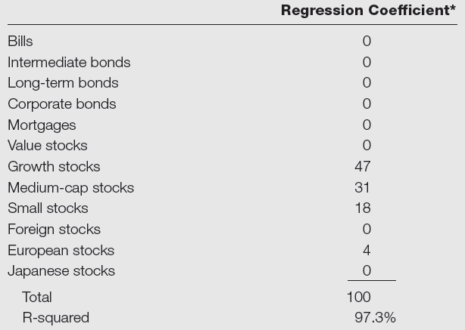
Table 18.3 Sharpe’s Style Portfolios for Magellan Fund
*Regressions are constrained to have nonnegative coefficients and to have coefficients that sum to 100%.

Slide 20
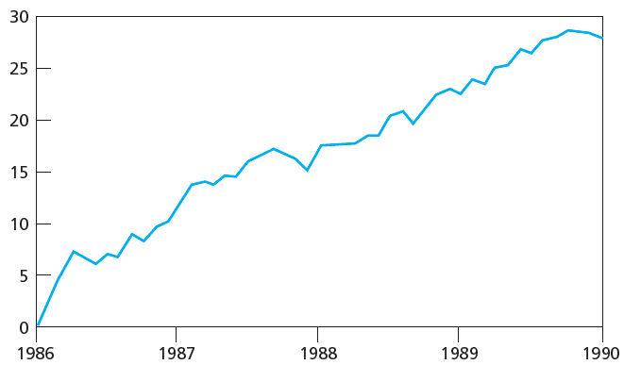
Figure 18.3 Fidelity Magellan Fund Cumulative Return Difference versus Style Benchmark

Slide 21
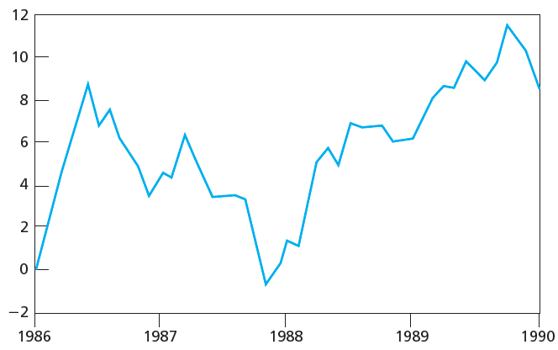
Figure 18.4 Fidelity Magellan Fund Cumulative Return Difference versus S&P 500

Slide 22
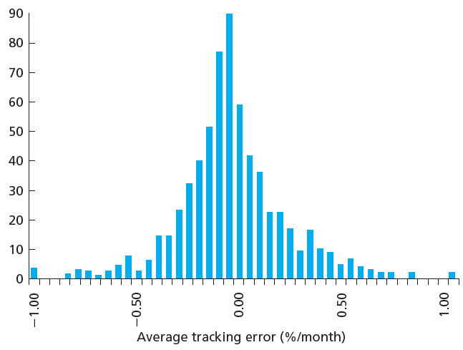
Figure 18.5 Average Tracking Error, 636 Mutual Funds, 85-89

Slide 23
18.3 Morningstar’s Risk-Adjusted Rating
Company peer groups established based on Morningstar style definitions
Risk-adjusted performance ranked; then stars assigned according to table
Percentile | Stars
0-10 | 1
10-32.5 | 2
32.5-67.5 | 3
67.5-90 | 4
90-100 | 5

Slide 24
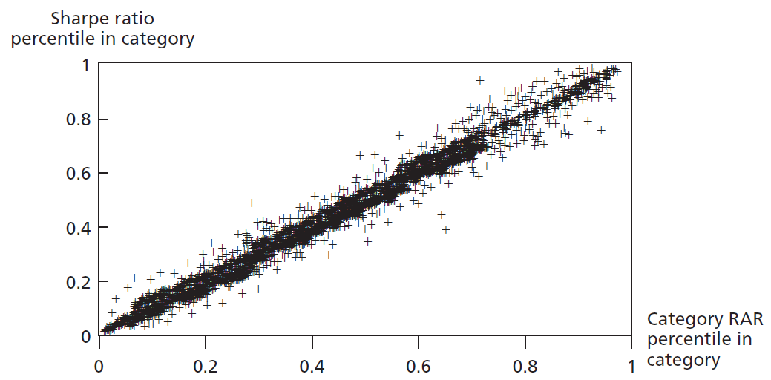
Figure 18.6 Rankings Based on Morningstar’s Category RARs and Excess Return Sharpe Ratios

Slide 25
18.4 Risk Adjustments with Changing Portfolio Composition
Problems with Performance Measures
Assume fund maintains constant level of risk
Particularly problematic for funds engaging in active asset allocation
In large universe of funds, some will have abnormal performance each period by chance
Survivorship bias
Upward bias in average fund performance due to failure to account for failed funds over sample period

Slide 26
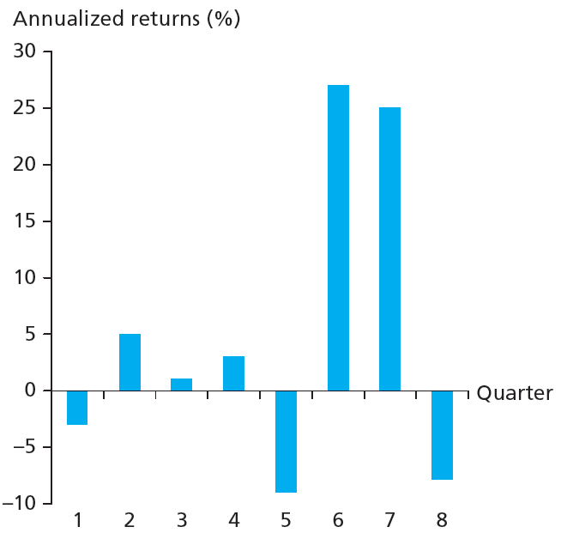
Figure 18.7 Portfolio Returns

Slide 27
18.5 Performance Attribution Procedures
Decomposing overall performance into components
Determined by specific portfolio choices
Broad asset allocation among types of securities
Industry weighting in equity portfolio
Security choice
Timing

Slide 28
Table 18.4 Performance of Managed Portfolio
Bogey
Benchmark portfolio comprised of three indexes with given weights
Bogey return represents return on unmanaged portfolio
Weights represent standard portfolio for typical risk tolerance of given type of client or typical fund in category

Slide 29
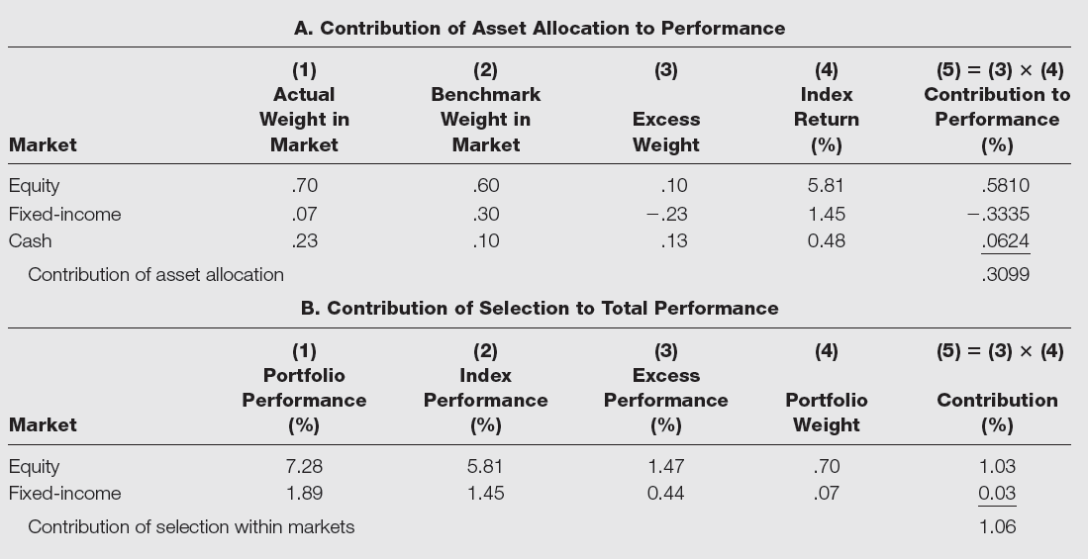
Table 18.5 Performance Attribution

Slide 30
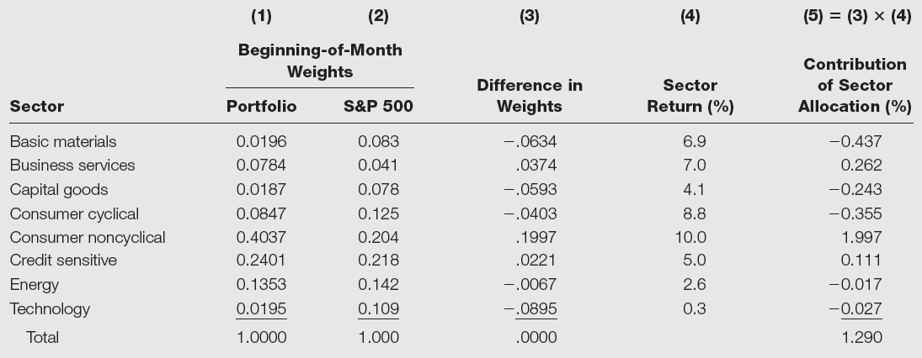
Table 18.6 Sector Allocation within Equity Market

Slide 31
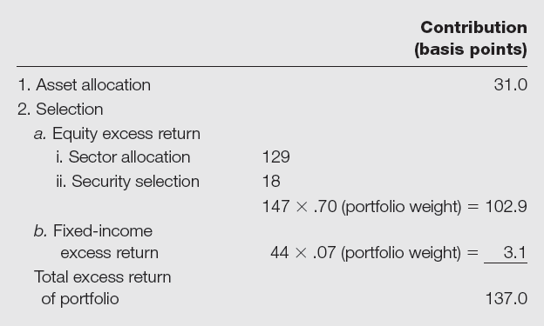
Table 18.7 Portfolio Attribution: Summary

Slide 32
18.6 Market Timing
Adjust asset allocation for changes in market
Shift between stocks and money market instruments or bonds
Option-like if one has perfect ability to forecast
Little evidence of persistent market-timing ability
With Imperfect Ability to Forecast
Takes long time horizon to judge ability
Judge proportions of correct calls: Bull vs. Bear

Slide 33
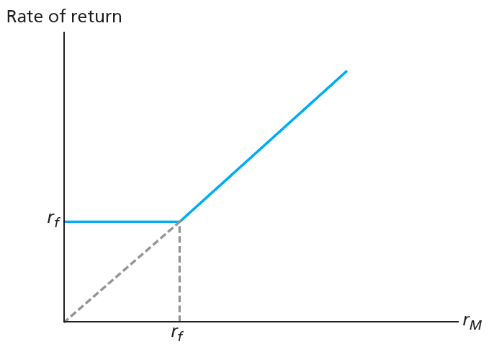
Figure 18.8 Rate of Return: Perfect Market Timer

Slide 34
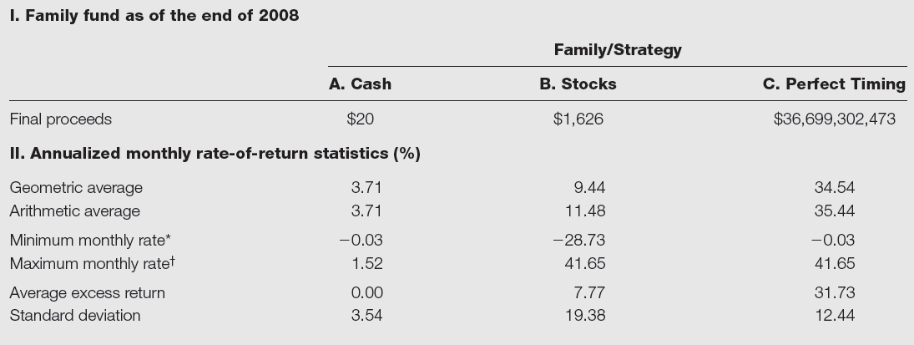
Table 18.8 Performance of Cash, Stocks, and Perfect Timing Strategies

Slide 35
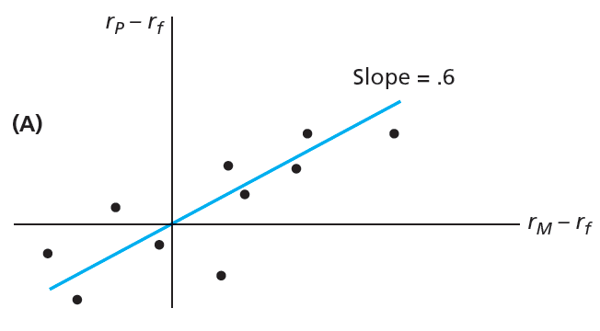
Figure 18.9A Characteristic Lines

Slide 36
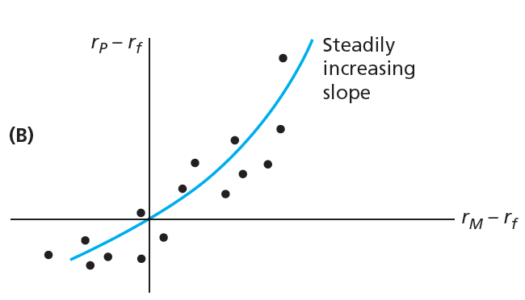
Figure 18.9B Characteristic Lines

