Slide 1
Chapter 10
Capital Markets and the Pricing of Risk

Slide 2
Chapter Outline
10.1 Risk and Return: Insights from 89 Years of Investor History
10.2 Common Measures of Risk and Return
10.3 Historical Returns of Stocks and Bonds
10.4 The Historical Trade-Off Between Risk and Return
10.5 Common Versus Independent Risk
10.6 Diversification in Stock Portfolios
10.7 Measuring Systematic Risk
10.8 Beta and the Cost of Capital

Slide 3
Learning Objectives
Define a probability distribution, the mean, the variance, the standard deviation, and the volatility.
Compute the realized or total return for an investment.
Using the empirical distribution of realized returns, estimate expected return, variance, and standard deviation (or volatility) of returns.

Slide 4
Learning Objectives
Use the standard error of the estimate to gauge the amount of estimation error in the average.
Discuss the volatility and return characteristics of large stocks versus large stocks and bonds.
Describe the relationship between volatility and return of individual stocks.

Slide 5
Learning Objectives
Define and contrast idiosyncratic and systematic risk and the risk premium required for taking each on.
Define an efficient portfolio and a market portfolio.
Discuss how beta can be used to measure the systematic risk of a security.

Slide 6
Learning Objectives
Use the Capital Asset Pricing Model to calculate the expected return for a risky security.
Use the Capital Asset Pricing Model to calculate the cost of capital for a particular project.
Explain why in an efficient capital market the cost of capital depends on systematic risk rather than diversifiable risk.

Slide 7
10.1 Risk and Return: Insights from 89 Years of Investor History
How would $100 have grown if it were placed in one of the following investments?
Standard & Poor’s 500: 90 U.S. stocks up to 1957 and 500 after that. Leaders in their industries and among the largest firms traded on U.S. Markets.
Small stocks: Securities traded on the NYSE with market capitalizations in the bottom 20%.

Slide 8
10.1 Risk and Return: Insights from 89 Years of Investor History (cont’d)
How would $100 have grown if it were placed in one of the following investments?
World Portfolio: International stocks from all the world’s major stock markets in North America, Europe, and Asia.
Corporate Bonds: Long-term, AAA-rated U.S. corporate bonds with maturities of approximately 20 years.
Treasury Bills: An investment in three-month Treasury bills.

Slide 9
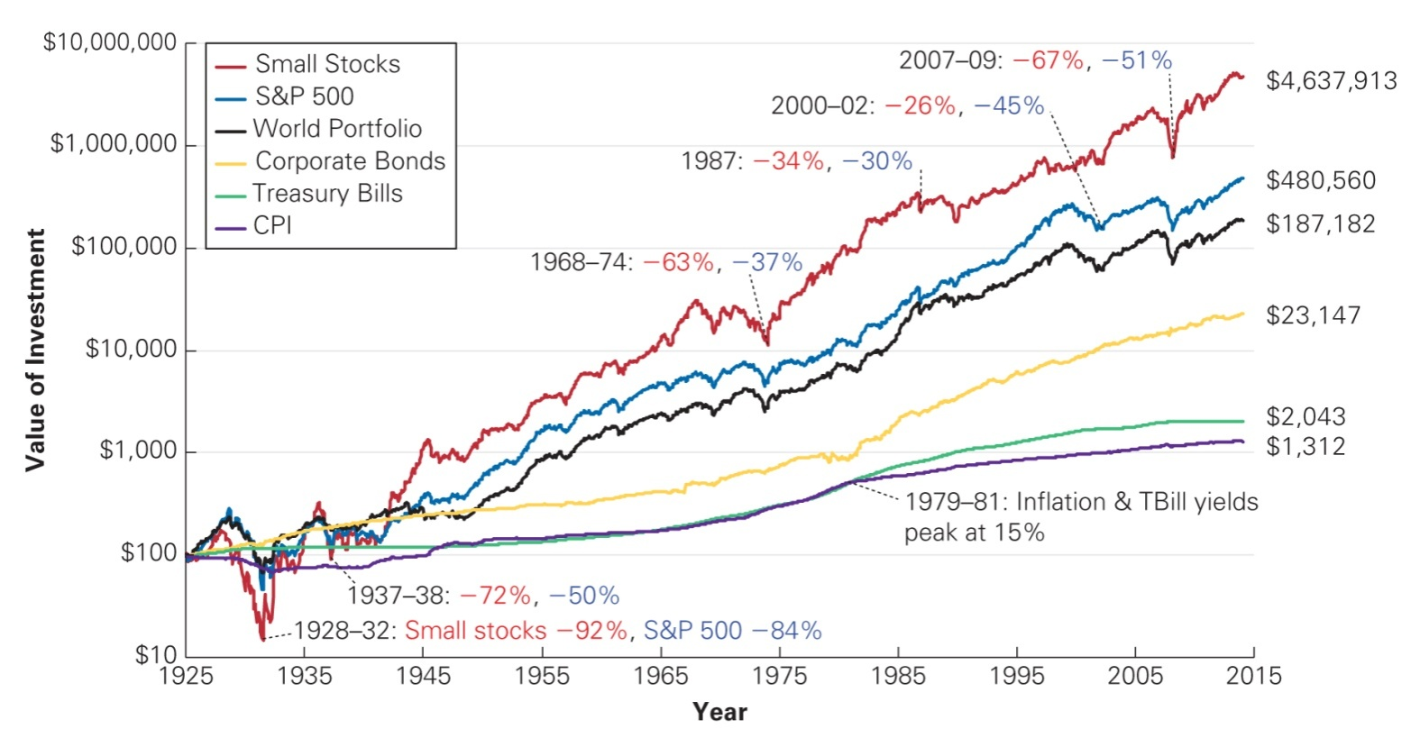
Figure 10.1 Value of $100 Invested at the End of 1925
Source: Chicago Center for Research in Security Prices, Standard and Poor’s, MSCI, and Global Financial Data.

Slide 10
10.1 Risk and Return: Insights from 89 Years of Investor History (cont’d)
Small stocks had the highest long-term returns, while T-Bills had the lowest long-term returns.
Small stocks had the largest fluctuations in price, while T-Bills had the lowest.
Higher risk requires a higher return.

Slide 11
10.1 Risk and Return: Insights from 89 Years of Investor History (cont’d)
Few people ever make an investment for 89 years.
More realistic investment horizons and different initial investment dates can greatly influence each investment's risk and return.

Slide 12
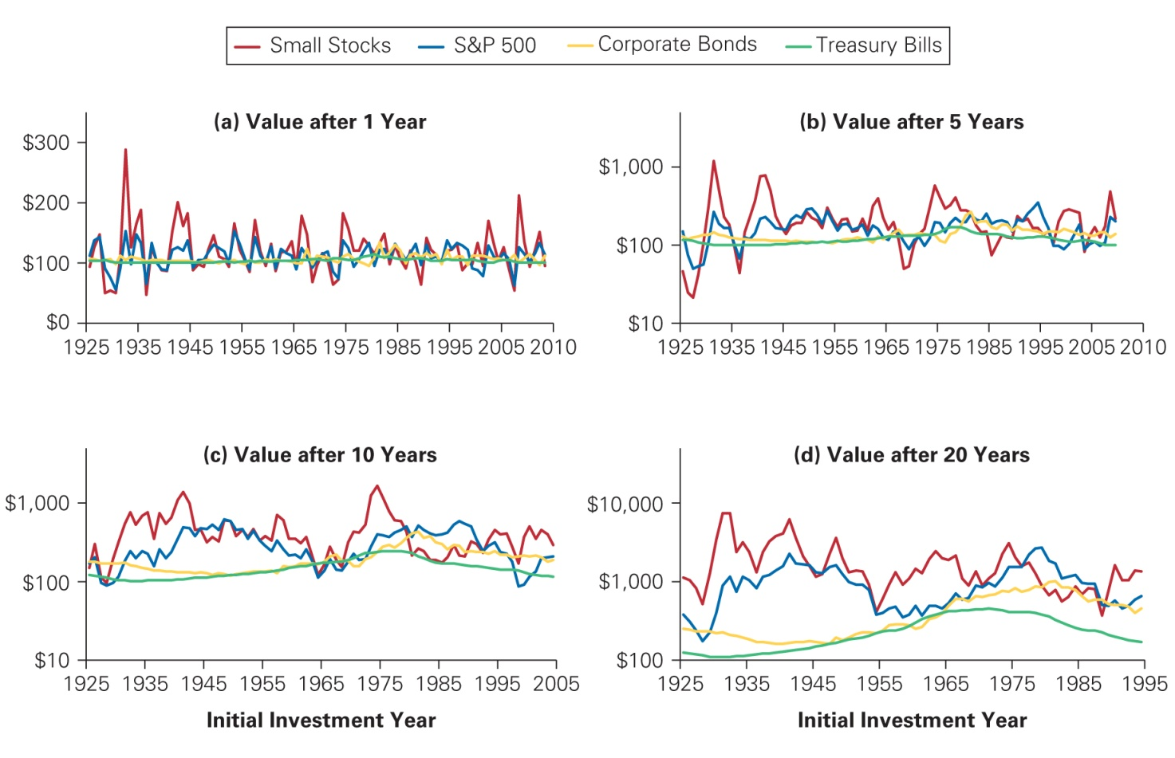
Figure 10.2 Value of $100 Invested in Alternative Investment for Differing Horizons
Source: Chicago Center for Research in Security Prices, Standard and Poor’s, MSCI, and Global Financial Data.

Slide 13
10.2 Common Measures of Risk and Return
Probability Distributions
When an investment is risky, it may earn different returns. Each possible return has some likelihood of occurring. This information is summarized with a probability distribution, which assigns a probability, P_{R} , that each possible return, R , will occur.
Assume BFI stock currently trades for $100 per share. In one year, there is a 25% chance the share price will be $140, a 50% chance it will be $110, and a 25% chance it will be $80.

Slide 14
Table 10.1 Probability Distribution of Returns for BFI

Slide 15
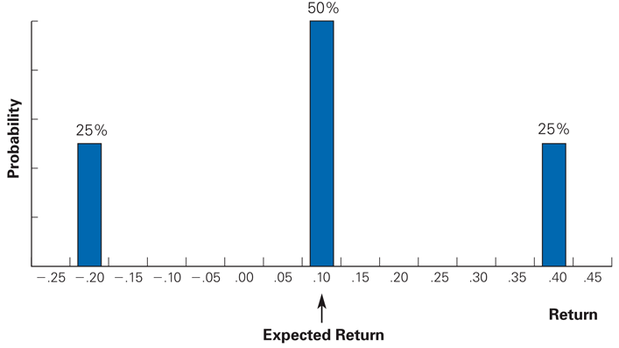
Figure 10.3 Probability Distribution of Returns for BFI

Slide 16
Expected Return
Expected (Mean) Return
Calculated as a weighted average of the possible returns, where the weights correspond to the probabilities.

Slide 17
Variance and Standard Deviation
Variance
The expected squared deviation from the mean
Standard Deviation
The square root of the variance
Both are measures of the risk of a probability distribution

Slide 18
Variance and Standard Deviation (cont'd)
For BFI, the variance and standard deviation are
In finance, the standard deviation of a return is also referred to as its volatility. The standard deviation is easier to interpret because it is in the same units as the returns themselves.

Slide 19
Textbook Example 10.1

Slide 20
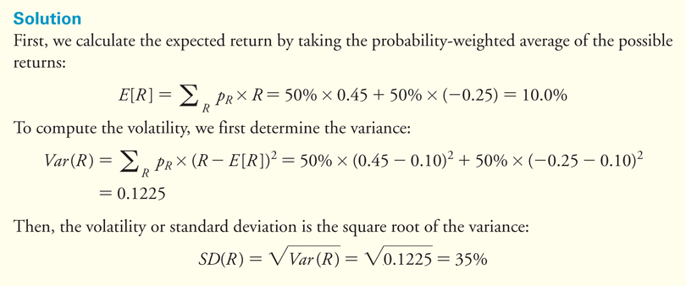
Textbook Example 10.1 (cont'd)

Slide 21
Alternative Example 10.1
Problem
TXU stock is has the following probability distribution:
What are its expected return and standard deviation?
Probability | Return
.25 | 8%
.55 | 10%
.20 | 12%

Slide 22
Alternative Example 10.1 (cont’d)
Solution
Expected Return
E[R] = (0.25)(0.08) + (0.55)(0.10) + (0.20)(0.12)
E[R] = 0.020 + 0.055 + 0.024 = 0.099 = 9.9%
Standard Deviation
SD(R) = [(0.25)(0.08 – 0.099)² + (0.55)(0.10 – 0.099)² + (0.20)(0.12 – 0.099)²]^{1/2}
SD(R) = [0.00009025 + 0.00000055 + 0.0000882]^{1/2}
SD(R) = 0.000179^{1/2} = 0.01338 = 1.338%

Slide 23
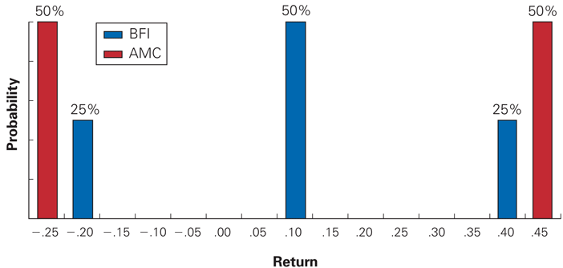
Figure 10.4 Probability Distributions for BFI and AMC Returns

Slide 24
10.3 Historical Returns of Stocks and Bonds
Computing Historical Returns
Realized Return
The return that actually occurs over a particular time period.

Slide 25
10.3 Historical Returns of Stocks and Bonds (cont'd)
Computing Historical Returns
If you hold the stock beyond the date of the first dividend, then to compute your return you must specify how you invest any dividends you receive in the interim. Let’s assume that all dividends are immediately reinvested and used to purchase additional shares of the same stock or security.

Slide 26
10.3 Historical Returns of Stocks and Bonds (cont'd)
Computing Historical Returns
If a stock pays dividends at the end of each quarter, with realized returns R_{Q1}, . . . ,R_{Q4} each quarter, then its annual realized return, R_{annual}, is computed as follows:

Slide 27
Textbook Example 10.2

Slide 28
Textbook Example 10.2 (cont'd)

Slide 29
Alternative Example 10.2
Problem
What were the realized annual returns for NRG stock in 2012 and in 2016?

Slide 30
Alternative Example 10.2 (cont’d)
Solution
First, we look up stock price data for NRG at the start and end of the year, as well as dividend dates. From these data, we construct the following table:
Date | Price ($) | Dividend ($) | Return | Date | Price ($) | Dividend ($) | Return
12/31/2011 | 58.69 |  |  | 12/31/2015 | 6.73 | 0
1/31/2012 | 61.44 | 0.26 | 5.13% | 3/31/2016 | 5.72 | 0 | -15.01%
4/30/2012 | 63.94 | 0.26 | 4.49% | 6/30/2016 | 4.81 | 0 | -15.91%
7/31/2012 | 48.5 | 0.26 | -23.74% | 9/30/2016 | 5.2 | 0 | 8.11%
10/31/2012 | 54.88 | 0.29 | 13.75% | 12/31/2016 | 2.29 | 0 | -55.96%
12/31/2012 | 53.31 |  | -2.86%

Slide 31
Alternative Example 10.2 (cont’d)
Solution
We compute each period’s return using Equation 10.4. For example, the return from December 31, 2011, to January 31, 2012, is
We then determine annual returns using Eq. 10.5:

Slide 32
Alternative Example 10.2 (cont’d)
Solution
Note that, since NRG did not pay dividends during 2016, the return can also be computed as follows:

Slide 33
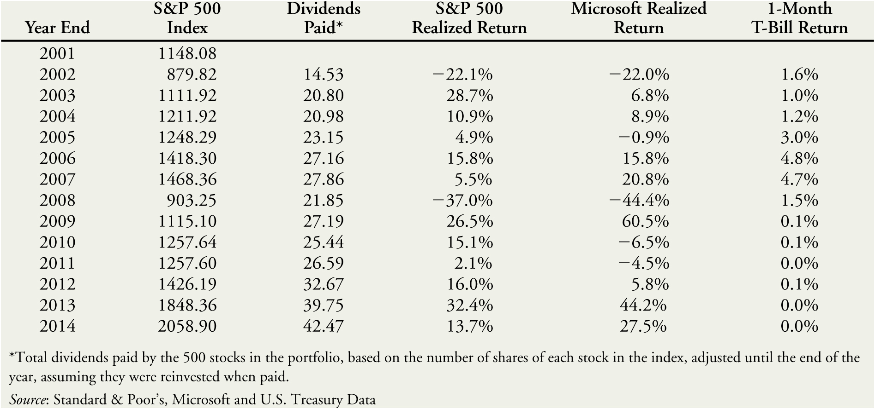
Table 10.2 Realized Return for the S&P 500, Microsoft, and Treasury Bills, 2002–2014

Slide 34
10.3 Historical Returns of Stocks and Bonds (cont'd)
Computing Historical Returns
By counting the number of times a realized return falls within a particular range, we can estimate the underlying probability distribution.
Empirical Distribution
When the probability distribution is plotted using historical data

Slide 35
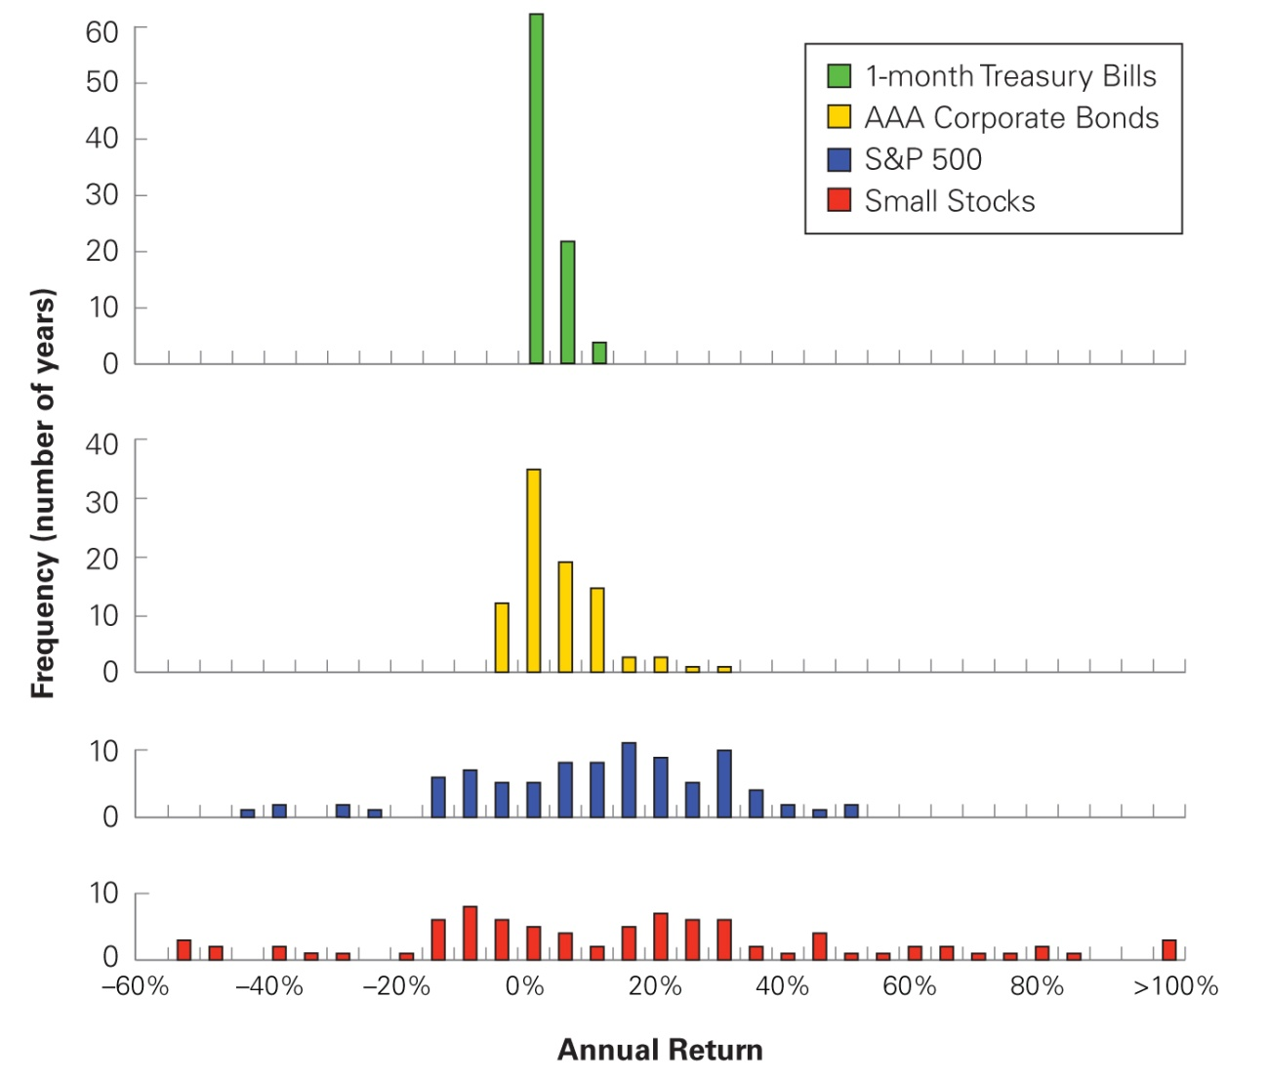
Figure 10.5 The Empirical Distribution of Annual Returns for U.S. Large Stocks (S&P 500), Small Stocks, Corporate Bonds, and Treasury Bills, 1926–2014

Slide 36
Table 10.3 Average Annual Returns for U.S. Small Stocks, Large Stocks (S&P 500), Corporate Bonds, and Treasury Bills, 1926–2014

Slide 37
Average Annual Return
Where R_{t} is the realized return of a security in year t, for the years 1 through T
Using the data from Table 10.2, the average annual return for the S&P 500 from 2002-2014 is as follows:

Slide 38
The Variance and Volatility of Returns
Variance Estimate Using Realized Returns
The estimate of the standard deviation is the square root of the variance.

Slide 39
Textbook Example 10.3

Slide 40
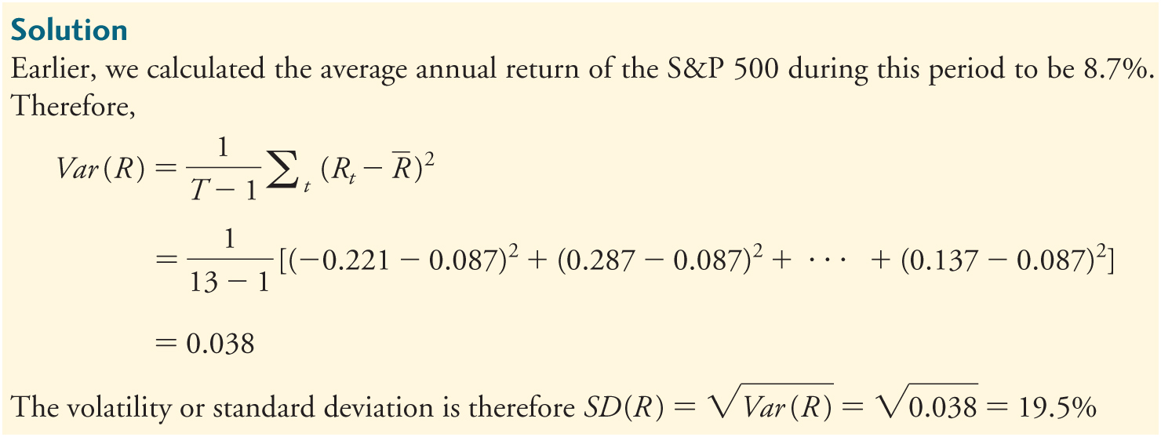
Textbook Example 10.3 (cont'd)

Slide 41
Alternative Example 10.3
Problem:
Using the data from Table 10.2, what are the variance and standard deviation of Microsoft’s returns from 2004 to 2014?

Slide 42
Alternative Example 10.3 (cont’d)
Solution:
First, we need to calculate the average return for Microsoft’s over that time period, using equation 10.6:

Slide 43
Alternative Example 10.3 (cont’d)
Next, we calculate the variance using equation 10.7:
The standard deviation is therefore

Slide 44
Table 10.4 Volatility of U.S. Small Stocks, Large Stocks (S&P 500), Corporate Bonds, and Treasury Bills, 1926–2014

Slide 45
Estimation Error: Using Past Returns to Predict the Future
We can use a security’s historical average return to estimate its actual expected return. However, the average return is just an estimate of the expected return.
Standard Error
A statistical measure of the degree of estimation error

Slide 46
Estimation Error: Using Past Returns to Predict the Future (cont'd)
Standard Error of the Estimate of the Expected Return
95% Confidence Interval
For the S&P 500 (1926–2014)
Or a range from 7.7% to 16.3%

Slide 47
Textbook Example 10.4

Slide 48
Textbook Example 10.4 (cont'd)

Slide 49
Alternative Example 10.4
Problem:
Using the data from Alternative Example 10.3, what is the 95% confidence interval you would estimate for Microsoft’s expected return?

Slide 50
Alternative Example 10.4 (cont’d)
Solution:
The 95% confidence interval for Microsoft’s expected return is calculated as follows:
Or a range from -5.8% to 29.4%

Slide 51
10.4 The Historical Trade-Off Between Risk and Return
The Returns of Large Portfolios
Excess Returns
The difference between the average return for an investment and the average return for T-Bills

Slide 52
Table 10.5 Volatility Versus Excess Return of U.S. Small Stocks, Large Stocks (S&P 500), Corporate Bonds, and Treasury Bills, 1926–2014

Slide 53
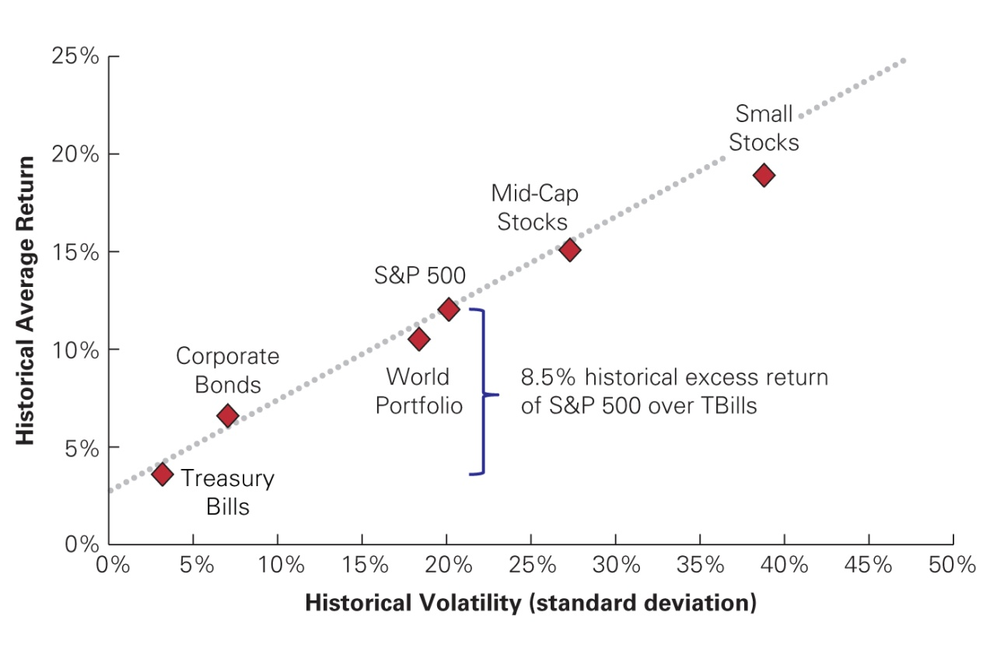
Figure 10.6 The Historical Trade-Off Between Risk and Return in Large Portfolios
Source: CRSP, Morgan Stanley Capital International

Slide 54
The Returns of Individual Stocks
Is there a positive relationship between volatility and average returns for individual stocks?
As shown on the next slide, there is no precise relationship between volatility and average return for individual stocks.
Larger stocks tend to have lower volatility than smaller stocks.
All stocks tend to have higher risk and lower returns than large portfolios.

Slide 55
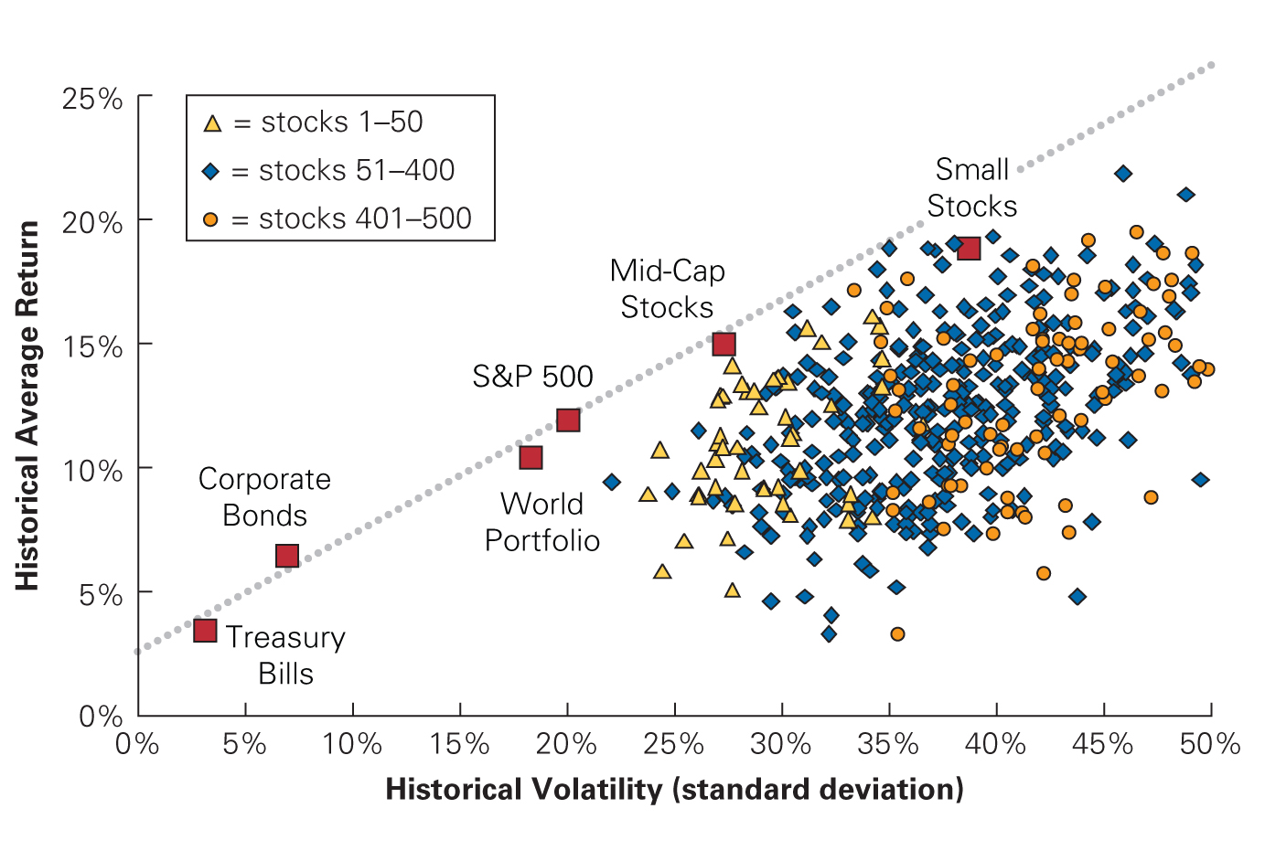
Figure 10.7 Historical Volatility and Return for 500 Individual Stocks, Ranked Annually by Size
Source: CRSP

Slide 56
10.5 Common Versus Independent Risk
Common Risk
Risk that is perfectly correlated
Risk that affects all securities
Independent Risk
Risk that is uncorrelated
Risk that affects a particular security
Diversification
The averaging out of independent risks in a large portfolio

Slide 57
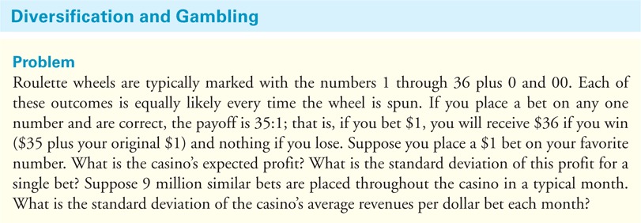
Textbook Example 10.5

Slide 58
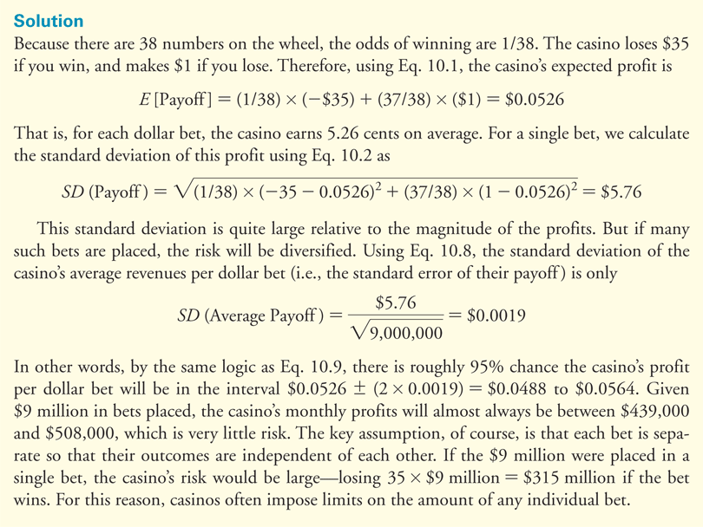
Textbook Example 10.5 (cont'd)

Slide 59
10.6 Diversification in Stock Portfolios
Firm-Specific Versus Systematic Risk
Firm Specific News
Good or bad news about an individual company
Market-Wide News
News that affects all stocks, such as news about the economy

Slide 60
10.6 Diversification in Stock Portfolios (cont'd)
Firm-Specific Versus Systematic Risk
Independent Risks
Due to firm-specific news
Also known as
Firm-Specific Risk
Idiosyncratic Risk
Unique Risk
Unsystematic Risk
Diversifiable Risk

Slide 61
10.6 Diversification in Stock Portfolios (cont'd)
Firm-Specific Versus Systematic Risk
Common Risks
Due to market-wide news
Also known as
Systematic Risk
Undiversifiable Risk
Market Risk

Slide 62
10.6 Diversification in Stock Portfolios (cont'd)
Firm-Specific Versus Systematic Risk
When many stocks are combined in a large portfolio, the firm-specific risks for each stock will average out and be diversified.
The systematic risk, however, will affect all firms and will not be diversified.

Slide 63
10.6 Diversification in Stock Portfolios (cont'd)
Firm-Specific Versus Systematic Risk
Consider two types of firms:
Type S firms are affected only by systematic risk. There is a 50% chance the economy will be strong and type S stocks will earn a return of 40%. There is a 50% change the economy will be weak and their return will be –20%. Because all these firms face the same systematic risk, holding a large portfolio of type S firms will not diversify the risk.

Slide 64
10.6 Diversification in Stock Portfolios (cont'd)
Firm-Specific Versus Systematic Risk
Consider two types of firms:
Type I firms are affected only by firm-specific risks. Their returns are equally likely to be 35% or –25%, based on factors specific to each firm’s local market. Because these risks are firm specific, if we hold a portfolio of the stocks of many type I firms, the risk is diversified.

Slide 65
10.6 Diversification in Stock Portfolios (cont'd)
Firm-Specific Versus Systematic Risk
Actual firms are affected by both market-wide risks and firm-specific risks. When firms carry both types of risk, only the unsystematic risk will be diversified when many firm’s stocks are combined into a portfolio. The volatility will therefore decline until only the systematic risk remains.

Slide 66
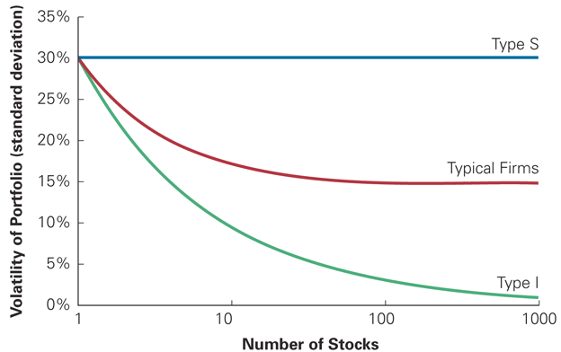
Figure 10.8 Volatility of Portfolios of Type S and I Stocks

Slide 67
Textbook Example 10.6

Slide 68
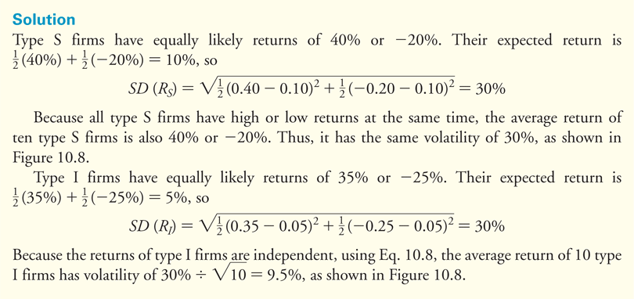
Textbook Example 10.6 (cont'd)

Slide 69
No Arbitrage and the Risk Premium
The risk premium for diversifiable risk is zero, so investors are not compensated for holding firm-specific risk.
If the diversifiable risk of stocks were compensated with an additional risk premium, then investors could buy the stocks, earn the additional premium, and simultaneously diversify and eliminate the risk.

Slide 70
No Arbitrage and the Risk Premium (cont'd)
By doing so, investors could earn an additional premium without taking on additional risk. This opportunity to earn something for nothing would quickly be exploited and eliminated. Because investors can eliminate firm-specific risk “for free” by diversifying their portfolios, they will not require or earn a reward or risk premium for holding it.

Slide 71
No Arbitrage and the Risk Premium (cont'd)
The risk premium of a security is determined by its systematic risk and does not depend on its diversifiable risk.
This implies that a stock’s volatility, which is a measure of total risk (that is, systematic risk plus diversifiable risk), is not especially useful in determining the risk premium that investors will earn.

Slide 72
No Arbitrage and the Risk Premium (cont'd)
Standard deviation is not an appropriate measure of risk for an individual security. There should be no clear relationship between volatility and average returns for individual securities. Consequently, to estimate a security’s expected return, we need to find a measure of a security’s systematic risk.

Slide 73
Textbook Example 10.7

Slide 74
Textbook Example 10.7 (cont'd)

Slide 75
10.7 Measuring Systematic Risk
To measure the systematic risk of a stock, determine how much of the variability of its return is due to systematic risk versus unsystematic risk.
To determine how sensitive a stock is to systematic risk, look at the average change in the return for each 1% change in the return of a portfolio that fluctuates solely due to systematic risk.

Slide 76
10.7 Measuring Systematic Risk (cont'd)
Efficient Portfolio
A portfolio that contains only systematic risk. There is no way to reduce the volatility of the portfolio without lowering its expected return.
Market Portfolio
An efficient portfolio that contains all shares and securities in the market
The S&P 500 is often used as a proxy for the market portfolio.

Slide 77
10.7 Measuring Systematic Risk (cont'd)
Sensitivity to Systematic Risk: Beta (β)
The expected percent change in the excess return of a security for a 1% change in the excess return of the market portfolio.
Beta differs from volatility. Volatility measures total risk (systematic plus unsystematic risk), while beta is a measure of only systematic risk.

Slide 78
Textbook Example 10.8

Slide 79
Textbook Example 10.8 (cont'd)

Slide 80
Alternative Example 10.8
Problem
Suppose the market portfolio tends to increase by 52% when the economy is strong and decline by 21% when the economy is weak.
What is the beta of a type S firm whose return is 55% on average when the economy is strong and -24% when the economy is weak?
What is the beta of a type I firm that bears only idiosyncratic, firm-specific risk?

Slide 81
Alternative Example 10.8 (cont’d)
Solution
The systematic risk of the strength of the economy produces a 52% - (-21%) = 73% change in the return of the market portfolio.
The type S firm’s return changes by 55% - (-24%) = 79% on average.
Thus the firm’s beta is β_{S} = 79%/73% = 1.082. That is, each 1% change in the return of the market portfolio leads to a 1.082% change in the type S firm’s return on average.

Slide 82
Alternative Example 10.8 (cont’d)
Solution
The return of a type I firm has only firm-specific risk, however, and so is not affected by the strength of the economy. Its return is affected only by factors specific to the firm.
Because it will have the same expected return, whether the economy is strong or weak, β_{I} = 0%/72% = 0.

Slide 83
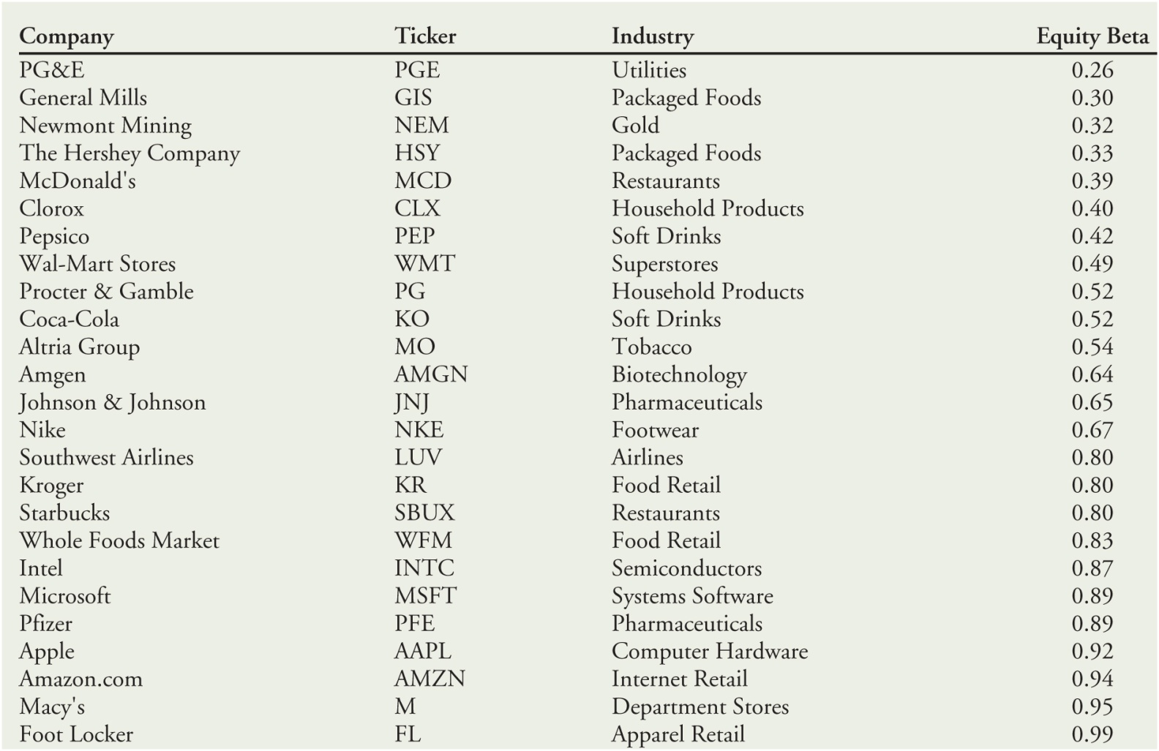
Table 10.6 Betas with Respect to the S&P 500 for Individual Stocks (based on monthly data for 2010–2015)

Slide 84
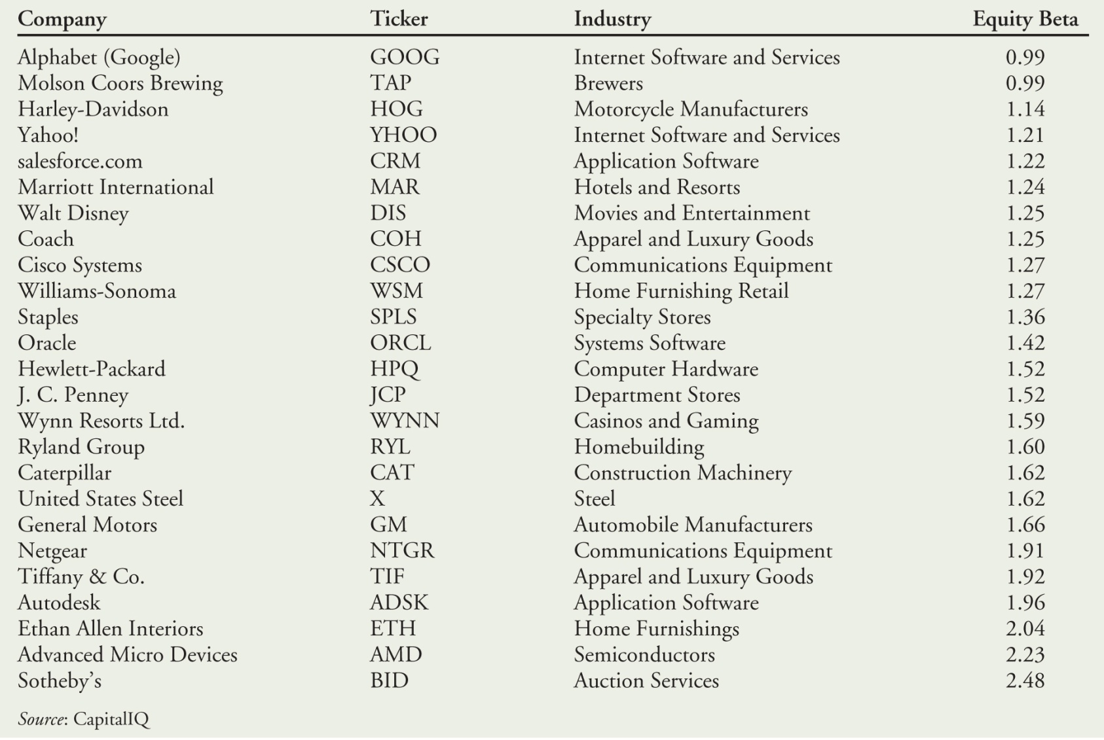
Table 10.6 Betas with Respect to the S&P 500 for Individual Stocks (based on monthly data for 2010–2015) (cont’d)

Slide 85
10.7 Measuring Systematic Risk (cont'd)
Interpreting Beta (β)
A security’s beta is related to how sensitive its underlying revenues and cash flows are to general economic conditions. Stocks in cyclical industries are likely to be more sensitive to systematic risk and have higher betas than stocks in less sensitive industries.

Slide 86
10.8 Beta and the Cost of Capital
Estimating the Risk Premium
Market risk premium
The market risk premium is the reward investors expect to earn for holding a portfolio with a beta of 1.

Slide 87
10.8 Beta and Cost of Capital (cont'd)
Adjusting for Beta
Estimating a Traded Security’s Cost of Capital of an investment from Its Beta

Slide 88
Textbook Example 10.9

Slide 89
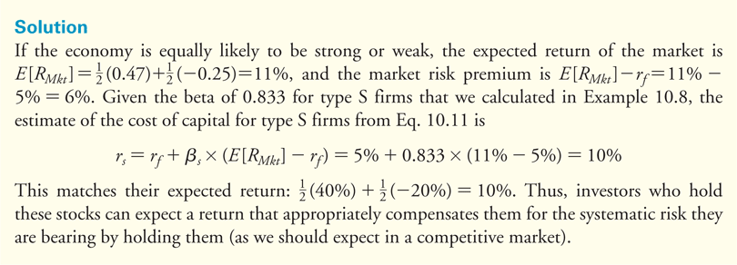
Textbook Example 10.9 (cont'd)

Slide 90
Alternative Example 10.9
Problem
Assume the economy has a 60% chance of the market return will 15% next year and a 40% chance the market return will be 5% next year.
Assume the risk-free rate is 6%.
If Microsoft’s beta is 1.18, what is its expected return next year?

Slide 91
Alternative Example 10.9 (cont’d)
Solution
E[R_{Mkt}] = (60% × 15%) + (40% × 5%) = 11%
E[R] = r_{f} + β ×(E[R_{Mkt}] − r_{f} )
E[R] = 6% + 1.18 × (11% − 6%)
E[R] = 6% + 5.9% = 11.9%

Slide 92
10.8 Beta and the Cost of Capital (cont'd)
Equation10.11 is often referred to as the Capital Asset Pricing Model (CAPM). It is the most important method for estimating the cost of capital that is used in practice.

Slide 93
Discussion of Data Case Key Topic
Find the betas for each of the 12 stocks listed in the data case. How do the firms compare when ranked by beta as opposed to the standard deviations you calculated?
Sources for betas available free on the web:
Yahoo! Finance
Value Line
Google Finance

Slide 94
Chapter Quiz
From 1926 to 2014, which of the following investments had the highest return: Standard & Poor’s 500, small stocks, world portfolio, corporate bonds, or Treasury bills?
How do we calculate the expected return of a stock?
What are the two most common measures of risk, and how are they related to each other?
We have 89 years of data on the S&P 500 returns, yet we cannot estimate the expected return of the S&P 500 very accurately. Why?
Do expected returns of well-diversified large portfolios of stocks appear to increase with volatility?

Slide 95
Chapter Quiz
Do expected returns for individual stocks appear to increase with volatility?
What is the difference between common risk and independent risk?
Explain why the risk premium of diversifiable risk is zero.
Why is the risk premium of a security determined only by its systematic risk?
Define the beta of a security.
How can you use a security’s beta to estimate its cost of capital?
If a risky investment has a beta of zero, what should its cost of capital be according to the CAPM? How can you justify this?

