Slide 1
Chapter 3
Time Value of Money: An Introduction

Slide 2
Chapter Outline
3.1 Cost-Benefit Analysis
3.2 Market Prices and the Valuation Principle
3.3 The Time Value of Money and Interest Rates
3.4 Valuing Cash Flows at Different Points in Time

Slide 3
Learning Objectives
Identify the role of financial managers and competitive markets in decision making
Understand the Valuation Principle, and how it can be used to identify decisions that increase the value of the firm
Assess the effect of interest rates on today’s value of future cash flows
Calculate the value of distant cash flows in the present and of current cash flows in the future

Slide 4
3.1 Cost-Benefit Analysis
Role of the Financial Manager
Make decisions on behalf of the firm’s investors
For good decisions, the benefits exceed the costs
Net Present Value =NPV= Present Value(Cash inflows)- Cost
NPV>0

Slide 5
3.1 Cost-Benefit Analysis
Role of the Financial Manager
Real-world opportunities are often difficult to quantify and involve using skills from other management disciplines:
Marketing- effect of advertising on revenues
Economics- Price and demand analysis
Organizational Behavior –management change and its effect on the productivity.
Strategy - competitor response to price strategy
Operations- cost and benefit of capital investment

Slide 6
3.1 Cost-Benefit Analysis
Quantifying Costs and Benefits
Any decision in which the value of the benefits exceeds the costs will increase the value of the firm
NPV>0

Slide 7
3.1 Cost-Benefit Analysis
Quantifying Costs and Benefits
Suppose a jewelry manufacturer has the opportunity to trade 200 ounces of silver and receive 10 ounces of gold today.
To compare the costs and benefits, we first need to convert them to a common unit.

Slide 8
3.1 Cost-Benefit Analysis
Quantifying Costs and Benefits
If the current market price for silver is $20 per ounce, then the 200 ounces of silver we give up has a cash value of:
(200 ounces of silver) × ($20/ounce) = $4,000

Slide 9
3.1 Cost-Benefit Analysis
Quantifying Costs and Benefits
Assume gold can be bought and sold for a current market price of $1,000 per ounce. Then the 10 ounces of gold we receive has a cash value of:
(10 ounces of gold) × ($1,000/ounce) = $10,000

Slide 10
3.1 Cost-Benefit Analysis
Quantifying Costs and Benefits
Therefore, the jeweler’s opportunity has a benefit of $10,000 today and a cost of $4,000 today. In this case, the net value of the project today is:
$10,000 - $4,000=$6,000
Because it is positive, the benefits exceed the costs and the jeweler should accept the trade.

Slide 11
3.1 Cost-Benefit Analysis
Quantifying Costs and Benefits
Role of Competitive Markets
A competitive market is one in which a good can be bought and sold at the same price
In a competitive market, the price determines the value of the good
Personal opinion of the “fair” price is irrelevant

Slide 12
Example 3.1 Competitive Market Prices Determine Value
Problem:
You have just won a radio contest and are disappointed to learn that the prize is 4 tickets to the Def Leppard reunion tour (face value $40 each). Not being a fan of 1980s power rock, you have no intention of going to the show. However, it turns out that there is a second choice: two tickets to your favorite band’s sold-out show (face value $45 each). You notice that on Ebay, tickets to the Def Leppard show are being bought and sold for $30 apiece and tickets to your favorite band’s show are being bought and sold at $50 each. What should you do?

Slide 13
Example 3.1 Competitive Market Prices Determine Value
Solution:
Plan:
Market prices, not your personal preference (nor the face value of the tickets), are relevant here:
4 Def Leppard tickets at $30 apiece
2 of your favorite band’s tickets at $50 apiece
You need to compare the market value of each option and choose the one with the highest market value.

Slide 14
Example 3.1 Competitive Market Prices Determine Value
Execute:
The Def Leppard tickets have a total value of $120 (4 × $30) versus the $100 total value of the other two tickets (2 × $50).
Instead of taking the tickets to your favorite band, you should accept the Def Leppard tickets, sell them on Ebay, and use the proceeds to buy two tickets to your favorite band’s show.
You’ll even have $20 left over to buy a t-shirt.

Slide 15
Example 3.1 Competitive Market Prices Determine Value
Evaluate:
Even though you prefer your favorite band, you should still take the opportunity to get the Def Leppard tickets instead.
As we emphasized earlier, whether this opportunity is attractive depends on its net value using market prices.
Because the net value of taking the Def Leppard tickets, selling them, and buying your favorite band’s tickets is positive $20, the opportunity is appealing.

Slide 16
3.2 Market Prices and the Valuation Principle
The Valuation Principle
The value of a commodity or an asset to the firm or its investors is determined by its competitive market price
The benefits and costs of a decision should be evaluated using those market prices
When the value of the benefits exceeds the value of the costs, the decision will increase the market value of the firm

Slide 17
Example 3.2 Applying the Valuation Principle
Problem:
You are the operations manager at your firm. Due to a pre-existing contract, you have the opportunity to acquire 200 barrels of oil and 3,000 pounds of copper for $25,000. The current market price of oil is $90 per barrel and for copper is $3.50 per pound. You are not sure that you need all of the oil and copper, so you are wondering if you should you take this opportunity. How valuable is it? Would your decision change if you believed the value of oil or copper would plummet over the next month?

Slide 18
Example 3.2 Applying the Valuation Principle
We need to quantify the costs and benefits using market prices. We are comparing $25,000 with:
200 barrels of oil at $90 per barrel
3,000 pounds of copper at $3.50 per pound
Using the competitive market prices we have:
(200 barrels) × ($90/barrel today) = $18,000 today
(3,000 pounds of copper) × ($3.50/pound today) = $10,500 today
The value of the opportunity is the value of the oil plus the value of the copper less the cost of the opportunity, $18,000 + $10,500 - $25,000 = $3,500 today.
Because the value is positive, we should take it

Slide 19
Example 3.2 Applying the Valuation Principle
Evaluate:
Since we are transacting today, only the current prices in a competitive market matter
Our own use for or opinion about the future prospects of oil or copper do not alter the value of the decision today
This decision is good for the firm, and will increase its value by $3,500

Slide 20
3.2 Market Prices and the Valuation Principle
Why There Can Be Only One Competitive Price for a Good
Law of One Price
In competitive markets, securities with the same cash flows must have the same price

Slide 21
3.2 Market Prices and the Valuation Principle
Why There Can Be Only One Competitive Price for a Good
Arbitrage
The practice of buying and selling equivalent goods to take advantage of a price difference
Arbitrage Opportunity
Any situation in which it is possible to make a profit without taking any risk or making any investment

Slide 22
3.3 The Time Value of Money and Interest Rates
The Time Value of Money
In general, a dollar today is worth more than a dollar in one year
If you have $1 today and you can deposit it in a bank at 10%, you will have $1.10 at the end of one year
The difference in value between money today and money in the future is the time value of money.

Slide 23
3.3 The Time Value of Money and Interest Rates
The Time Value of Money
Consider a firm's investment opportunity with a cost of $100,000 today and a benefit of $105,000 at the end of one year.

Slide 24
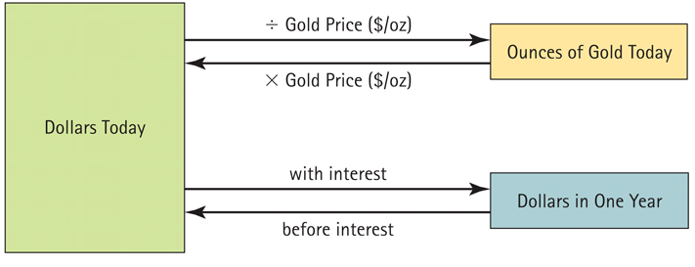
Figure 3.1 Converting Between Dollars Today and Gold or Dollars in the Future

Slide 25
3.3 The Time Value of Money and Interest Rates
The Interest Rate: Converting Cash Across Time
By depositing money, we convert money today into money in the future
By borrowing money, we exchange money today for money in the future

Slide 26
3.3 The Time Value of Money and Interest Rates
The Interest Rate: Converting Cash Across Time
Interest Rate (r)
The rate at which money can be borrowed or lent over a given period
Interest Rate Factor (1 + r)
It is the rate of exchange between dollars today and dollars in the future
It has units of “$ in one year/$ today”

Slide 27
3.3 The Time Value of Money and Interest Rates
The Interest Rate: Converting Cash Across Time
Value of $100,000 Investment in One Year
If the interest is 10%, the cost of the investment is:
Cost = ($100,000 today) × (1.10 $ in one year/$ today)
= $110,000 in one year

Slide 28
3.3 The Time Value of Money and Interest Rates
The Interest Rate: Converting Cash Across Time
Value of $100,000 Investment in One Year
$110,000 is the opportunity cost of spending $100,000 today
The firm gives up the $110,000 it would have had in one year if it had left the money in the bank
Alternatively, by borrowing the $100,000 from the same bank, the firm would owe $110,000 in one year.

Slide 29
3.3 The Time Value of Money and Interest Rates
The Interest Rate: Converting Cash Across Time
Value of $100,000 Investment in One Year
The investment’s net value is difference between the cost of the investment and the benefit in one year:
$105,000 - $110,000 = -$5,000 in one year

Slide 30
3.3 The Time Value of Money and Interest Rates
The Interest Rate: Converting Cash Across Time
Value of $100,000 Investment Today
How much would we need to have in the bank today so that we would end up with $105,000 in the bank in one year?
This is calculated by dividing by the interest rate factor:

Slide 31
3.3 The Time Value of Money and Interest Rates
The Interest Rate: Converting Cash Across Time
Value of $100,000 Investment Today
The investment’s net value is difference between the cost of the investment and the benefit in one year: $95,454.55 - $100,000 = -$4,545.55 today

Slide 32
3.3 The Time Value of Money and Interest Rates
The Interest Rate: Converting Cash Across Time
Present Versus Future Value
Present Value
The value of a cost or benefit computed in terms of cash today
(-$4,545.45)
Future Value
The value of a cash flow that is moved forward in time
($5,000)
(-$4,545.45 today) × (1.10 $ in one year/$ today) = -$5,000 in one year

Slide 33
3.3 The Time Value of Money and Interest Rates
The Interest Rate: Converting Cash Across Time
Discount Factors and Rates
Money in the future is worth less today so its price reflects a discount
Discount Rate
The appropriate rate to discount a cash flow to determine its value at an earlier time
Discount Factor
The value today of a dollar received in the future, expressed as:

Slide 34
Example 3.3 Comparing Revenues at Different Points in Time
Problem:
The launch of Sony’s PlayStation 3 was delayed until November 2006, giving Microsoft’s Xbox 360 a full year on the market without competition. Sony did not repeat this mistake in 2013 when the PS4 launched at the same time as the Xbox One. Imagine that it is November 2005 and you are the marketing manager for the PlayStation. You estimate that if the PlayStation 3 were ready to be launched immediately, you could sell $2 billion worth of the console in its first year. However, if your launch is delayed a year, you believe that Microsoft’s head start will reduce your first-year sales by 20% to $1.6 billion. If the interest rate is 8%, what is the cost of a delay in terms of dollars in 2005?

Slide 35
Example 3.3 Comparing Revenues at Different Points in Time
Solution:
Plan:
Revenues if released today: $2 billion
Revenue if delayed: $1.6 billion
Interest rate: 8%
We need to compute the revenues if the launch is delayed and compare them to the revenues from launching today. However, in order to make a fair comparison, we need to convert the future revenues of the PlayStation if delayed into an equivalent present value of those revenues today.

Slide 36
Example 3.3 Comparing Revenues at Different Points in Time
Execute:
If the launch is delayed to 2006, revenues will drop by 20% of $2 billion, or $400 million, to $1.6 billion.
To compare this amount to revenues of $2 billion if launched in 2005, we must convert it using the interest rate of 8%:
$1.6 billion in 2006 ÷ ($1.08 in 2006/$1 in 2005) =
$1.6 billion/1.08 = $1.481 billion in 2005
Therefore, the cost of a delay of one year is
$2 billion - $1.481 billion = $0.519 billion ($519 million).

Slide 37
Example 3.3 Comparing Revenues at Different Points in Time
Evaluate:
Delaying the project for one year was equivalent to giving up $519 million in cash.
In this example, we focused only on the effect on the first year’s revenues. However, delaying the launch delays the entire revenue stream by one year, so the total cost would be calculated in the same way by summing the cost of delay for each year of revenues.

Slide 38
3.3 The Time Value of Money and Interest Rates
Timelines
Constructing a Timeline
Identifying Dates on a Timeline
Date 0 is today, the beginning of the first year
Date 1 is the end of the first year

Slide 39
3.3 The Time Value of Money and Interest Rates
Timelines
Distinguishing Cash Inflows from Outflows
Representing Various Time Periods
Just change the label from “Year” to “Month” if monthly

Slide 40
3.4 Valuing Cash Flows at Different Points in Time
Rule 1: Comparing and Combining Values
It is only possible to compare or combine values at the same point in time

Slide 41
3.4 Valuing Cash Flows at Different Points in Time
Rule 2: Compounding
To calculate a cash flow’s future value, you must compound it

Slide 42
3.4 Valuing Cash Flows at Different Points in Time
Rule 2: Compounding
Compound Interest
The effect of earning “interest on interest”

Slide 43
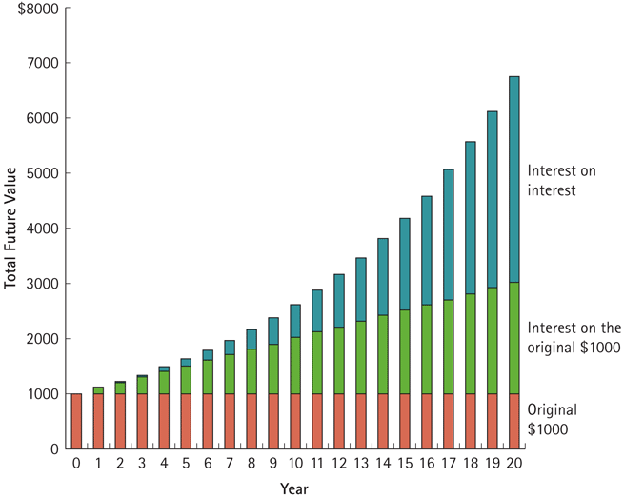
Figure 3.2 The Composition of Interest over Time

Slide 44
3.4 Valuing Cash Flows at Different Points in Time
Rule 3: Discounting
To calculate the value of a future cash flow at an earlier point in time, we must discount it.

Slide 45
3.4 Valuing Cash Flows at Different Points in Time
Rule 3: Discounting
If $826.45 is invested today for two years at 10% interest, the future value will be $1000

Slide 46
3.4 Valuing Cash Flows at Different Points in Time
Rule 3: Discounting
If $1000 were three years away, the present value, if the interest rate is 10%, will be $751.31

Slide 47
Example 3.4 Present Value of a Single Future Cash Flow
Problem:
You are considering investing in a savings bond that will pay $15,000 in 10 years. If the competitive market interest rate is fixed at 6% per year, what is the bond worth today?

Slide 48
Example 3.5 Present Value of a Single Future Cash Flow
Solution:
Plan:
First set up your timeline. The cash flows for this bond are represented by the following timeline:
Thus, the bond is worth $15,000 in 10 years. To determine the value today, we compute the present value using Eq. 3.2 and our interest rate of 6%.

Slide 49
Example 3.4 Present Value of a Single Future Cash Flow
Execute:
Given: | 10 | 6 |  | 0 | 15,000
Solve for: |  |  | -8,375.92
Excel Formula: =PV(RATE,NPER, PMT, FV) = PV(0.06,10,0,15000)

Slide 50
Example 3.4 Present Value of a Single Future Cash Flow
Evaluate:
The bond is worth much less today than its final payoff because of the time value of money.

Slide 51
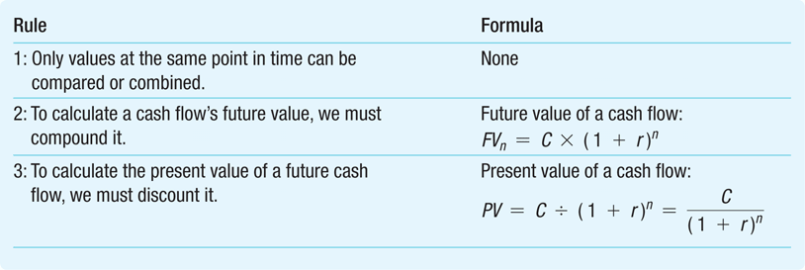
Table 3.1 The Three Rules of Valuing Cash Flows

Slide 52
Chapter Quiz
If crude oil trades in a competitive market, would an oil refiner that has a use for the oil value it differently than another investor would?
How do we determine whether a decision increases the value of the firm?
Is the value today of money to be received in one year higher when interest rates are high or when interest rates are low?
What do you need to know to compute a cash flow’s present or future value?

