Slide 1
Chapter 11
Optimal Portfolio Choice and the Capital Asset Pricing Model

Slide 2
Chapter Outline
11.1 The Expected Return of a Portfolio
11.2 The Volatility of a Two-Stock Portfolio
11.3 The Volatility of a Large Portfolio
11.4 Risk Versus Return: Choosing an Efficient Portfolio
11.5 Risk-Free Saving and Borrowing
11.6 The Efficient Portfolio and Required Returns

Slide 3
Chapter Outline (cont’d)
11.7 The Capital Asset Pricing Model
11.8 Determining the Risk Premium
Appendix

Slide 4
Learning Objectives
Given a portfolio of stocks, including the holdings in each stock and the expected return in each stock, compute the following:
Portfolio weight of each stock (equation 11.1)
Expected return on the portfolio (equation 11.3)
Covariance of each pair of stocks in the portfolio (equation 11.5)
Correlation coefficient of each pair of stocks in the portfolio (equation 11.6)
Variance of the portfolio (equation 11.8)
Standard deviation of the portfolio

Slide 5
Learning Objectives (cont'd)
Compute the variance of an equally weighted portfolio, using equation 11.12.
Describe the contribution of each security to the portfolio.
Use the definition of an efficient portfolio from Chapter 10 to describe the efficient frontier.
Explain how an individual investor will choose from the set of efficient portfolios.

Slide 6
Learning Objectives (cont'd)
Describe what is meant by a short sale, and illustrate how short selling extends the set of possible portfolios.
Explain the effect of combining a risk-free asset with a portfolio of risky assets, and compute the expected return and volatility for that combination.

Slide 7
Learning Objectives (cont'd)
Illustrate why the risk-return combinations of the risk-free investment and a risky portfolio lie on a straight line.
Define the Sharpe ratio, and explain how it helps identify the portfolio with the highest possible expected return for any level of volatility, and how this information can be used to identify the tangency (efficient) portfolio.

Slide 8
Learning Objectives (cont'd)
Calculate the beta of investment with a portfolio.
Use the beta of a security, expected return on a portfolio, and the risk-free rate to decide whether buying shares of that security will improve the performance of the portfolio.
Explain why the expected return must equal the required return.

Slide 9
Learning Objectives (cont'd)
Use the risk-free rate, the expected return on the efficient (tangency) portfolio, and the beta of a security with the efficient portfolio to calculate the risk premium for an investment.
List the three main assumptions underlying the Capital Asset Pricing Model.

Slide 10
Learning Objectives (cont'd)
Explain why the CAPM implies that the market portfolio of all risky securities is the efficient portfolio.
Compare and contrast the capital market line with the security market line.
Define beta for an individual stock and for a portfolio.

Slide 11
11.1 The Expected Return of a Portfolio
Portfolio Weights
The fraction of the total investment in the portfolio held in each individual investment in the portfolio
The portfolio weights must add up to 1.00 or 100%.

Slide 12
11.1 The Expected Return of a Portfolio (cont'd)
Then the return on the portfolio, R_{p} , is the weighted average of the returns on the investments in the portfolio, where the weights correspond to portfolio weights.

Slide 13
Textbook Example 11.1

Slide 14
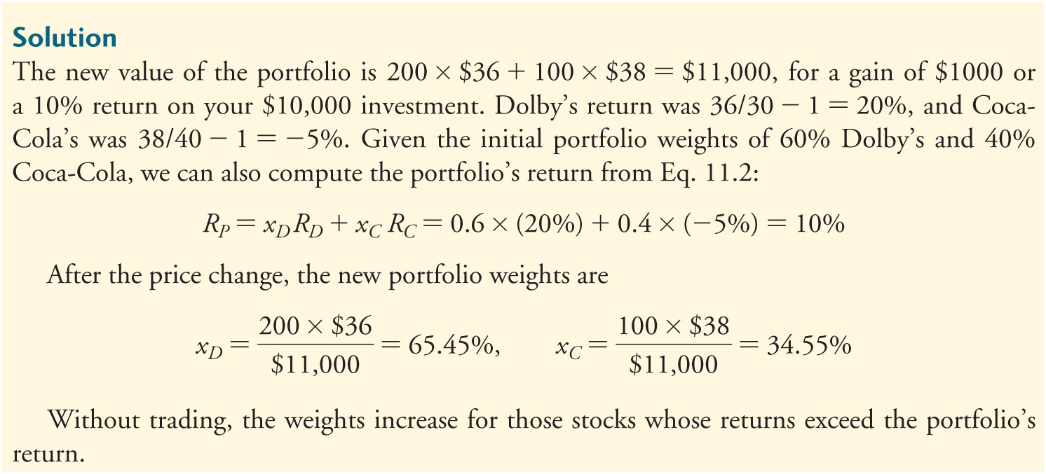
Textbook Example 11.1 (cont'd)

Slide 15
Alternative Example 11.1
Problem
Suppose you buy 500 shares of Ford at $11 per share and 100 shares of Citigroup stock at $28 per share. If Ford’s share price goes up to $13 and Citigroup’s rises to $40, what is the new value of the portfolio, and what return did it earn? Show that Eq. 11.2 holds.
After the price change, what are the new portfolio weights?
Notes:
15

Slide 16
Alternative Example 11.1 (cont’d)
Solution
The initial value of the portfolio is 500 * $11 + 100 * $28 = $8,300. The new value of the portfolio is 500 * $13 + 100 * $40 = $10,500, for a gain of $2,200 or a 26.5% return on your $8,300 investment.
Ford’s return was $13/$11 - 1 = 18.18%, and Citigroup’s was $40/$28 - 1 = 42.86%.
Notes:
16

Slide 17
Alternative Example 11.1 (cont’d)
Solution
Given the initial portfolio weights of $5,500/$8,300 = 66.3% for Ford and $2,800/$8,300 = 33.7% for Citigroup, we can also compute the portfolio’s return from Eq. 11.2:
Thus, Equation 11.2 holds.
Notes:
17

Slide 18
Alternative Example 11.1 (cont’d)
Solution
After the price change, the new portfolio weights are $6,500/$10,500 = 61.9% for Ford and $4,000/$10,500 = 38.1% for Citigroup.
Notes:
18

Slide 19
11.1 The Expected Return of a Portfolio (cont'd)
The expected return of a portfolio is the weighted average of the expected returns of the investments within it.

Slide 20
Textbook Example 11.2

Slide 21
Textbook Example 11.2 (cont'd)

Slide 22
Alternative Example 11.2
Problem
Assume your portfolio consists of $25,000 of Intel stock and $35,000 of ATP Oil and Gas.
Your expected return is 18% for Intel and 25% for ATP Oil and Gas.
What is the expected return for your portfolio?
Notes:
22

Slide 23
Alternative Example 11.2 (cont’d)
Solution
Total Portfolio = $25,000 + 35,000= $60,000
Portfolio Weights
Intel: $25,000 ÷ $60,000 = 0.4167
ATP: $35,000 ÷ $60,000 = 0.5833
Expected Return
E[R] = (0.4167)(0.18) + (0.5833)(0.25)
E[R] = 0.075006 + 0.145825 = 0.220885 = 22.1%
Notes:
23

Slide 24
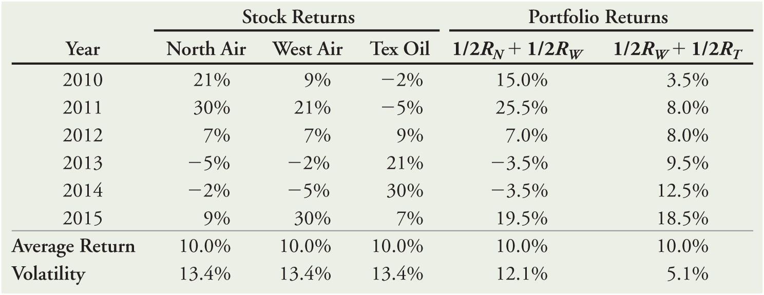
11.2 The Volatility of a Two-Stock Portfolio
Combining Risks
Table 11.1 Returns for Three Stocks, and Portfolios of Pairs of Stocks

Slide 25
11.2 The Volatility of a Two-Stock Portfolio (cont'd)
Combining Risks
While the three stocks in the previous table have the same volatility and average return, the pattern of their returns differs.
For example, when the airline stocks performed well, the oil stock tended to do poorly, and when the airlines did poorly, the oil stock tended to do well.

Slide 26
11.2 The Volatility of a Two-Stock Portfolio (cont'd)
Combining Risks
Consider the portfolio which consists of equal investments in West Air and Tex Oil. The average return of the portfolio is equal to the average return of the two stocks
However, the volatility of 5.1% is much less than the volatility of the two individual stocks.

Slide 27
11.2 The Volatility of a Two-Stock Portfolio (cont'd)
Combining Risks
By combining stocks into a portfolio, we reduce risk through diversification.
The amount of risk that is eliminated in a portfolio depends on the degree to which the stocks face common risks and their prices move together.

Slide 28
Determining Covariance and Correlation
To find the risk of a portfolio, one must know the degree to which the stocks’ returns move together.

Slide 29
Determining Covariance and Correlation (cont'd)
Covariance
The expected product of the deviations of two returns from their means
Covariance between Returns R_{i} and R_{j}
Estimate of the Covariance from Historical Data
If the covariance is positive, the two returns tend to move together.
If the covariance is negative, the two returns tend to move in opposite directions.

Slide 30
Determining Covariance and Correlation (cont'd)
Correlation
A measure of the common risk shared by stocks that does not depend on their volatility
The correlation between two stocks will always be between –1 and +1.

Slide 31
Figure 11.1 Correlation

Slide 32
Textbook Example 11.3

Slide 33
Textbook Example 11.3 (cont'd)

Slide 34
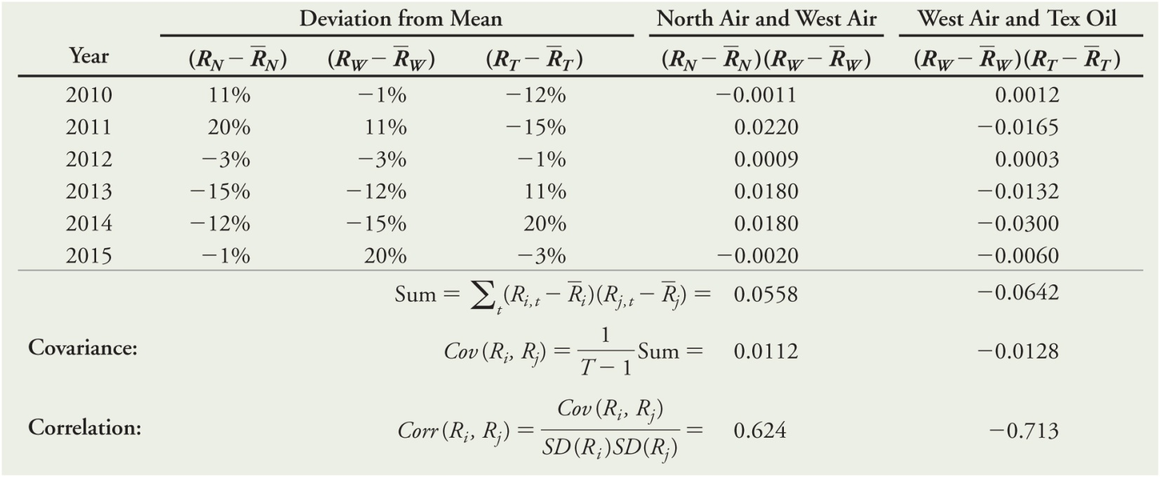
Table 11.2 Computing the Covariance and Correlation between Pairs of Stocks

Slide 35
Table 11.3 Historical Annual Volatilities and Correlations for Selected Stocks

Slide 36
Textbook Example 11.4

Slide 37
Textbook Example 11.4 (cont'd)

Slide 38
Textbook Example 11.5
Table 11.3 Historical Annual Volatilities and Correlations for Selected Stocks

Slide 39
Alternative Example 11.5
Problem
Using the data from Table 11.3, what is the covariance between General Mills and Ford?
Solution

Slide 40
Computing a Portfolio’s Variance and Volatility
For a two security portfolio,
The Variance of a Two-Stock Portfolio

Slide 41
Textbook Example 11.6

Slide 42
Textbook Example 11.6 (cont'd)
Table 11.3 Historical Annual Volatilities and Correlations for Selected Stocks

Slide 43
Alternative Example 11.6
Problem
Continuing with Alternative Example 11.2:
Assume the annual standard deviation of returns is 43% for Intel and 68% for ATP Oil and Gas.
If the correlation between Intel and ATP is 0.49, what is the standard deviation of your portfolio?
Notes:
43

Slide 44
Alternative Example 11.6 (cont’d)
Solution
Notes:
44

Slide 45
11.3 The Volatility of a Large Portfolio
The variance of a portfolio is equal to the weighted average covariance of each stock with the portfolio:
which reduces to

Slide 46
Diversification with an Equally Weighted Portfolio
Equally Weighted Portfolio
A portfolio in which the same amount is invested in each stock
Variance of an Equally Weighted Portfolio of n Stocks

Slide 47
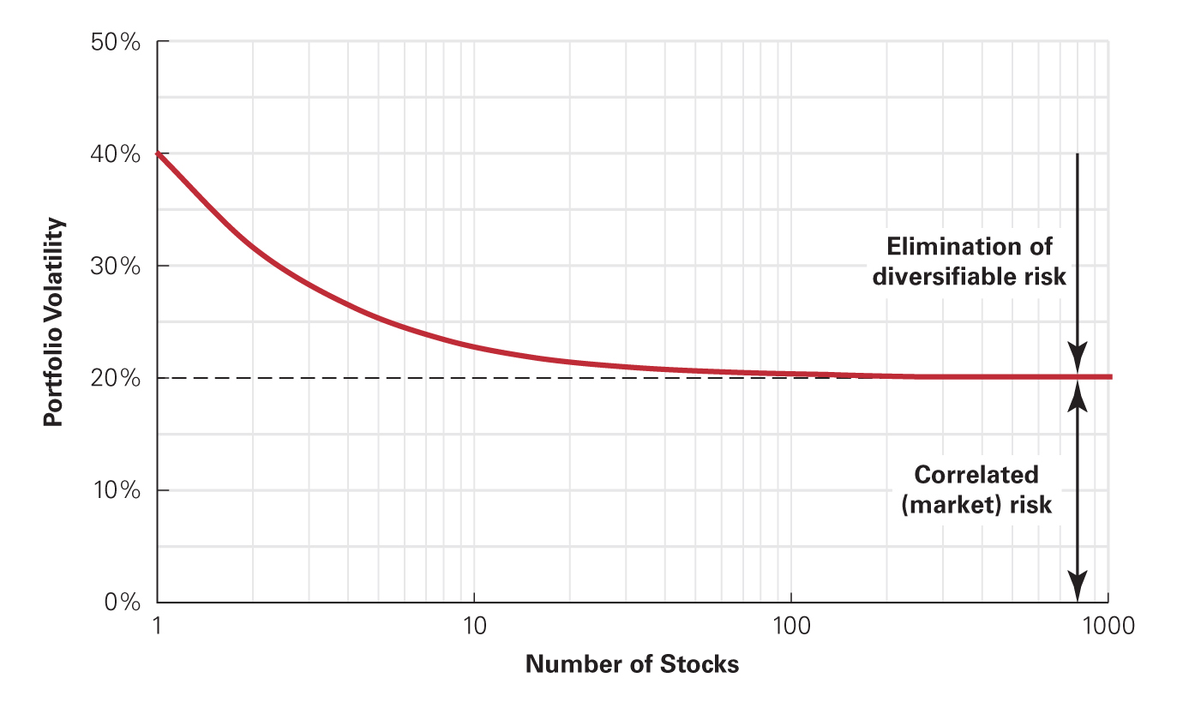
Figure 11.2 Volatility of an Equally Weighted Portfolio Versus the Number of Stocks

Slide 48
Textbook Example 11.7

Slide 49
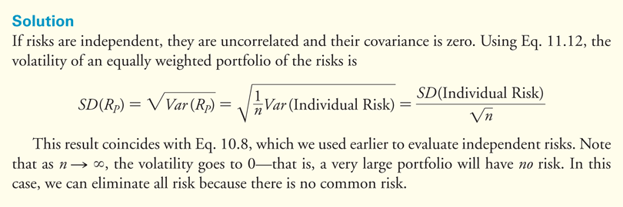
Textbook Example 11.8

Slide 50
Diversification with General Portfolios
For a portfolio with arbitrary weights, the standard deviation is calculated as follows:
Volatility of a Portfolio with Arbitrary Weights
Unless all of the stocks in a portfolio have a perfect positive correlation of +1 with one another, the risk of the portfolio will be lower than the weighted average volatility of the individual stocks:

Slide 51
11.4 Risk Versus Return: Choosing an Efficient Portfolio
Efficient Portfolios with Two Stocks
Identifying Inefficient Portfolios
In an inefficient portfolio, it is possible to find another portfolio that is better in terms of both expected return and volatility.
Identifying Efficient Portfolios
Recall from Chapter 10, in an efficient portfolio there is no way to reduce the volatility of the portfolio without lowering its expected return.

Slide 52
11.4 Risk Versus Return: Choosing an Efficient Portfolio (cont'd)
Efficient Portfolios with Two Stocks
Consider a portfolio of Intel and Coca-Cola
Table 11.4 Expected Returns and Volatility for Different
Portfolios of Two Stocks

Slide 53
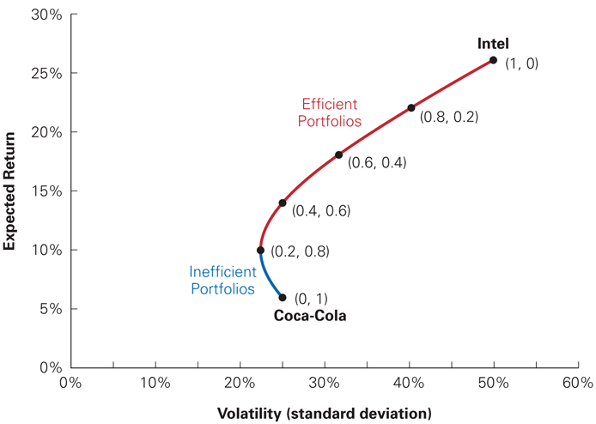
Figure 11.3 Volatility Versus Expected Return for Portfolios of Intel and Coca-Cola Stock

Slide 54
11.4 Risk Versus Return: Choosing an Efficient Portfolio (cont'd)
Efficient Portfolios with Two Stocks
Consider investing 100% in Coca-Cola stock. As shown in on the previous slide, other portfolios—such as the portfolio with 20% in Intel stock and 80% in Coca-Cola stock—make the investor better off in two ways: It has a higher expected return, and it has lower volatility. As a result, investing solely in Coca-Cola stock is inefficient.

Slide 55
Textbook Example 11.9

Slide 56
Alternative Example 11.9
Problem
Using Figure 11.3, what combination of Intel and Coca-Cola provides the worst risk/return trade-off? What combination provides the lowest amount of risk? The greatest amount of risk?
Solution
The worst risk/return trade-off is 100% in Coca-Cola because you can earn a higher return with the same amount of risk or the same return with a lower amount of risk by moving to a more efficient portfolio.
20% in Intel and 80% in Coca-Cola provides the lowest risk, while 100% in Intel offers the highest amount of risk.
Notes:
56

Slide 57
The Effect of Correlation
Correlation has no effect on the expected return of a portfolio. However, the volatility of the portfolio will differ depending on the correlation.
The lower the correlation, the lower the volatility we can obtain. As the correlation decreases, the volatility of the portfolio falls.
The curve showing the portfolios will bend to the left to a greater degree as shown on the next slide.

Slide 58
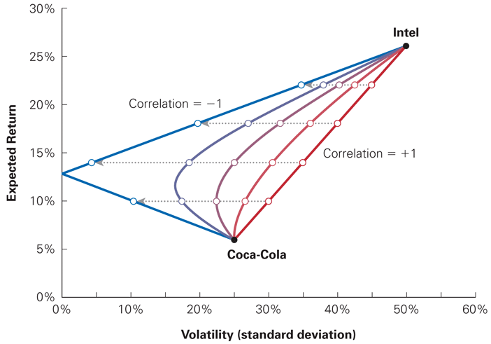
Figure 11.4 Effect on Volatility and Expected Return of Changing the Correlation between Intel and Coca-Cola Stock

Slide 59
Short Sales
Long Position
A positive investment in a security
Short Position
A negative investment in a security
In a short sale, you sell a stock that you do not own and then buy that stock back in the future.
Short selling is an advantageous strategy if you expect a stock price to decline in the future.

Slide 60
Textbook Example 11.10

Slide 61
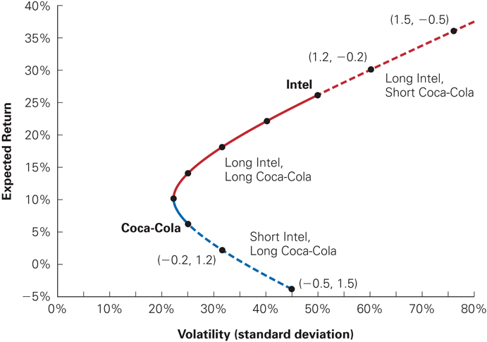
Figure 11.5 Portfolios of Intel and Coca-Cola Allowing for Short Sales

Slide 62
Efficient Portfolios with Many Stocks
Consider adding Bore Industries to the two-stock portfolio:
Although Bore has a lower return and the same volatility as Coca-Cola, it still may be beneficial to add Bore to the portfolio for the diversification benefits.

Slide 63
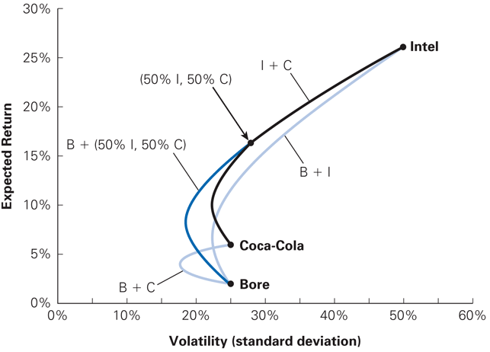
Figure 11.6 Expected Return and Volatility for Selected Portfolios of Intel, Coca-Cola, and Bore Industries Stocks

Slide 64
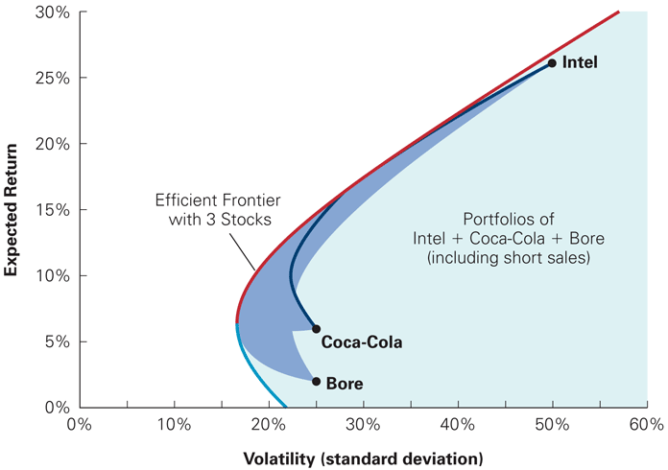
Figure 11.7 The Volatility and Expected Return for All Portfolios of Intel, Coca-Cola, and Bore Stock

Slide 65
Risk Versus Return: Many Stocks
The efficient portfolios, those offering the highest possible expected return for a given level of volatility, are those on the northwest edge of the shaded region, which is called the efficient frontier for these three stocks.
In this case, none of the stocks, on its own, is on the efficient frontier, so it would not be efficient to put all our money in a single stock.

Slide 66
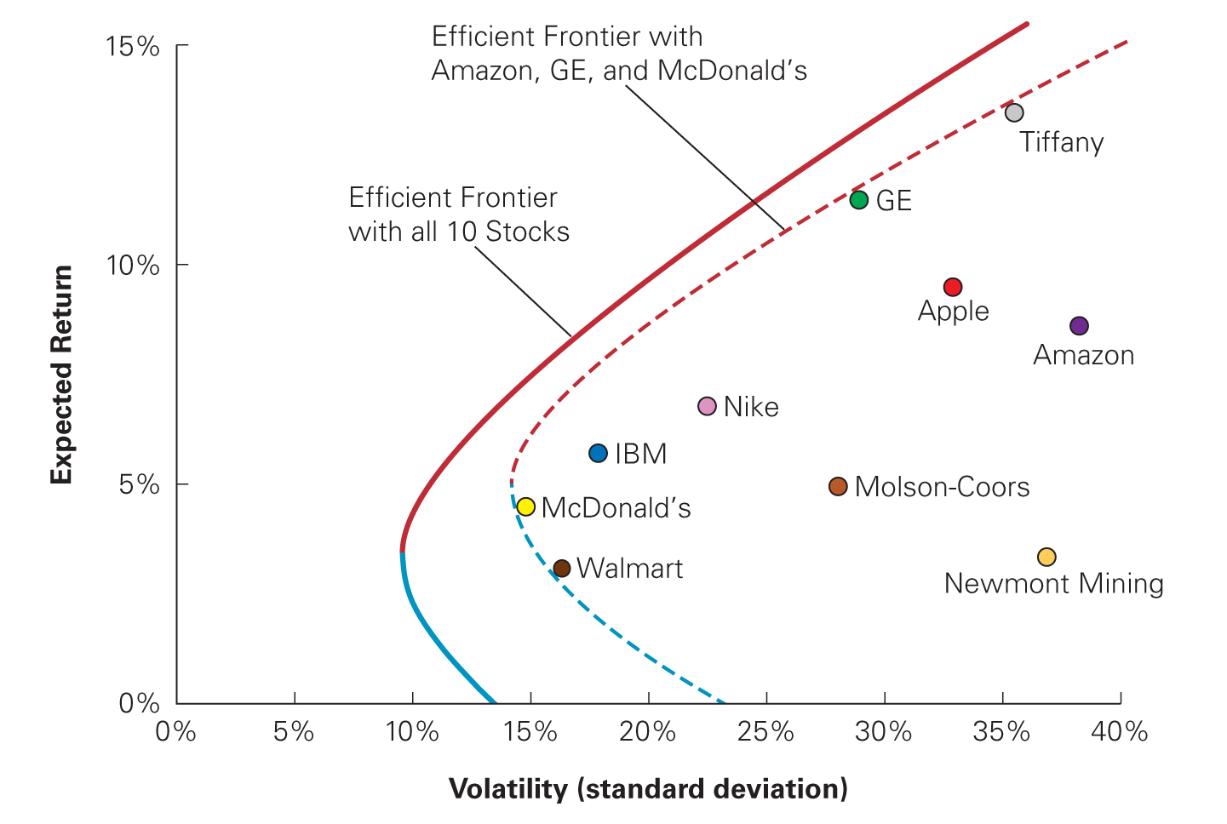
Figure 11.8 Efficient Frontier with Three Stocks Versus Ten Stocks

Slide 67
11.5 Risk-Free Saving and Borrowing
Risk can also be reduced by investing a portion of a portfolio in a risk-free investment, like T-Bills. However, doing so will likely reduce the expected return.
On the other hand, an aggressive investor who is seeking high expected returns might decide to borrow money to invest even more in the stock market.

Slide 68
Investing in Risk-Free Securities
Consider an arbitrary risky portfolio and the effect on risk and return of putting a fraction of the money in the portfolio, while leaving the remaining fraction in risk-free Treasury bills.
The expected return would be

Slide 69
Investing in Risk-Free Securities (cont'd)
The standard deviation of the portfolio would be calculated as follows:
Note: The standard deviation is only a fraction of the volatility of the risky portfolio, based on the amount invested in the risky portfolio.
0

Slide 70
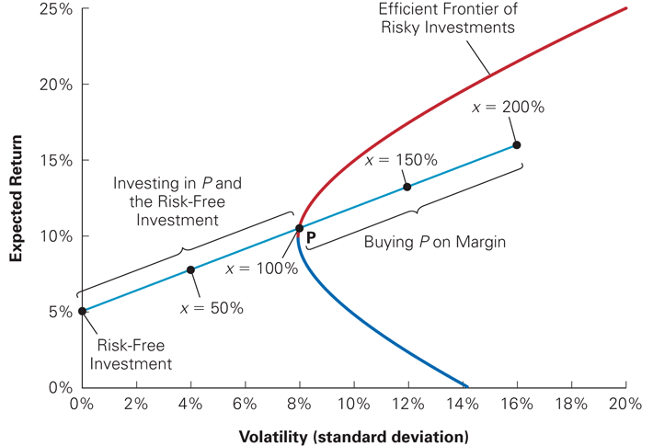
Figure 11.9 The Risk–Return Combinations from Combining a Risk-Free Investment and a Risky Portfolio

Slide 71
Borrowing and Buying Stocks on Margin
Buying Stocks on Margin
Borrowing money to invest in a stock.
A portfolio that consists of a short position in the risk-free investment is known as a levered portfolio. Margin investing is a risky investment strategy.

Slide 72
Textbook Example 11.11

Slide 73
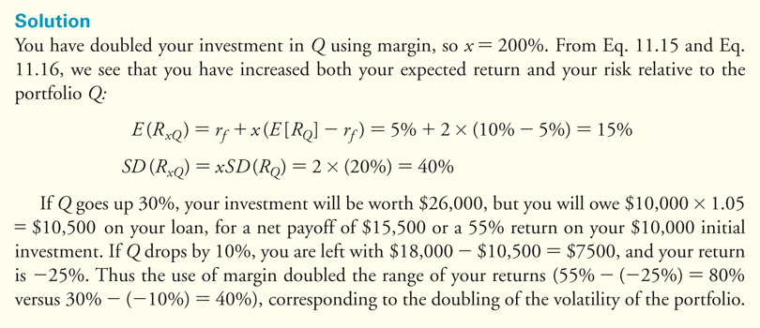
Textbook Example 11.11 (cont'd)

Slide 74
Identifying the Tangent Portfolio
To earn the highest possible expected return for any level of volatility we must find the portfolio that generates the steepest possible line when combined with the risk-free investment.

Slide 75
Identifying the Tangent Portfolio (cont'd)
Sharpe Ratio
Measures the ratio of reward-to-volatility provided by a portfolio
The portfolio with the highest Sharpe ratio is the portfolio where the line with the risk-free investment is tangent to the efficient frontier of risky investments. The portfolio that generates this tangent line is known as the tangent portfolio.

Slide 76
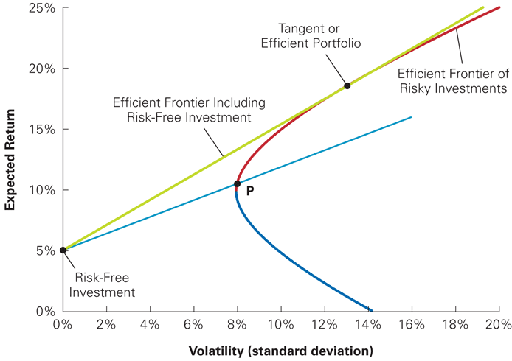
Figure 11.10 The Tangent or Efficient Portfolio

Slide 77
Identifying the Tangent Portfolio (cont'd)
Combinations of the risk-free asset and the tangent portfolio provide the best risk and return trade-off available to an investor.
This means that the tangent portfolio is efficient and that all efficient portfolios are combinations of the risk-free investment and the tangent portfolio. Every investor should invest in the tangent portfolio independent of his or her taste for risk.

Slide 78
Identifying the Tangent Portfolio (cont'd)
An investor’s preferences will determine only how much to invest in the tangent portfolio versus the risk-free investment.
Conservative investors will invest a small amount in the tangent portfolio.
Aggressive investors will invest more in the tangent portfolio.
Both types of investors will choose to hold the same portfolio of risky assets, the tangent portfolio, which is the efficient portfolio.

Slide 79
Textbook Example 11.12

Slide 80
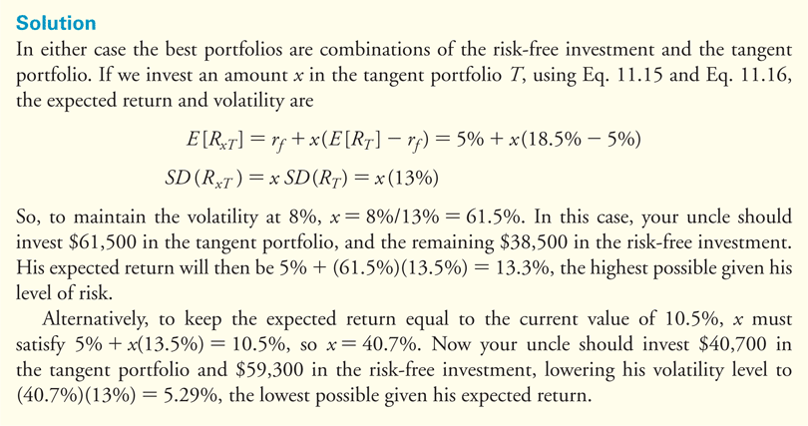
Textbook Example 11.12 (cont'd)

Slide 81
11.6 The Efficient Portfolio and Required Returns
Portfolio Improvement: Beta and the Required Return
Assume there is a portfolio of risky securities, P. To determine whether P has the highest possible Sharpe ratio, consider whether its Sharpe ratio could be raised by adding more of some investment i to the portfolio.
The contribution of investment i to the volatility of the portfolio depends on the risk that i has in common with the portfolio, which is measured by i’s volatility multiplied by its correlation with P.

Slide 82
11.6 The Efficient Portfolio and Required Returns (cont'd)
Portfolio Improvement: Beta and the Required Return
If you were to purchase more of investment i by borrowing, you would earn the expected return of i minus the risk-free return. Thus adding i to the portfolio P will improve our Sharpe ratio if

Slide 83
11.6 The Efficient Portfolio and Required Returns (cont'd)
Portfolio Improvement: Beta and the Required Return
Beta of Portfolio i with Portfolio P

Slide 84
11.6 The Efficient Portfolio and Required Returns (cont'd)
Portfolio Improvement: Beta and the Required Return
Increasing the amount invested in i will increase the Sharpe ratio of portfolio P if its expected return E[R_{i}] exceeds the required return r_{i} , which is given by

Slide 85
11.6 The Efficient Portfolio and Required Returns (cont'd)
Portfolio Improvement: Beta and the Required Return
Required Return of i
The expected return that is necessary to compensate for the risk investment i will contribute to the portfolio.

Slide 86
Textbook Example 11.13

Slide 87
Alternative Example 11.13
Problem
Assume you own a portfolio of 25 different “large cap” stocks. You expect your portfolio will have a return of 12% and a standard deviation of 15%. A colleague suggests you add gold to your portfolio. Gold has an expected return of 8%, a standard deviation of 25%, and a correlation with your portfolio of -0.05. If the risk-free rate is 2%, will adding gold improve your portfolio’s Sharpe ratio?

Slide 88
Alternative Example 11.13 (cont’d)
Solution
The beta of gold with your portfolio is
The required return that makes gold an attractive addition to your portfolio is
Because the expected return of 8% exceeds the required return of 2.5%, adding gold to your portfolio will increase your Sharpe ratio.

Slide 89
Expected Returns and the Efficient Portfolio
Expected Return of a Security
A portfolio is efficient if and only if the expected return of every available security equals its required return.

Slide 90
Textbook Example 11.14

Slide 91
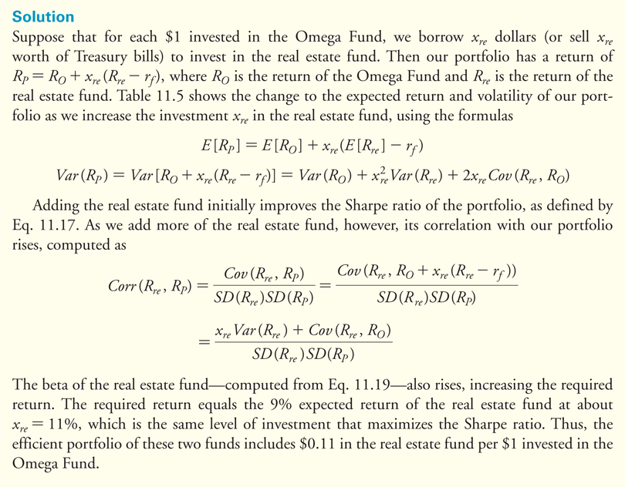
Textbook Example 11.14 (cont'd)

Slide 92
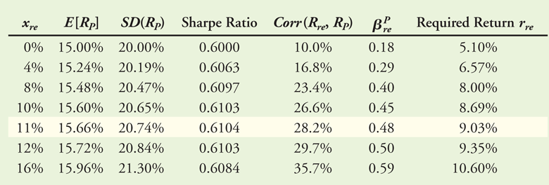
Table 11.5 Sharpe Ratio and Required Return for Different Investments in the Real Estate Fund

Slide 93
11.7 The Capital Asset Pricing Model
The Capital Asset Pricing Model (CAPM) allows us to identify the efficient portfolio of risky assets without having any knowledge of the expected return of each security.
Instead, the CAPM uses the optimal choices investors make to identify the efficient portfolio as the market portfolio, the portfolio of all stocks and securities in the market.

Slide 94
The CAPM Assumptions
Three Main Assumptions
Assumption 1
Investors can buy and sell all securities at competitive market prices (without incurring taxes or transactions costs) and can borrow and lend at the risk-free interest rate.

Slide 95
The CAPM Assumptions (cont'd)
Three Main Assumptions
Assumption 2
Investors hold only efficient portfolios of traded securities—portfolios that yield the maximum expected return for a given level of volatility.

Slide 96
The CAPM Assumptions (cont'd)
Three Main Assumptions
Assumption 3
Investors have homogeneous expectations regarding the volatilities, correlations, and expected returns of securities.
Homogeneous Expectations
All investors have the same estimates concerning future investments and returns.

Slide 97
Supply, Demand, and the Efficiency of the Market Portfolio
Given homogeneous expectations, all investors will demand the same efficient portfolio of risky securities.
The combined portfolio of risky securities of all investors must equal the efficient portfolio.
Thus, if all investors demand the efficient portfolio, and the supply of securities is the market portfolio, the demand for market portfolio must equal the supply of the market portfolio.

Slide 98
Textbook Example 11.15

Slide 99
Optimal Investing: The Capital Market Line
When the CAPM assumptions hold, an optimal portfolio is a combination of the risk-free investment and the market portfolio.
When the tangent line goes through the market portfolio, it is called the capital market line (CML).

Slide 100
Optimal Investing: The Capital Market Line (cont'd)
The expected return and volatility of a capital market line portfolio are

Slide 101
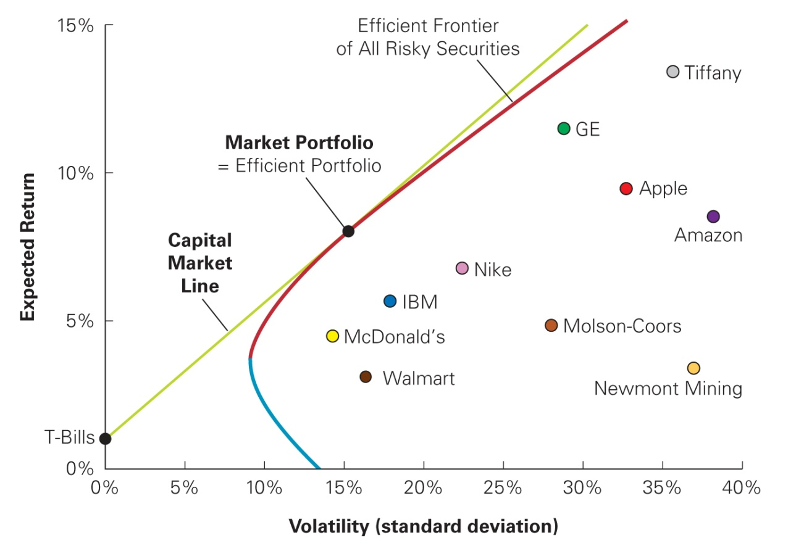
Figure 11.11 The Capital Market Line

Slide 102
11.8 Determining the Risk Premium
Market Risk and Beta
Given an efficient market portfolio, the expected return of an investment is
The beta is defined as follows:

Slide 103
Textbook Example 11.16

Slide 104
Alternative Example 11.16
Problem
Assume the risk-free return is 5% and the market portfolio has an expected return of 12% and a standard deviation of 44%.
ATP Oil and Gas has a standard deviation of 68% and a correlation with the market of 0.91.
What is ATP’s beta with the market?
Under the CAPM assumptions, what is its expected return?
Notes:
104

Slide 105
Alternative Example 11.16 (cont’d)
Solution
Notes:
105

Slide 106
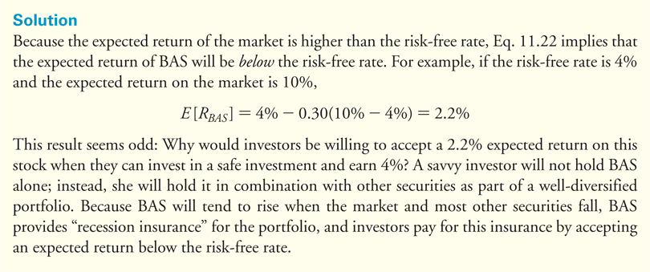
Textbook Example 11.17

Slide 107
Alternative Example 11.17
Problem
Assume you own a security with a beta of 1.5 and you have found a security that has a beta of -1.5. How much market risk could be eliminated by adding this security to create a two-security portfolio? Conceptually, what would be the expected return of this portfolio?
Notes:
107

Slide 108
Alternative Example 11.17 (cont’d)
Solution
A portfolio with 50% in a security with a beta of 1.5 and 50% in another security with a beta of -1.5% would yield a portfolio beta of 0, indicating an elimination of the market risk.
The expected return on a portfolio with a beta of 0 will be equal to the risk-free rate.
Notes:
108

Slide 109
The Security Market Line
There is a linear relationship between a stock’s beta and its expected return (See figure on next slide). The security market line (SML) is graphed as the line through the risk-free investment and the market.
According to the CAPM, if the expected return and beta for individual securities are plotted, they should all fall along the SML.

Slide 110
Figure 11.12 The Capital Market Line and the Security Market Line

Slide 111
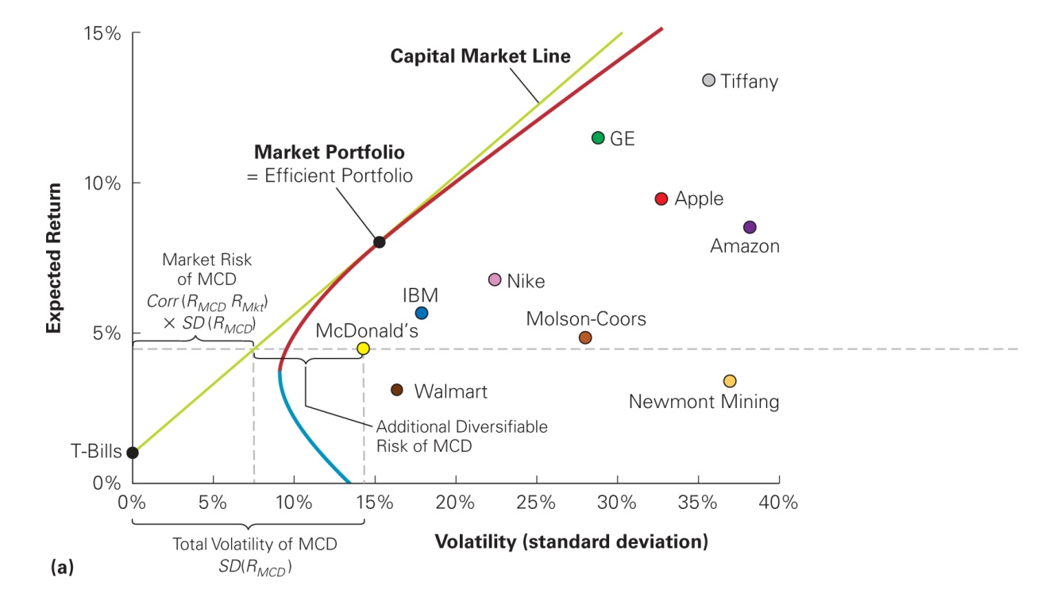
Figure 11.12 The Capital Market Line and the Security Market Line, panel (a)
(a) The CML depicts portfolios combining the risk-free investment and the efficient portfolio, and shows the highest expected return that we can attain for each level of volatility. According to the CAPM, the market portfolio is on the CML and all other stocks and portfolios contain diversifiable risk and lie to the right of the CML, as illustrated for Exxon Mobil (XOM).

Slide 112
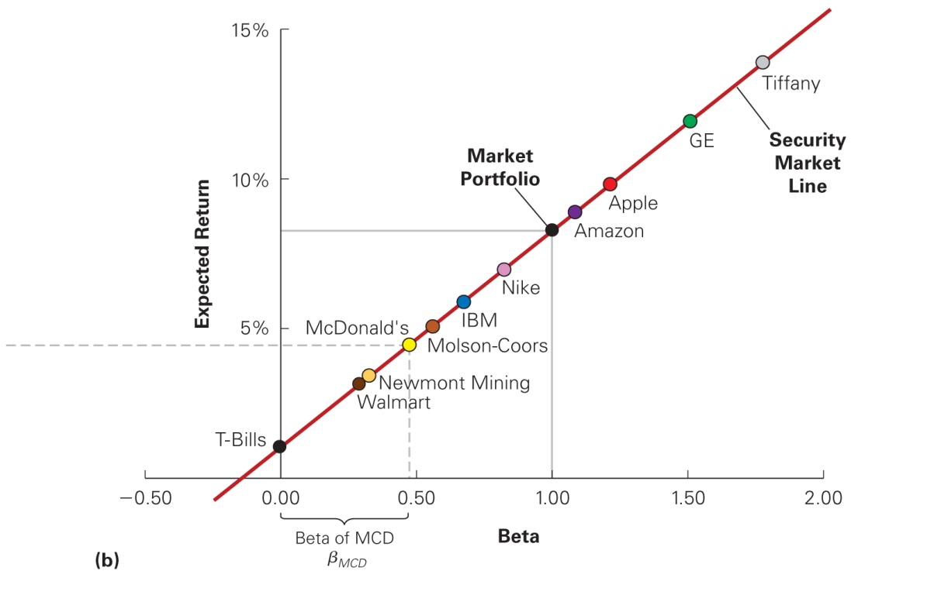
Figure 11.12 The Capital Market Line and the Security Market Line, panel (b)
(b) The SML shows the expected return for each security as a function of its beta with the market. According to the CAPM, the market portfolio is efficient, so all stocks and portfolios should lie on the SML.

Slide 113
The Security Market Line (cont'd)
Beta of a Portfolio
The beta of a portfolio is the weighted average beta of the securities in the portfolio.

Slide 114
Textbook Example 11.18

Slide 115
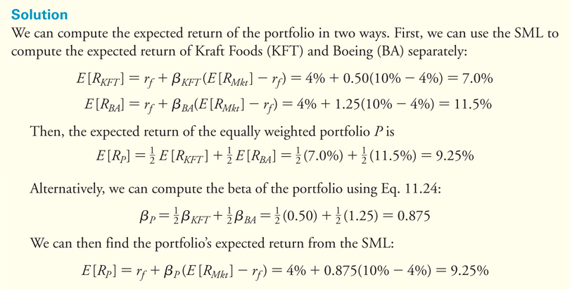
Textbook Example 11.18 (cont’d)

Slide 116
Alternative Example 11.18
Problem
Suppose the stock of the 3M Company (MMM) has a beta of 0.69 and the beta of Hewlett-Packard Co. (HPQ) stock is 1.77.
Assume the risk-free interest rate is 5% and the expected return of the market portfolio is 12%.
What is the expected return of a portfolio of 40% of 3M stock and 60% Hewlett-Packard stock, according to the CAPM?
Notes:
116

Slide 117
Alternative Example 11.18 (cont’d)
Solution
Notes:
117

Slide 118
Summary of the Capital Asset Pricing Model
The market portfolio is the efficient portfolio.
The risk premium for any security is proportional to its beta with the market.

Slide 119
Discussion of Data Case Key Topic
See if you can find a security that would be negatively correlated with your 12 stocks. How would your analysis change if you included this stock in your portfolio?
http://www.google.com/finance

Slide 120
Chapter Quiz
How do you calculate a portfolio return?
Conceptually, how are covariance and correlation different?
How does adding stocks to a portfolio affect its volatility?
What is the efficient frontier?
What is the Sharpe ratio, and what does it measure?
How does beta affect an investment’s cost of capital?

Slide 121
Chapter Quiz (cont’d)
Is the market portfolio efficient? Justify your answer.
How are the capital market line and security market line similar? How are they different?

Slide 122
Chapter 11
Appendix

Slide 123
Appendix
The CAPM with Differing Interest Rates
If borrowing and lending rates differ, then investors with different preferences will choose different portfolios of risky securities.
With different saving and borrowing rates, the CAPM conclusion that the market portfolio is the unique efficient portfolio of risky investments is no longer valid.

Slide 124
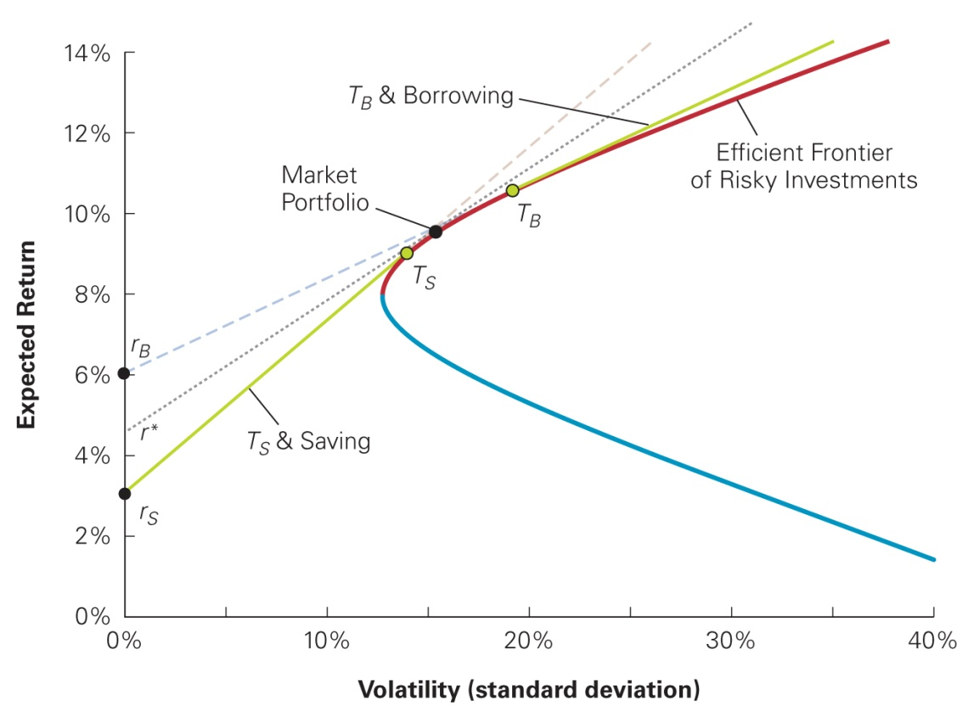
Appendix (cont’d)
Figure 11A.1 The CAPM with Different Saving and Borrowing Rates

Slide 125
Appendix (cont’d)
The Security Market Line with Differing Interest Rates
Determination of the security market line depends only on the market portfolio being tangent for some interest rate; the SML still holds in the following form:
The SML holds with some rate r* between r_{S} and r_{B} in place of r_{f}, as illustrated in Figure 11A.1.

