Slide 1
Chapter 4
NPV and the Time Value of Money

Slide 2
Chapter Outline
4.1 The Timeline
4.2 Valuing Cash Flows at Different Points in Time
4.3 Valuing a Stream of Cash Flows
4.4 The Net Present Value of a Stream of Cash Flows
4.5 Perpetuities, Annuities, and Other Special Cases
4.6 Solving for Variables Other Than Present Value or Future Value

Slide 3
Learning Objectives
Construct a cash flow timeline as the first step in solving problems
Calculate the value of distant cash flows in the present and of current cash flows in the future
Value a series of many cash flows
Understand how to compute the net present value of any set of cash flows
Apply shortcuts to value special sets of regular cash flows called perpetuities and annuities
Compute the number of periods, cash flow, or rate of return in a loan or investment

Slide 4
4.1 The Timeline
A series of cash flows lasting several periods is defined as a stream of cash flows. We can represent a stream of cash flows on a timeline, a linear representation of the timing of the expected cash flows.

Slide 5
Constructing a Timeline
Date 0 represents the present. Date 1 is one year later

Slide 6
Distinguishing Cash Inflows from Outflows
The first cash flow at date 0 (today) is represented as negative because it is an outflow

Slide 7
Example 4.1 Constructing a Timeline
Problem:
Suppose you must pay tuition of $10,000 per year for the next four years. Your tuition payments must be made in equal installments of $5,000 each every 6 months. What is the timeline of your tuition payments?

Slide 8
Example 4.1 Constructing a Timeline
Solution:
Assuming today is the start of the first semester, your first payment occurs at date 0 (today). The remaining payments occur at 6-month intervals. Using one-half year (6 months) as the period length, we can construct a timeline as follows:

Slide 9
4.2 Valuing Cash Flows at Different Points in Time
Three Important Rules Central to Financial Decision Making
Rule 1: Comparing and Combining Values
Rule 2: Compounding
Rule 3: Discounting

Slide 10
Rule 1: Comparing and Combining Values
A dollar today and a dollar in one year are not equivalent. Having money now is more valuable than having money in the future; if you have the money today you can earn interest on it.

Slide 11
Rule 2: Compounding
The process of moving forward along the timeline to determine a cash flow’s value in the future (its future value) is known as compounding. Our second rule stipulates that to calculate a cash flow’s future value, you must compound it.

Slide 12
Rule 2: Compounding
We can apply this rule repeatedly. Suppose we want to know how much the $1,000 is worth in two years’ time. If the interest rate for year 2 is also 10%, then we convert:

Slide 13
Rule 2: Compounding
This effect of earning interest on both the original principal plus the accumulated interest, so that you are earning “interest on interest,” is known as compound interest. Compounding the cash flow a third time, assuming the competitive market interest rate is fixed at 10%, we get:

Slide 14
Future Value of a Cash Flow
(Eq. 4.1)

Slide 15
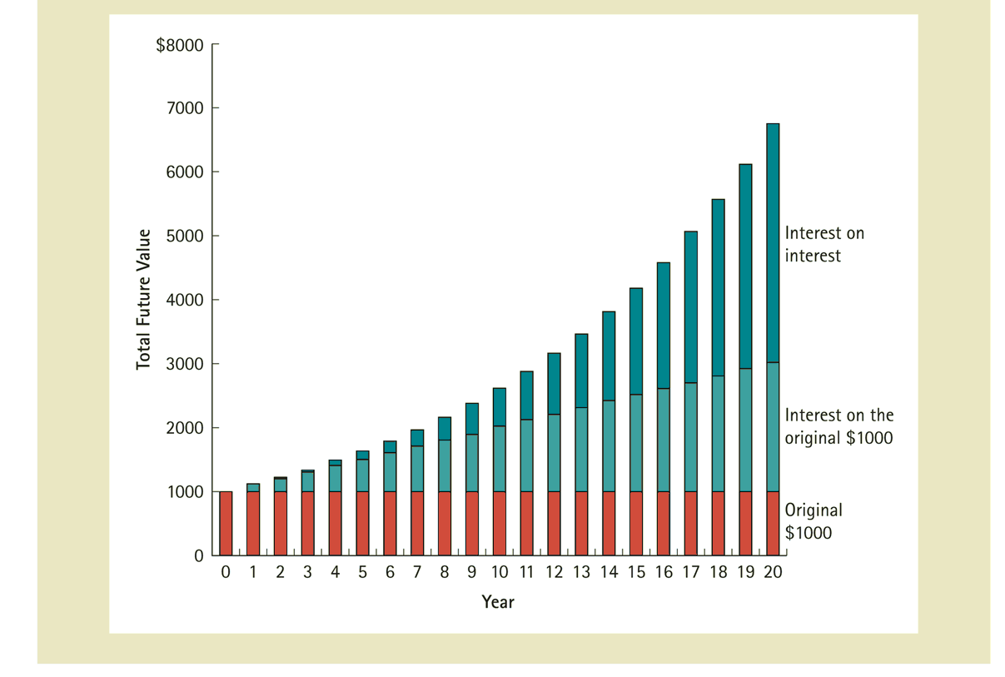
Figure 4.1 The Composition of Interest over Time

Slide 16
Rule 3: Discounting
The process of finding the equivalent value today of a future cash flow is known as discounting. Our third rule stipulates that to calculate the value of a future cash flow at an earlier point in time, we must discount it.

Slide 17
Present Value of a Cash Flow
(Eq. 4.2)

Slide 18
Using A Financial Calculator
Solving for Present and Future Values
Financial calculators have a set of functions that perform the calculations that finance professionals do most often. The functions are all based on the following timeline, which among other things can handle most types of loans:
There are a total of five variables: N, PV, PMT, FV, and the interest rate, denoted I/Y. Each function takes four of these variables as inputs and returns the value of the fifth one that ensures that the NPV of the cash flows is zero.

Slide 19
Example 4.2 Personal Finance Present Value of a Single Future Cash Flow
Problem:
You are considering investing in a savings bond that will pay $15,000 in ten years. If the competitive market interest rate is fixed at 6% per year, what is the bond worth today?

Slide 20
Example 4.2 Personal Finance Present Value of a Single Future Cash Flow
Solution
Plan:
First set up your timeline. The cash flows for this bond are represented by the following timeline:
Thus, the bond is worth $15,000 in ten years. To determine the value today, we compute the present value using Eq. 4.2 and our interest rate of 6%.

Slide 21
Example 4.2 Personal Finance Present Value of a Single Future Cash Flow
Execute:
Given: | 10 | 6 |  | 0 | 15,000
Solve for: |  |  | -8,375.92
Excel Formula: =PV(RATE,NPER, PMT, FV) = PV(0.06,10,0,15000)

Slide 22
Example 4.2 Personal Finance Present Value of a Single Future Cash Flow
Evaluate:
The bond is worth much less today than its final payoff because of the time value of money.

Slide 23
Example 4.2a Solving for the Interest Rate
Problem:
The U.S. Treasury offers to sell you a bond for $613.81. No payments will be made until the bond matures 10 years from now, at which time it will be redeemed for $1,000. What interest rate would you earn if you bought this bond at the offer price?

Slide 24
Example 4.2a Solving for the Interest Rate
Solution:
Plan:
First set up your timeline. The cash flows for this bond are represented by the following timeline:
To determine the interest rate, we compute the annual interest rate using the financial calculator.
-$613.81
$1,000

Slide 25
Example 4.2a Solving for the Interest Rate
Execute:
Given: | 10 |  | -613.81 | 0 | 1,000
Solve for: |  | 5.0

Slide 26
Example 4.2a Solving for the Interest Rate
Evaluate:
The annual rate of return to the purchaser of the bond that holds the bond until maturity is 5%.

Slide 27
Table 4.1 The Three Rules of Valuing Cash Flows

Slide 28
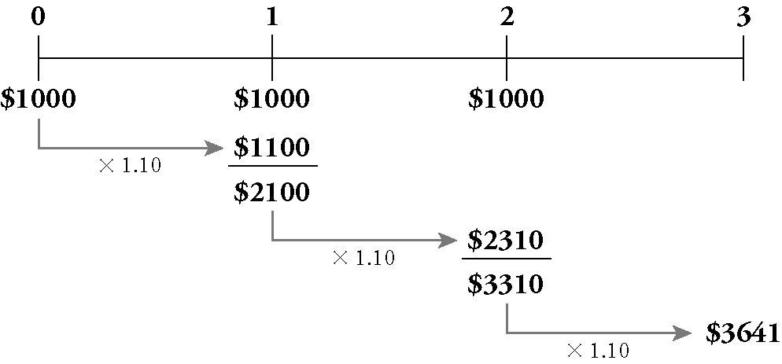
Applying the Rules of Valuing Cash Flows
Suppose we plan to save $1,000 today, and $1,000 at the end of each of the next two years. If we earn a fixed 10% interest rate on our savings, how much will we have three years from today?

Slide 29
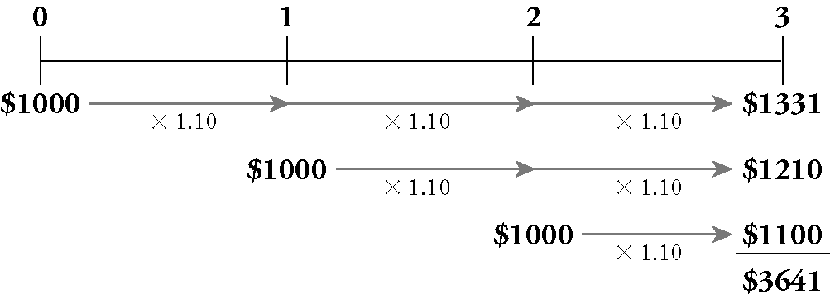
Applying the Rules of Valuing Cash Flows
Another approach to the problem is to compute the future value in year 3 of each cash flow separately. Once all three amounts are in year 3 dollars, we can then combine them.

Slide 30
Example 4.3 Personal Finance Computing the Future Value
Problem:
Let’s revisit the savings plan we considered earlier: We plan to save $1,000 today and at the end of each of the next two years. At a fixed 10% interest rate, how much will we have in the bank three years from today?

Slide 31
Example 4.3 Personal Finance Computing the Future Value
Solution:
Plan:
We’ll start with the timeline for this savings plan:
Let’s solve this problem in a different way than we did in the text, of course still following the rules we established. First we’ll compute the present value of the cash flows. Then we’ll compute its value 3 years later (its future value).

Slide 32
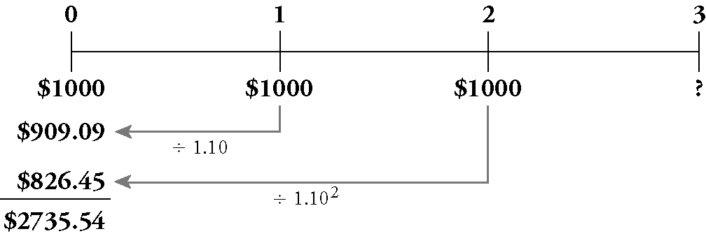
Example 4.3 Personal Finance Computing the Future Value
Execute:
There are several ways to calculate the present value of the cash flows. Here we treat each cash flow separately and then combine the present values.

Slide 33
Example 4.3 Personal Finance Computing the Future Value
Execute (cont’d):
Now let’s compute its future value in year 3:

Slide 34
Example 4.3 Personal Finance Computing the Future Value
Evaluate:
This answer of $3,641 is precisely the same result we found earlier. As long as we apply the three rules of valuing cash flows, we will always get the correct answer.

Slide 35
4.3 Valuing a Stream of Cash Flows
Previous examples were easy to evaluate because available current market values made converting to cash simple. Having costs and benefits in terms of “cash today” is essential.

Slide 36
4.4 The Net Present Value of a Stream of Cash Flows
We can represent any investment decision on a timeline as a cash flow stream where the cash outflows (investments) are negative cash flows and the inflows are positive cash flows. Thus, the NPV of an investment opportunity is also the present value of the stream of cash flows of the opportunity:

Slide 37
Example 4.5 Personal Finance Net Present Value of an Investment Opportunity
Problem:
You have been offered the following investment opportunity: If you invest $1,000 today, you will receive $500 at the end of the next two years, followed by $550 at the end of the third year. If you could otherwise earn 10% per year on your money, should you undertake the investment opportunity?

Slide 38
Example 4.5 Personal Finance Net Present Value of an Investment Opportunity
Solution:
Plan:
As always, start with a timeline. We denote the upfront investment as a negative cash flow (because it is money we need to spend) and the money we receive as a positive cash flow.
To decide whether we should accept this opportunity, we’ll need to compute the NPV by computing the present value of the stream
$550

Slide 39
Example 4.5 Personal Finance Net Present Value of an Investment Opportunity
Execute:
The NPV is:

Slide 40
Example 4.5 Personal Finance Net Present Value of an Investment Opportunity
Evaluate:
Because the NPV is positive, the benefits exceed the costs and we should make the investment. Indeed, the NPV tells us that taking this opportunity is equivalent to getting an extra $280.99 that you can spend today. To illustrate, suppose you borrow $1,000 to invest in the opportunity and an extra $280.99 to spend today. How much would you owe on the $1,280.99 loan in three years?

Slide 41
Example 4.5 Personal Finance Net Present Value of an Investment Opportunity
Evaluate (cont’d):
At 10% interest, the amount you would owe would be:
At the same time, the investment opportunity generates cash flows. If you put these cash flows into a bank account, how much will you have saved three years from now?

Slide 42
Example 4.5 Personal Finance Net Present Value of an Investment Opportunity
Evaluate (cont’d):
The future value of the savings is
As you see, you can use your bank savings to repay the loan. Taking the opportunity therefore allows you to spend $280.99 today at no extra cost.

Slide 43
4.5 Perpetuities, Annuities, and Other Special Cases
In this section we consider two types of cash flow streams:
Perpetuities
Annuities

Slide 44
4.5 Perpetuities, Annuities, and Other Special Cases
Perpetuities
A perpetuity is a stream of equal cash flows that occur at regular intervals and last forever. Here is the timeline for a perpetuity:
the first cash flow does not occur immediately; it arrives at the end of the first period

Slide 45
4.5 Perpetuities, Annuities, and Other Special Cases
Investing $100 in the bank today, you can, in effect, create a perpetuity paying $5 per year:

Slide 46
Present Value of a Perpetuity
(Eq. 4.4)

Slide 47
Example 4.6 Personal Finance Endowing a Perpetuity
Problem:
You want to endow an annual graduation party at your alma mater. You want the event to be a memorable one, so you budget $30,000 per year forever for the party. If the university earns 8% per year on its investments, and if the first party is in one year’s time, how much will you need to donate to endow the party?

Slide 48
Example 4.6 Personal Finance Endowing a Perpetuity
Solution:
Plan:
The timeline of the cash flows you want to provide is:
This is a standard perpetuity of $30,000 per year. The funding you would need to give the university in perpetuity is the present value of this cash flow stream

Slide 49
Example 4.6 Personal Finance Endowing a Perpetuity
Execute:
From the formula for a perpetuity,

Slide 50
Example 4.6 Personal Finance Endowing a Perpetuity
Evaluate:
If you donate $375,000 today, and if the university invests it at 8% per year forever, then the graduates will have $30,000 every year for their graduation party.

Slide 51
4.5 Perpetuities, Annuities, and Other Special Cases
Annuities
An annuity is a stream of N equal cash flows paid at regular intervals.
The difference between an annuity and a perpetuity is that an annuity ends after some fixed number of payments

Slide 52
4.5 Perpetuities, Annuities, and Other Special Cases
With an initial $100 investment at 5% interest, you can create a 20-year annuity of $5 per year, plus you will receive an extra $100 when you close the account at the end of 20 years:

Slide 53
Present Value of a Annuity
(Eq. 4.5)

Slide 54
Example 4.7 Personal Finance Present Value of a Lottery Prize Annuity
Problem:
You are the lucky winner of the $30 million state lottery. You can take your prize money either as (a) 30 payments of $1 million per year (starting today), or (b) $15 million paid today. If the interest rate is 8%, which option should you take?

Slide 55
Example 4.7 Personal Finance Present Value of a Lottery Prize Annuity
Solution:
Plan:
Option (a) provides $30 million in prize money but paid over time. To evaluate it correctly, we must convert it to a present value. Here is the timeline:

Slide 56
Example 4.7 Personal Finance Present Value of a Lottery Prize Annuity
Plan (cont’d):
Because the first payment starts today, the last payment will occur in 29 years (for a total of 30 payments). The $1 million at date 0 is already stated in present value terms, but we need to compute the present value of the remaining payments. Fortunately, this case looks like a 29-year annuity of $1 million per year, so we can use the annuity formula.

Slide 57
Example 4.7 Personal Finance Present Value of a Lottery Prize Annuity
Execute:
From the formula for a annuity,

Slide 58
Example 4.7 Personal Finance Present Value of a Lottery Prize Annuity
Execute (cont’d):
Thus, the total present value of the cash flows is $1 million + $11.16 million = $12.16 million. In timeline form:

Slide 59
Example 4.7 Personal Finance Present Value of a Lottery Prize Annuity
Execute (cont’d):
Financial calculators or Excel can handle annuities easily—just enter the cash flow in the annuity as the PMT:
Given: | 29 | 8.0 |  | 1,000,000 | 0
Solve for: |  |  | -11,158,406
Excel Formula: =PV(RATE,NPER, PMT, FV) = PV(0.08,29,1000000,0)

Slide 60
Example 4.7 Personal Finance Present Value of a Lottery Prize Annuity
Evaluate:
The reason for the difference is the time value of money. If you have the $15 million today, you can use $1 million immediately and invest the remaining $14 million at an 8% interest rate. This strategy will give you $14 million × 8% = $1.12 million per year in perpetuity! Alternatively, you can spend $15 million – $11.16 million = $3.84 million today, and invest the remaining $11.16 million, which will still allow you to withdraw $1 million each year for the next 29 years before your account is depleted.

Slide 61
Future Value of an Annuity
(Eq. 4.6)

Slide 62
Example 4.8 Personal Finance Retirement Savings Plan Annuity
Problem:
Ellen is 35 years old, and she has decided it is time to plan seriously for her retirement. At the end of each year until she is 65, she will save $10,000 in a retirement account. If the account earns 10% per year, how much will Ellen have saved at age 65?

Slide 63
Example 4.8 Personal Finance Retirement Savings Plan Annuity
Solution
Plan:
As always, we begin with a timeline. In this case, it is helpful to keep track of both the dates and Ellen’s age:

Slide 64
Example 4.8 Personal Finance Retirement Savings Plan Annuity
Ellen’s savings plan looks like an annuity of $10,000 per year for 30 years. (Hint: It is easy to become confused when you just look at age, rather than at both dates and age. A common error is to think there are only payments. Writing down both dates and age avoids this problem.) To determine the amount Ellen will have in the bank at age 65, we’ll need to compute the future value of this annuity.

Slide 65
Example 4.8 Personal Finance Retirement Savings Plan Annuity
Execute:
Using Financial calculators or Excel:
Given: | 30 | 10.0 | 0 | -10,000
Solve for: |  |  |  |  | -1,644,940
Excel Formula: =FV(RATE,NPER, PMT, PV) = FV(0.10,30,10000,0)

Slide 66
Example 4.8 Personal Finance Retirement Savings Plan Annuity
Evaluate:
By investing $10,000 per year for 30 years (a total of $300,000) and earning interest on those investments, the compounding will allow her to retire with $1.645 million.

Slide 67
4.5 Perpetuities, Annuities, and Other Special Cases
Growing Cash Flows
A growing perpetuity is a stream of cash flows that occur at regular intervals and grow at a constant rate forever. For example, a growing perpetuity with a first payment of $100 that grows at a rate of 3% has the following timeline:

Slide 68
Present Value of a Growing Perpetuity
(Eq. 4.7)

Slide 69
Example 4.9 Personal Finance Endowing a Growing Perpetuity
Problem:
In Example 4.6, you planned to donate money to your alma mater to fund an annual $30,000 graduation party. Given an interest rate of 8% per year, the required donation was the present value of $375,000. Before accepting the money, however, the student association has asked that you increase the donation to account for the effect of inflation on the cost of the party in future years. Although $30,000 is adequate for next year’s party, the students estimate that the party’s cost will rise by 4% per year thereafter. To satisfy their request, how much do you need to donate now?

Slide 70
Example 4.9 Personal Finance Endowing a Growing Perpetuity
Solution:
Plan:
The cost of the party next year is $30,000, and the cost then increases 4% per year forever. From the timeline, we recognize the form of a growing perpetuity and can value it that way.

Slide 71
Example 4.9 Personal Finance Endowing a Growing Perpetuity
Execute:
To finance the growing cost, you need to provide the present value today of:

Slide 72
Example 4.9 Personal Finance Endowing a Growing Perpetuity
Evaluate:
You need to double the size of your gift!

Slide 73
4.6 Solving for Variables Other Than Present Value or Future Value
In some situations, we use the present and/or future values as inputs, and solve for the variable we are interested in. We examine several special cases in this section.

Slide 74
Loan Payment
(Eq. 4.8)

Slide 75
Example 4.10 Computing a Loan Payment
Problem:
Your firm plans to buy a warehouse for $100,000. The bank offers you a 30-year loan with equal annual payments and an interest rate of 8% per year. The bank requires that your firm pay 20% of the purchase price as a down payment, so you can borrow only $80,000. What is the annual loan payment?

Slide 76
Example 4.10 Computing a Loan Payment
Solution:
Plan:
We start with the timeline (from the bank’s perspective):
Using Eq. 4.8, we can solve for the loan payment, C, given N=30, r = 8% (0.08) and P=$80,000

Slide 77
Example 4.10 Computing a Loan Payment
Execute:
Eq. 4.8 gives the payment (cash flow) as follows:

Slide 78
Example 4.10 Computing a Loan Payment
Execute (cont’d):
Using a financial calculator or Excel:
Given: | 30 | 8.0 | -80,000 |  | 0
Solve for: |  |  |  | 7106.19
Excel Formula: =PMT(RATE,NPER, PV, FV) = PMT(0.08,30,-80000,0)

Slide 79
Example 4.10 Computing a Loan Payment
Evaluate:
Your firm will need to pay $7,106.19 each year to repay the loan. The bank is willing to accept these payments because the PV of 30 annual payments of $7,106.19 at 8% interest rate per year is exactly equal to the $80,000 it is giving you today.

Slide 80
4.6 Solving for Variables Other Than Present Value or Future Value
Internal Rate of Return
The interest rate that equates the present value and cash flows of an investment opportunity is called the internal rate of return (IRR), defined as the interest rate that sets the net present value of the cash flows equal to zero

Slide 81
4.6 Solving for Variables Other Than Present Value or Future Value
Internal Rate of Return
Solving the IRR without a Calculator requires guessing the IRR using the following equation to make the NPV = to zero:

Slide 82
4.6 Solving for Variables Other Than Present Value or Future Value
An easier solution than guessing the IRR and manually calculating values is to use a spreadsheet or calculator to automate the guessing process.

Slide 83
Example 4.11 Personal Finance Computing the Internal Rate of Return with a Financial Calculator
Problem:
Let’s return to the lottery example (Example 4.7). How high of a rate of return do you need to earn investing on your own in order to prefer the $15 million payout?

Slide 84
Example 4.11 Personal Finance Computing the Internal Rate of Return with a Financial Calculator
Solution:
Plan:
We need to solve for the internal rate of return that makes the two offers equivalent. Anything above that rate of return would make the present value of the annuity lower than the $15 million lump sum payment and anything below that rate of return would make it greater than the $15 million.

Slide 85
Example 4.11 Personal Finance Computing the Internal Rate of Return with a Financial Calculator
Execute:
Given: | 29 |  | -14,000,000 | 1,000,000 | 0
Solve for: |  | 5.72
Excel Formula: =RATE(NPER, PMT, PV,FV) = RATE(29,1000000,‑14000000,0)
The IRR equating the two options is 5.72%.

Slide 86
Example 4.11 Personal Finance Computing the Internal Rate of Return with a Financial Calculator
Evaluate:
5.72% is the rate of return that makes giving up the $15 million payment and taking the 30 installments of $1 million exactly a zero NPV action. If you could earn more than 5.72% investing on your own, then you could take the $15 million, invest it and generate thirty installments that are each more than $1 million. If you could not earn at least 5.72% on your investments, you would be unable to replicate the $1 million installments on your own and would be better off taking the installment plan.

Slide 87
4.6 Solving for Variables Other Than Present Value or Future Value
Solving for the Number of Periods
In addition to solving for cash flows or the interest rate, we can solve for the amount of time it will take a sum of money to grow to a known value. In this case, the interest rate, present value, and future value are all known. We need to compute how long it will take for the present value to grow to the future value.

Slide 88
Example 4.12 Personal Finance Solving for the Number of Periods in a Savings Plan
Problem:
Let’s return to your savings for a down payment on a house. Imagine that some time has passed and you have $10,050 saved already, and you can now afford to save $5,000 per year at the end of each year. Also, interest rates have increased so that you now earn 7.25% per year on your savings. How long will it take you to get to your goal of $60,000?

Slide 89
Example 4.12 Personal Finance Solving for the Number of Periods in a Savings Plan
Solution:
Plan:
The timeline for this problem is

Slide 90
Example 4.12 Personal Finance Solving for the Number of Periods in a Savings Plan
Plan (cont’d):
We need to find N so that the future value of our current savings plus the future value of our planned additional savings (which is an annuity) equals our desired amount. There are two contributors to the future value: the initial lump sum $10,050 that will continue to earn interest, and the annuity contributions of $5,000 per year that will earn interest as they are contributed. Thus, we need to find the future value of the lump sum plus the future value of the annuity

Slide 91
Example 4.12 Personal Finance Solving for the Number of Periods in a Savings Plan
Execute:
Given: |  | 7.25 | -10.050 | -5,000 | 60,000
Solve for: | 7
Excel Formula: =NPER(RATE,PMT, PV, FV) = NPER(0.0725,‑5000,‑10050,60000)

Slide 92
Example 4.12 Personal Finance Solving for the Number of Periods in a Savings Plan
Evaluate:
It will take seven years to save the down payment

Slide 93
Chapter Quiz
How can you distinguish cash inflows from outflows on a timeline?
What do you need to know to compute a cash flow’s present or future value?
What benefit does a firm receive when it accepts a project with a positive NPV?
How do you calculate the present value of an annuity?
What is the internal rate of return, and how do you calculate it?

