Slide 1
Chapter 9
Valuing Stocks

Slide 2
Chapter Outline
9.1 The Dividend-Discount Model
9.2 Applying the Dividend-Discount Model
9.3 Total Payout and Free Cash Flow Valuation Models
9.4 Valuation Based on Comparable Firms
9.5 Information, Competition, and Stock Prices

Slide 3
Learning Objectives
Describe, in words, the Law of One Price value for a common stock, including the discount rate that should be used.
Calculate the total return of a stock, given the dividend payment, the current price, and the previous price.

Slide 4
Learning Objectives
Use the dividend-discount model to compute the value of a dividend-paying company’s stock, whether the dividends grow at a constant rate starting now or at some time in the future.
Discuss the determinants of future dividends and growth rate in dividends, and the sensitivity of the stock price to estimates of those two factors.

Slide 5
Learning Objectives (cont'd)
Given the retention rate and the return on new investment, calculate the growth rate in dividends, earnings, and share price.
Describe circumstances in which cutting the firm’s dividend will raise the stock price.

Slide 6
Learning Objectives (cont'd)
Assuming a firm has a long-term constant growth rate after time N + 1, use the constant growth model to calculate the terminal value of the stock at time N.
Compute the stock value of a firm that pays dividends as well as repurchasing shares.

Slide 7
Learning Objectives (cont'd)
Use the discounted free cash flow model to calculate the value of stock in a company with leverage.
Use comparable firm multiples to estimate stock value.
Explain why several valuation models are required to value a stock.
Describe the impact of efficient markets hypothesis on positive-NPV trades by individuals with no inside information.

Slide 8
Learning Objectives (cont'd)
Discuss why investors who identify positive-NPV trades should be skeptical about their findings, unless they have inside information or a competitive advantage. As part of that, describe the return the average investor should expect to get.
Assess the impact of stock valuation on recommended managerial actions.

Slide 9
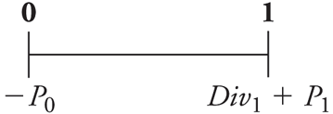
9.1 The Dividend-Discount Model
A One-Year Investor
Potential Cash Flows
Dividend
Sale of Stock
Timeline for One-Year Investor
Since the cash flows are risky, we must discount them at the equity cost of capital.

Slide 10
9.1 The Dividend-Discount Model (cont'd)
A One-Year Investor
If the current stock price were less than this amount, expect investors to rush in and buy it, driving up the stock’s price.
If the stock price exceeded this amount, selling it would cause the stock price to quickly fall.

Slide 11
Dividend Yields, Capital Gains, and Total Returns
Dividend Yield
Capital Gain
Capital Gain Rate
Total Return
Dividend Yield + Capital Gain Rate
The expected total return of the stock should equal the expected return of other investments available in the market with equivalent risk.

Slide 12
Textbook Example 9.1

Slide 13
Textbook Example 9.1 (cont'd)

Slide 14
Alternative Example 9.1
Problem
3M (MMM) just paid a dividend of $4.50 per share.
You expect the stock price will $178.50 and the dividend to be 5% higher by the end of the year.
Investments with equivalent risk have an expected return of 11%.
Based on the Dividend-Discount Model, what would pay today for 3M stock?

Slide 15
Alternative Example 9.1 (cont’d)
Solution
Dividend in one year
$4.50 x 1.05 = $4.725

Slide 16
A Multi-Year Investor
What is the price if we plan on holding the stock for two years?

Slide 17
The Dividend-Discount Model Equation
What is the price if we plan on holding the stock for N years?
This is known as the Dividend-Discount Model.
Note that the above equation (9.4) holds for any horizon N. Thus all investors (with the same beliefs) will attach the same value to the stock, independent of their investment horizons.

Slide 18
The Dividend-Discount Model Equation (cont'd)
The price of any stock is equal to the present value of the expected future dividends it will pay.

Slide 19
9.2 Applying the Discount-Dividend Model
Constant Dividend Growth
The simplest forecast for the firm’s future dividends states that they will grow at a constant rate, g, forever.

Slide 20
9.2 Applying the Discount-Dividend Model (cont'd)
Constant Dividend Growth Model
The value of the firm depends on the current dividend level, the cost of equity, and the growth rate.

Slide 21
Textbook Example 9.2

Slide 22
Textbook Example 9.2 (cont'd)

Slide 23
Alternative Example 9.2
Problem
AT&T plans to pay $1.44 per share in dividends in the coming year.
Its equity cost of capital is 8%.
Dividends are expected to grow by 4% per year in the future.
Estimate the value of AT&T’s stock.

Slide 24
Alternative Example 9.2 (cont’d)

Slide 25
Dividends Versus Investment and Growth
A Simple Model of Growth
Dividend Payout Ratio
The fraction of earnings paid as dividends each year

Slide 26
Dividends Versus Investment and Growth (cont'd)
A Simple Model of Growth
Assuming the number of shares outstanding is constant, the firm can do two things to increase its dividend:
Increase its earnings (net income)
Increase its dividend payout rate

Slide 27
Dividends Versus Investment and Growth (cont'd)
A Simple Model of Growth
A firm can do one of two things with its earnings:
It can pay them out to investors.
It can retain and reinvest them.

Slide 28
Dividends Versus Investment and Growth (cont'd)
A Simple Model of Growth
Retention Rate
Fraction of current earnings that the firm retains

Slide 29
Dividends Versus Investment and Growth (cont'd)
A Simple Model of Growth
If the firm keeps its retention rate constant, then the growth rate in dividends will equal the growth rate of earnings.

Slide 30
Dividends Versus Investment and Growth (cont'd)
Profitable Growth
If a firm wants to increase its share price, should it cut its dividend and invest more, or should it cut investment and increase its dividend?
The answer will depend on the profitability of the firm’s investments.
Cutting the firm’s dividend to increase investment will raise the stock price if, and only if, the new investments have a positive NPV.

Slide 31
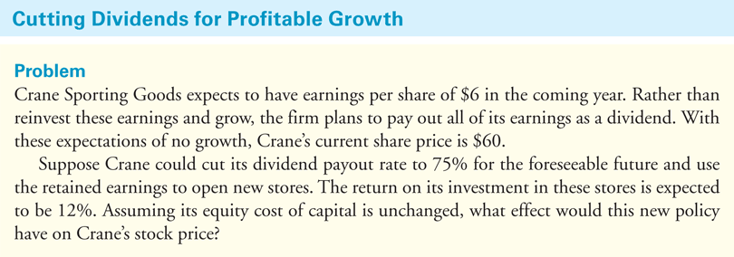
Textbook Example 9.3

Slide 32
Textbook Example 9.3 (cont'd)

Slide 33
Textbook Example 9.4

Slide 34
Textbook Example 9.4 (cont'd)

Slide 35
Alternative Example 9.4
Problem
Dren Industries is considering expanding into a new product line.
Earnings per share are expected to be $5 in the coming year and are expected to grow annually at 5% without the new product line but growth would increase to 7% if the new product line is introduced.
To finance the expansion, Dren would need to cut its dividend payout ratio from 80% to 50%.
If Dren’s equity cost of capital is 11%, what would be the impact on Dren’s stock price if they introduce the new product line? Assume the equity cost of capital will remain unchanged.

Slide 36
Alternative Example 9.4 (cont’d)
Solution
First, calculate the current price for Dren if they do not introduce the new product. To calculate the price, D₁ is needed. To find D₁, EPS₁ is required:
EPS₁ = EPS₀ × (1 + g) = $5.00 × 1.05 = $5.25
D₁ = EPS₁ × Payout Ratio = $5.25 × 0.8 = $4.20
P₀ = D₁/(r_{E} - g) = $4.20/(0.11 - 0.05) = $70.00
Thus, the current price without the new product should be $70 per share.

Slide 37
Alternative Example 9.4 (cont’d)
Solution
Next, calculate the expected current price for Dren if they introduce the new product:
EPS₁ = EPS₀ × (1 + g) = $5.00 × 1.07 = $5.35
D₁ = EPS₁ × Payout Ratio = $5.35 × 0.50 = $2.675
P₀ = D₁/(r_{E} - g) = $2.675/(0.11 - 0.07) = $66.875
Thus, the current price is expected to fall from $70 to $66.875 if the new product line is introduced.

Slide 38
Changing Growth Rates
We cannot use the constant dividend growth model to value a stock if the growth rate is not constant.
For example, young firms often have very high initial earnings growth rates. During this period of high growth, these firms often retain 100% of their earnings to exploit profitable investment opportunities. As they mature, their growth slows. At some point, their earnings exceed their investment needs, and they begin to pay dividends.

Slide 39
Changing Growth Rates (cont'd)
Although we cannot use the constant dividend growth model directly when growth is not constant, we can use the general form of the model to value a firm by applying the constant growth model to calculate the future share price of the stock once the expected growth rate stabilizes.

Slide 40
Changing Growth Rates (cont'd)
Dividend-Discount Model with Constant Long-Term Growth

Slide 41
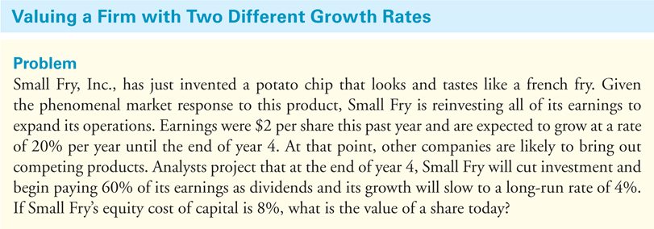
Textbook Example 9.5

Slide 42
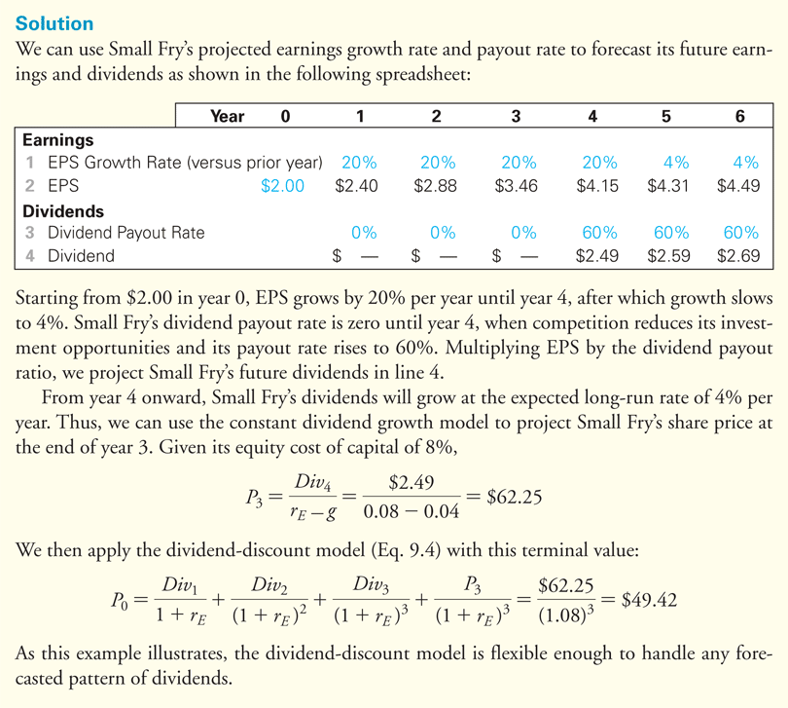
Textbook Example 9.5 (cont'd)

Slide 43
Limitations of the Dividend-Discount Model
There is a tremendous amount of uncertainty associated with forecasting a firm’s dividend growth rate and future dividends.
Small changes in the assumed dividend growth rate can lead to large changes in the estimated stock price.

Slide 44
9.3 Total Payout and Free Cash Flow Valuation Models
Share Repurchases and the Total Payout Model
Share Repurchase
When the firm uses excess cash to buy back its own stock
Implications for the Dividend-Discount Model
The more cash the firm uses to repurchase shares, the less it has available to pay dividends.
By repurchasing, the firm decreases the number of shares outstanding, which increases its earnings and dividends per share.

Slide 45
9.3 Total Payout and Free Cash Flow Valuation Models (cont'd)
Share Repurchases and the Total Payout Model

Slide 46
9.3 Total Payout and Free Cash Flow Valuation Models (cont'd)
Share Repurchases and the Total Payout Model
Total Payout Model
Values all of the firm’s equity, rather than a single share. You discount total dividends and share repurchases and use the growth rate of earnings (rather than earnings per share) when forecasting the growth of the firm’s total payouts.

Slide 47
Textbook Example 9.6

Slide 48
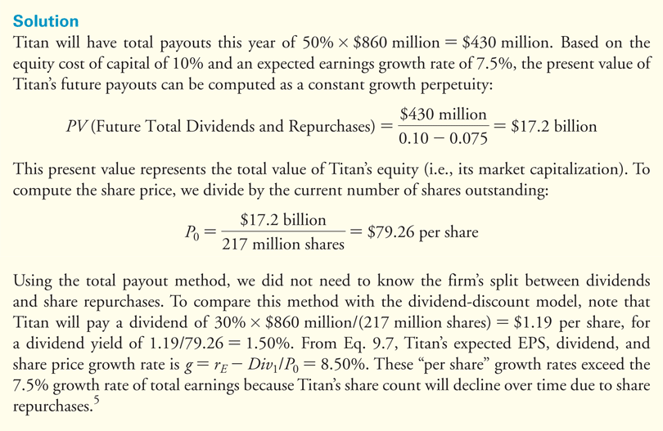
Textbook Example 9.6 (cont'd)

Slide 49
Alternative Example 9.6
Problem
Montalvan Inc. expects to have $125 million in earnings for the year and earnings are expected to grow at 6% annually.
The firm does not pay any dividends, but it intends to use 25% of its earnings for stock repurchases.
Motalvan’s cost of equity is 15%, and it has 25 million shares outstanding.
What is Montalvan’s stock price?

Slide 50
Alternative Example 9.6 (cont’d)
Solution
Amount dedicated to stock repurchases
25% x $125 million = $31.25 million

Slide 51
The Discounted Free Cash Flow Model
Discounted Free Cash Flow Model
Determines the value of the firm to all investors, including both equity and debt holders
The enterprise value can be interpreted as the net cost of acquiring the firm’s equity, taking its cash, paying off all debt, and owning the unlevered business.

Slide 52
The Discounted Free Cash Flow Model (cont'd)
Valuing the Enterprise
Free Cash Flow
Cash flow available to pay both debt holders and equity holders
Discounted Free Cash Flow Model

Slide 53
The Discounted Free Cash Flow Model (cont'd)
Implementing the Model
Since we are discounting cash flows to both equity holders and debt holders, the free cash flows should be discounted at the firm’s weighted average cost of capital, r_{wacc}. If the firm has no debt, r_{wacc} = r_{E}.

Slide 54
The Discounted Free Cash Flow Model (cont'd)
Implementing the Model
Often, the terminal value is estimated by assuming a constant long-run growth rate g_{FCF} for free cash flows beyond year N, so that

Slide 55
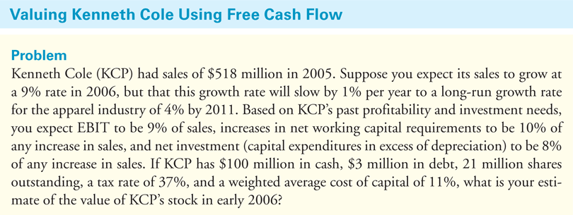
Textbook Example 9.7

Slide 56
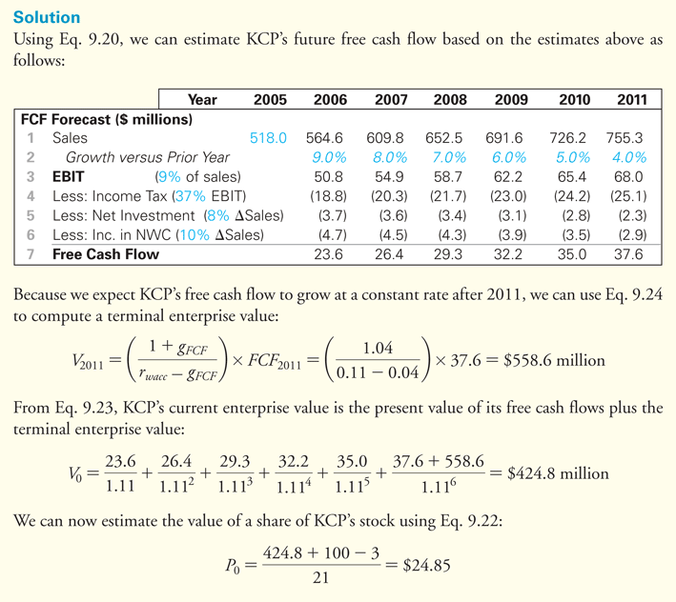
Textbook Example 9.7 (cont'd)

Slide 57
Alternative Example 9.7
Problem
At the end of 2016, Newerks Inc. forecasts that its free cash flow will be $50 million in 2017, $60 million in 2018, and $72 million in 2019.
After 2019, Newerks expects its free cash flow earnings to grow at an annual rate of 6%.
Newerks has $75 million in debt and $25 million in cash.
If Newerks has 5 million shares outstanding and a cost of capital of 14%, what is Newerks stock price at the end of 2016?

Slide 58
Alternative Example 9.7 (cont’d)
Solution
The terminal enterprise value at the end of 2019 is calculated as

Slide 59
Alternative Example 9.7 (cont’d)
Solution
The present value of its free cash flows plus the terminal enterprise value is calculated as

Slide 60
The Discounted Free Cash Flow Model (cont'd)
Connection to Capital Budgeting
The firm’s free cash flow is equal to the sum of the free cash flows from the firm’s current and future investments, so we can interpret the firm’s enterprise value as the total NPV that the firm will earn from continuing its existing projects and initiating new ones.
The NPV of any individual project represents its contribution to the firm’s enterprise value. To maximize the firm’s share price, we should accept projects that have a positive NPV.

Slide 61
Textbook Example 9.8

Slide 62
Textbook Example 9.8 (cont'd)

Slide 63
Figure 9.1 A Comparison of Discounted Cash Flow Models of Stock Valuation

Slide 64
9.4 Valuation Based on Comparable Firms
Method of Comparables (Comps)
Estimate the value of the firm based on the value of other, comparable firms or investments that we expect will generate very similar cash flows in the future.

Slide 65
Valuation Multiples
Valuation Multiple
A ratio of firm’s value to some measure of the firm’s scale or cash flow
The Price-Earnings Ratio
P/E Ratio
Share price divided by earnings per share

Slide 66
Valuation Multiples (cont'd)
Trailing Earnings
Earnings over the last 12 months
Trailing P/E
Forward Earnings
Expected earnings over the next 12 months
Forward P/E

Slide 67
Valuation Multiples (cont'd)
Firms with high growth rates, and which generate cash well in excess of their investment needs so that they can maintain high payout rates, should have high P/E multiples.

Slide 68
Textbook Example 9.9

Slide 69
Textbook Example 9.9 (cont'd)

Slide 70
Alternative Example 9.9
Problem
Best Buy Co. Inc. (BBY) has earnings per share of $2.22.
The average P/E of comparable companies’ stocks is 19.7.
Estimate a value for Best Buy using the P/E as a valuation multiple.
Notes:
70

Slide 71
Alternative Example 9.9 (cont’d)
Solution
The share price for Best Buy is estimated by multiplying its earnings per share by the P/E of comparable firms.
P₀ = $2.22 × 19.7 = $43.73
Notes:
71

Slide 72
Valuation Multiples (cont'd)
Enterprise Value Multiples
This valuation multiple is higher for firms with high growth rates and low capital requirements (so that free cash flow is high in proportion to EBITDA).

Slide 73
Textbook Example 9.10

Slide 74
Textbook Example 9.10 (cont'd)

Slide 75
Alternative Example 9.10
Problem
Best Buy Co. Inc. (BBY) has EBITDA of $2,766,000,000 and 410 million shares outstanding.
Best Buy also has $1,963,000,000 in debt and $509,000,000 in cash.
If Best Buy has an enterprise value to EBITDA multiple of 7.7, estimate the value for a share of Best Buy stock.

Slide 76
Alternative Example 9.10 (cont’d)
Solution
Using the enterprise value to EBITDA multiple, Best Buy’s enterprise value is $2,766 million × 7.7 = $21,298.20 million.
Subtract out the debt, add the cash, and divide by the number of shares to estimate the Best Buy’s share price.

Slide 77
Valuation Multiples (cont'd)
Other Multiples
Multiple of sales
Price to book value of equity per share
Enterprise value per subscriber
Used in cable TV industry

Slide 78
Limitations of Multiples
When valuing a firm using multiples, there is no clear guidance about how to adjust for differences in expected future growth rates, risk, or differences in accounting policies.
Comparables only provide information regarding the value of a firm relative to other firms in the comparison set.
Using multiples will not help us determine if an entire industry is overvalued,

Slide 79
Comparison with Discounted Cash Flow Methods
Discounted cash flows methods have the advantage that they can incorporate specific information about the firm’s cost of capital or future growth.
The discounted cash flow methods have the potential to be more accurate than the use of a valuation multiple.

Slide 80
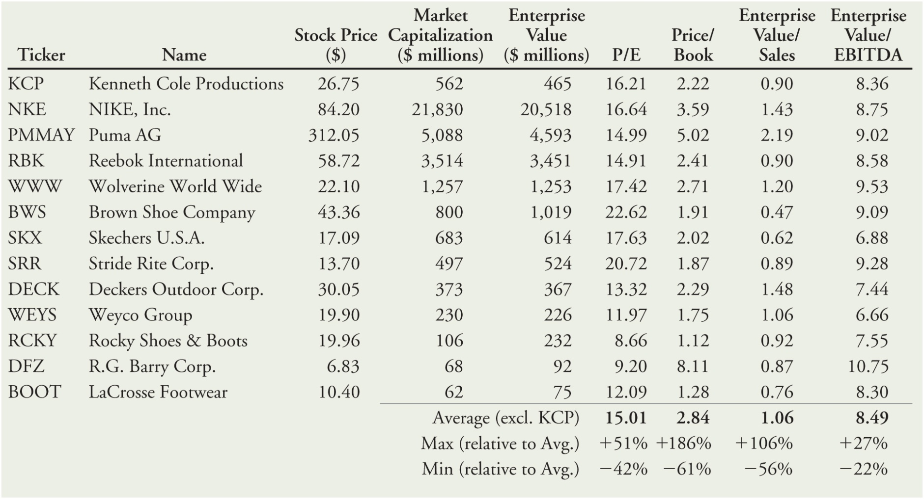
Table 9.1 Stock Prices and Multiples for the Footwear Industry, January 2006

Slide 81
Stock Valuation Techniques: The Final Word
No single technique provides a final answer regarding a stock’s true value. All approaches require assumptions or forecasts that are too uncertain to provide a definitive assessment of the firm’s value.
Most real-world practitioners use a combination of these approaches and gain confidence if the results are consistent across a variety of methods.

Slide 82
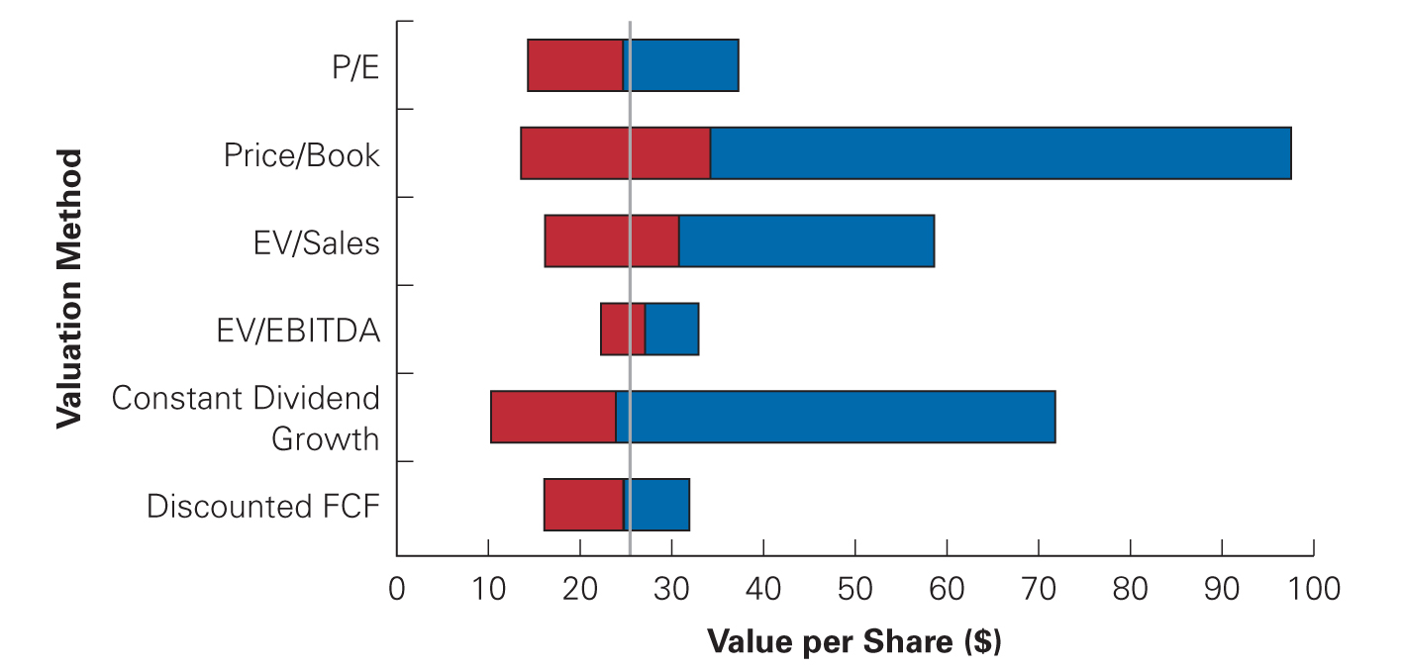
Figure 9.2 Range of Valuations for KCP Stock Using Alternative Valuation Methods

Slide 83
9.5 Information, Competition, and Stock Prices
Information in Stock Prices
Our valuation model links the firm’s future cash flows, its cost of capital, and its share price. Given accurate information about any two of these variables, a valuation model allows us to make inferences about the third variable.

Slide 84
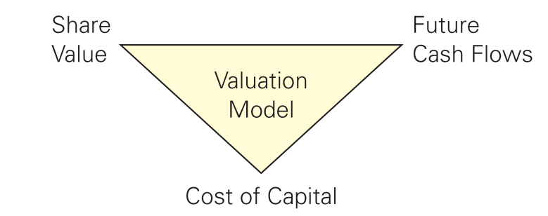
Figure 9.3 The Valuation Triad

Slide 85
9.5 Information, Competition, and Stock Prices (cont'd)
Information in Stock Prices
For a publicly traded firm, its current stock price should already provide very accurate information, aggregated from a multitude of investors, regarding the true value of its shares.
Based on its current stock price, a valuation model will tell us something about the firm’s future cash flows or cost of capital.

Slide 86
Textbook Example 9.11

Slide 87
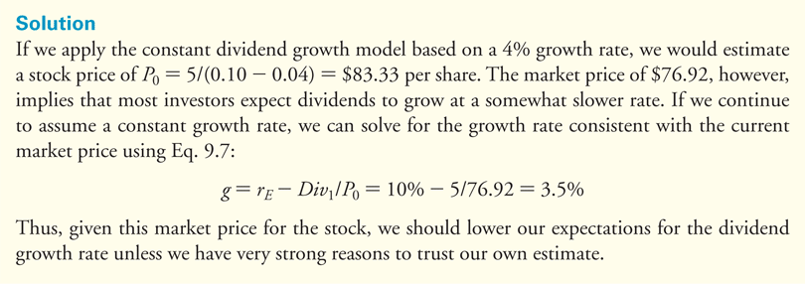
Textbook Example 9.11 (cont'd)

Slide 88
Alternative Example 9.11
Problem
FitOne Company plans to pay a dividend this year of $3.50 per share.
Its equity cost of capital is 12%, and you expect its dividends to grow at a rate of about 3% per year, though you are somewhat unsure of the precise growth rate.
If FitOne’s stock is currently trading for $45.00 per share, how would you update your beliefs about its dividend growth rate?

Slide 89
Alternative Example 9.11 (cont’d)
Solution
Applying the constant dividend growth model based on a 3% growth rate, we would estimate a stock price of P₀ = $3.50/(0.12 - 0.03) = $38.89 per share.
The market price of $45.00, however, implies that most investors expect dividends to grow at a somewhat faster rate.

Slide 90
Alternative Example 9.11 (cont’d)
Solution
If we continue to assume a constant growth rate, we can solve for the growth rate consistent with the current market price using Eq. 9.7:

Slide 91
Competition and Efficient Markets
Efficient Markets Hypothesis
Implies that securities will be fairly priced, based on their future cash flows, given all information that is available to investors.

Slide 92
Competition and Efficient Markets (cont'd)
Public, Easily Interpretable Information
If the impact of information that is available to all investors (news reports, financials statements, etc.) on the firm’s future cash flows can be readily ascertained, then all investors can determine the effect of this information on the firm’s value.
In this situation, we expect the stock price to react nearly instantaneously to such news.

Slide 93
Textbook Example 9.12

Slide 94
Textbook Example 9.12 (cont'd)

Slide 95
Competition and Efficient Markets (cont'd)
Private or Difficult-to-Interpret Information
Private information will be held by a relatively small number of investors. These investors may be able to profit by trading on their information.
In this case, the efficient markets hypothesis will not hold in the strict sense. However, as these informed traders begin to trade, they will tend to move prices, so over time prices will begin to reflect their information as well.

Slide 96
Competition and Efficient Markets (cont'd)
Private or Difficult-to-Interpret Information
If the profit opportunities from having private information are large, others will devote the resources needed to acquire it.
In the long run, we should expect that the degree of “inefficiency” in the market will be limited by the costs of obtaining the private information.

Slide 97
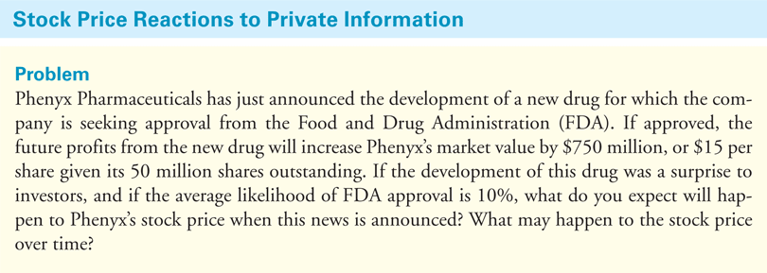
Textbook Example 9.13

Slide 98
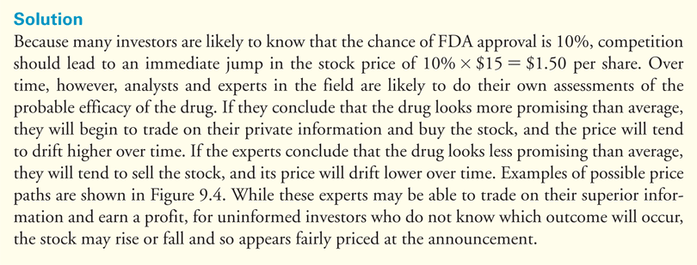
Textbook Example 9.13 (cont'd)

Slide 99
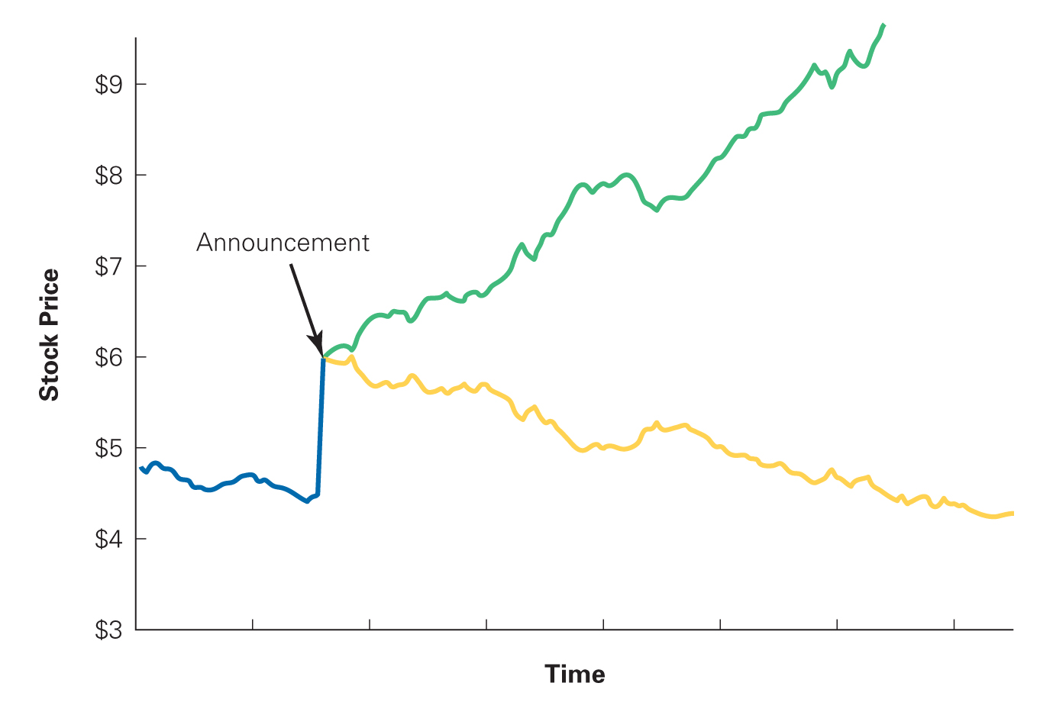
Figure 9.4 Possible Stock Price Paths for Example 9.13

Slide 100
Lessons for Investors and Corporate Managers
Consequences for Investors
If stocks are fairly priced, then investors who buy stocks can expect to receive future cash flows that fairly compensate them for the risk of their investment.
In such cases, the average investor can invest with confidence, even if he is not fully informed.

Slide 101
Lessons for Investors and Corporate Managers (cont'd)
Implications for Corporate Managers
Focus on NPV and free cash flow
Avoid accounting illusions
Use financial transactions to support investment

Slide 102
The Efficient Markets Hypothesis Versus No Arbitrage
The efficient markets hypothesis states that securities with equivalent risk should have the same expected return.
An arbitrage opportunity is a situation in which two securities with identical cash flows have different prices.

Slide 103
Discussion of Data Case Key Topic
How do the assumptions regarding the cost of equity, cost of debt, and expected return on investments impact your decision?
How sensitive are your estimates for GE’s stock price and enterprise value to these assumptions?

Slide 104
Chapter Quiz
What discount rate do you use to discount the future cash flows of a stock?
Does an investor’s expected holding period affect the amount they would be willing to pay for a stock?
How can a firm increase its future dividend per share?
What is the enterprise value of a firm?
What are the implicit assumptions made when valuing a firm using multiples?

Slide 105
Chapter Quiz
What is the efficient market hypothesis? What are its implications for corporate managers?

