Slide 1
Chapter 6
Valuing Bonds

Slide 2
Chapter Outline
6.1 Bond Cash Flows, Prices, and Yields
6.2 Dynamic Behavior of Bond Prices
6.3 The Yield Curve and Bond Arbitrage
6.4 Corporate Bonds
6.5 Sovereign Bonds

Slide 3
Learning Objectives
Identify the cash flows for both coupon bonds and zero-coupon bonds, and calculate the value for each type of bond.
Calculate the yield to maturity for both coupon and zero-coupon bonds, and interpret its meaning for each.

Slide 4
Learning Objectives
Given coupon rate and yield to maturity, determine whether a coupon bond will sell at a premium or a discount; describe the time path the bond’s price will follow as it approaches maturity, assuming prevailing interest rates remain the same over the life of the bond.

Slide 5
Learning Objectives
Illustrate the change in bond price that will occur as a result of changes in interest rates; differentiate between the effect of such a change on long-term versus short-term bonds.
Discuss the effect of coupon rate to the sensitivity of a bond price to changes in interest rates.
Define duration, and discuss its use by finance practitioners.

Slide 6
Learning Objectives
Calculate the price of a coupon bond using the Law of One Price and a series of zero-coupon bonds.
Discuss the relation between a corporate bond’s expected return and the yield to maturity; define default risk and explain how these rates incorporate default risk.
Assess the creditworthiness of a corporate bond using its bond rating; define default risk.

Slide 7
6.1 Bond Cash Flows, Prices, and Yields
Bond Terminology
Bond Certificate
States the terms of the bond
Maturity Date
Final repayment date
Term
The time remaining until the repayment date
Coupon
Promised interest payments

Slide 8
6.1 Bond Cash Flows, Prices, and Yields (cont'd)
Bond Terminology
Face Value
Notional amount used to compute the interest payments
Coupon Rate
Determines the amount of each coupon payment, expressed as an APR
Coupon Payment

Slide 9
Zero-Coupon Bonds
Zero-Coupon Bond
Does not make coupon payments
Always sells at a discount (a price lower than face value), so they are also called pure discount bonds
Treasury Bills are U.S. government zero-coupon bonds with a maturity of up to one year.

Slide 10
Zero-Coupon Bonds (cont'd)
Suppose that a one-year, risk-free, zero-coupon bond with a $100,000 face value has an initial price of $96,618.36. The cash flows would be
Although the bond pays no “interest,” your compensation is the difference between the initial price and the face value.

Slide 11
Zero-Coupon Bonds (cont'd)
Yield to Maturity
The discount rate that sets the present value of the promised bond payments equal to the current market price of the bond.
Price of a Zero-Coupon bond

Slide 12
Zero-Coupon Bonds (cont'd)
Yield to Maturity
For the one-year zero coupon bond:
Thus, the YTM is 3.5%.

Slide 13
Zero-Coupon Bonds (cont'd)
Yield to Maturity
Yield to Maturity of an n-Year Zero-Coupon Bond

Slide 14
Textbook Example 6.1

Slide 15
Textbook Example 6.1 (cont'd)

Slide 16
Alternative Example 6.1
Problem
Suppose that the following zero-coupon bonds are selling at the prices shown below per $100 face value. Determine the corresponding yield to maturity for each bond.
Maturity | 1 year | 2 years | 3 years | 4 years
Price | $98.04 | $95.18 | $91.51 | $87.14

Slide 17
Alternative Example 6.1 (cont'd)
Solution

Slide 18
Zero-Coupon Bonds (cont'd)
Risk-Free Interest Rates
A default-free zero-coupon bond that matures on date n provides a risk-free return over the same period. Thus, the Law of One Price guarantees that the risk-free interest rate equals the yield to maturity on such a bond.
Risk-Free Interest Rate with Maturity n

Slide 19
Zero-Coupon Bonds (cont'd)
Risk-Free Interest Rates
Spot Interest Rate
Another term for a default-free, zero-coupon yield
Zero-Coupon Yield Curve
A plot of the yield of risk-free zero-coupon bonds as a function of the bond’s maturity date

Slide 20
Coupon Bonds
Coupon Bonds
Pay face value at maturity
Pay regular coupon interest payments
Treasury Notes
U.S. Treasury coupon security with original maturities of 1–10 years
Treasury Bonds
U.S. Treasury coupon security with original maturities over 10 years

Slide 21
Textbook Example 6.2

Slide 22
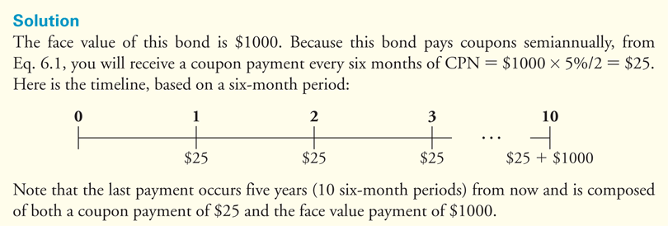
Textbook Example 6.2 (cont'd)

Slide 23
Alternative Example 6.2
Problem
Suppose that Proctor & Gamble has just issued a 10-year, $1000 bond with a 4% coupon and semi-annual coupon payments. What cash flows will you receive if you hold the bond until maturity?

Slide 24
Alternative Example 6.2 (cont'd)
Solution:
Here is the timeline, based on a six-month period:
Note that the last payment is composed of both a coupon payment of $20 and the face value payment of $1000.

Slide 25
Coupon Bonds (cont'd)
Yield to Maturity
The YTM is the single discount rate that equates the present value of the bond’s remaining cash flows to its current price.
Yield to Maturity of a Coupon Bond

Slide 26
Textbook Example 6.3

Slide 27
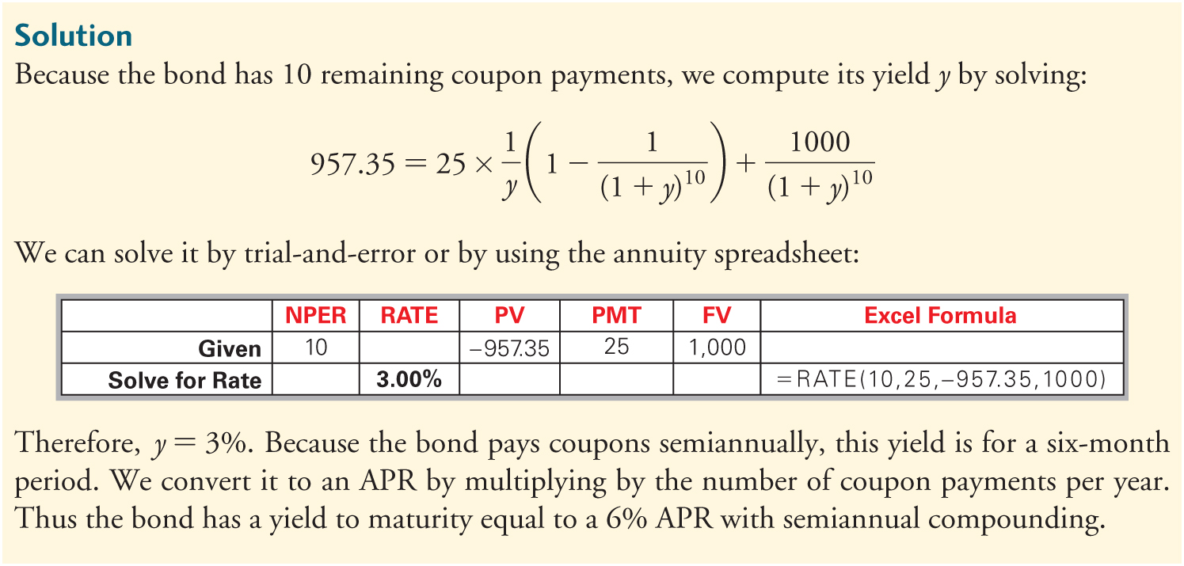
Textbook Example 6.3 (cont'd)

Slide 28
Financial Calculator Solution
Since the bond pays interest semi-annually, the calculator should be set to 2 periods per year.

Slide 29
Alternative Example 6.3
Problem
Consider the following semi-annual bond:
$1000 par value
7 years until maturity
9% coupon rate
Price is $1,080.55
What is the bond’s yield to maturity?
Notes:
29

Slide 30
Alternative Example 6.3
Solution
N = 7 years × 2 = 14
PMT = (9% × $1000) ÷ 2 = $45
Notes:
30

Slide 31
Textbook Example 6.4

Slide 32
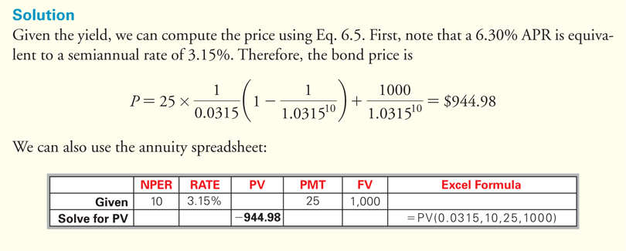
Textbook Example 6.4 (cont'd)

Slide 33
Financial Calculator Solution
Since the bond pays interest semi-annually, the calculator should be set to 2 periods per year.

Slide 34
Alternative Example 6.4
Problem
Consider the bond in the previous example.
Suppose its yield to maturity has increased to 10%
What is the bond’s new price?
Notes:
34

Slide 35
Alternative Example 6.4
Solution
N = 7 years × 2 = 14
PMT = (9% × $1000) ÷ 2 = $45
Notes:
35

Slide 36
6.2 Dynamic Behavior of Bond Prices
Discount
A bond is selling at a discount if the price is less than the face value.
Par
A bond is selling at par if the price is equal to the face value.
Premium
A bond is selling at a premium if the price is greater than the face value.

Slide 37
Discounts and Premiums
If a coupon bond trades at a discount, an investor will earn a return both from receiving the coupons and from receiving a face value that exceeds the price paid for the bond.
If a bond trades at a discount, its yield to maturity will exceed its coupon rate.

Slide 38
Discounts and Premiums (cont'd)
If a coupon bond trades at a premium, it will earn a return from receiving the coupons, but this return will be diminished by receiving a face value less than the price paid for the bond.
Most coupon bonds have a coupon rate so that the bonds will initially trade at, or very close to, par.

Slide 39
Discounts and Premiums (cont'd)
Table 6.1 Bond Prices Immediately After a Coupon Payment

Slide 40
Textbook Example 6.5

Slide 41
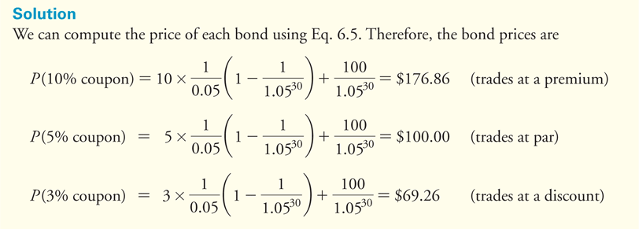
Textbook Example 6.5 (cont'd)

Slide 42
Financial Calculator Solution

Slide 43
Financial Calculator Solution (cont'd)

Slide 44
Financial Calculator Solution (cont'd)

Slide 45
Alternative Example 6.5
Problem
Suppose that Proctor & Gamble issued a bond that has seven years remaining until maturity, a $1000 face value, and a 4% coupon rate with annual coupon payments. If the current market interest rate is 3%, what is bond’s premium or discount? What if the current market rate is 6%?

Slide 46
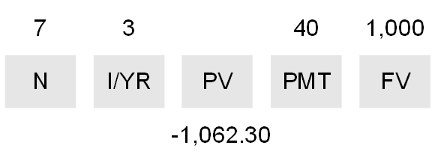
Alternative Example 6.5 (cont'd)
Solution:
At a market rate of 3%, the price of the bond will be
So the premium is $1062.30 - $1000 = $62.30.

Slide 47
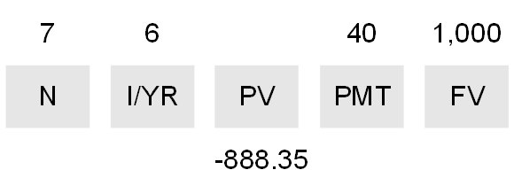
Alternative Example 6.5 (cont'd)
Solution:
At a market rate of 6%, the price of the bond will be
So the discount is $1000 – $888.35 = $111.65.

Slide 48
Time and Bond Prices
Holding all other things constant, a bond’s yield to maturity will not change over time.
Holding all other things constant, the price of discount or premium bond will move toward par value over time.
If a bond’s yield to maturity has not changed, then the IRR of an investment in the bond equals its yield to maturity even if you sell the bond early.

Slide 49
Textbook Example 6.6

Slide 50
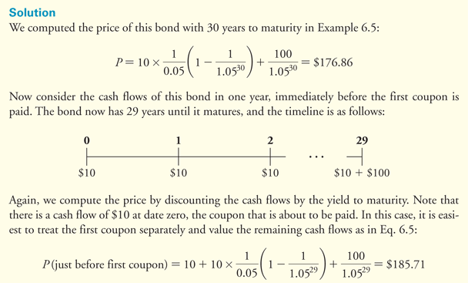
Textbook Example 6.6 (cont'd)

Slide 51
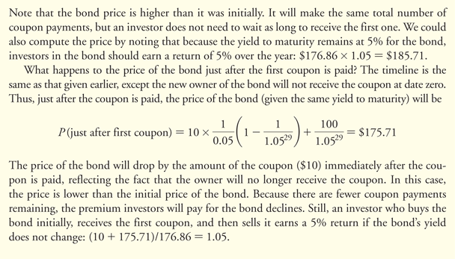
Textbook Example 6.6 (cont'd)

Slide 52
Financial Calculator Solution
Initial Price

Slide 53
Financial Calculator Solution (cont'd)
Price just after first coupon
Price just before first coupon
$175.71 + $10 = $185.71

Slide 54
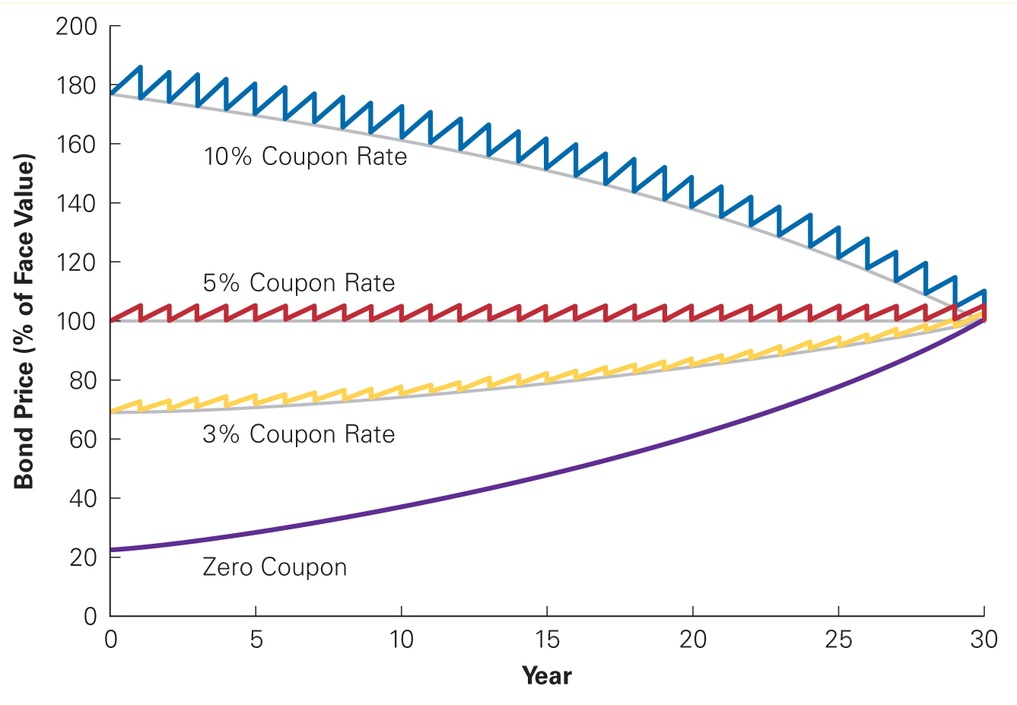
Figure 6.1 The Effect of Time on Bond Prices

Slide 55
Interest Rate Changes and Bond Prices
There is an inverse relationship between interest rates and bond prices.
As interest rates and bond yields rise, bond prices fall.
As interest rates and bond yields fall, bond prices rise.

Slide 56
Interest Rate Changes and Bond Prices (cont'd)
The sensitivity of a bond’s price to changes in interest rates is measured by the bond’s duration.
Bonds with high durations are highly sensitive to interest rate changes.
Bonds with low durations are less sensitive to interest rate changes.

Slide 57
Textbook Example 6.7

Slide 58
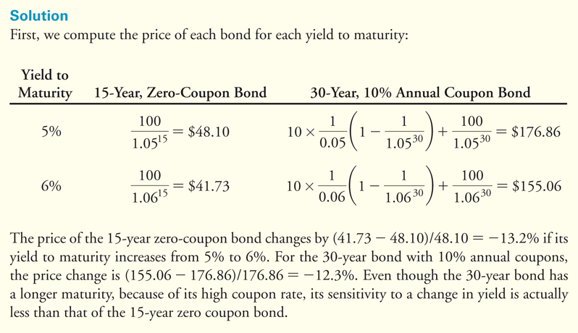
Textbook Example 6.7 (cont'd)

Slide 59
Alternative Example 6.7
Problem
The University of Pennsylvania sold $300 million of 100-year bonds with a yield to maturity of 4.67%. Assuming the bonds were sold at par and pay an annual coupon, by what percentage will the price of the bond change if its yield to maturity decreases by 1%? Increases by 2%?
Notes:
59

Slide 60
Alternative Example 6.7
Solution
Yield decreases by 1%
Price increases by 26.5%
$1,265.03/$1,000 – 1 = 0.265
Notes:
60

Slide 61
Alternative Example 6.7
Solution
Yield increases by 2%
Price decreases by 29.9%
$700.62/$1,000 – 1 = -0.299
Notes:
61

Slide 62
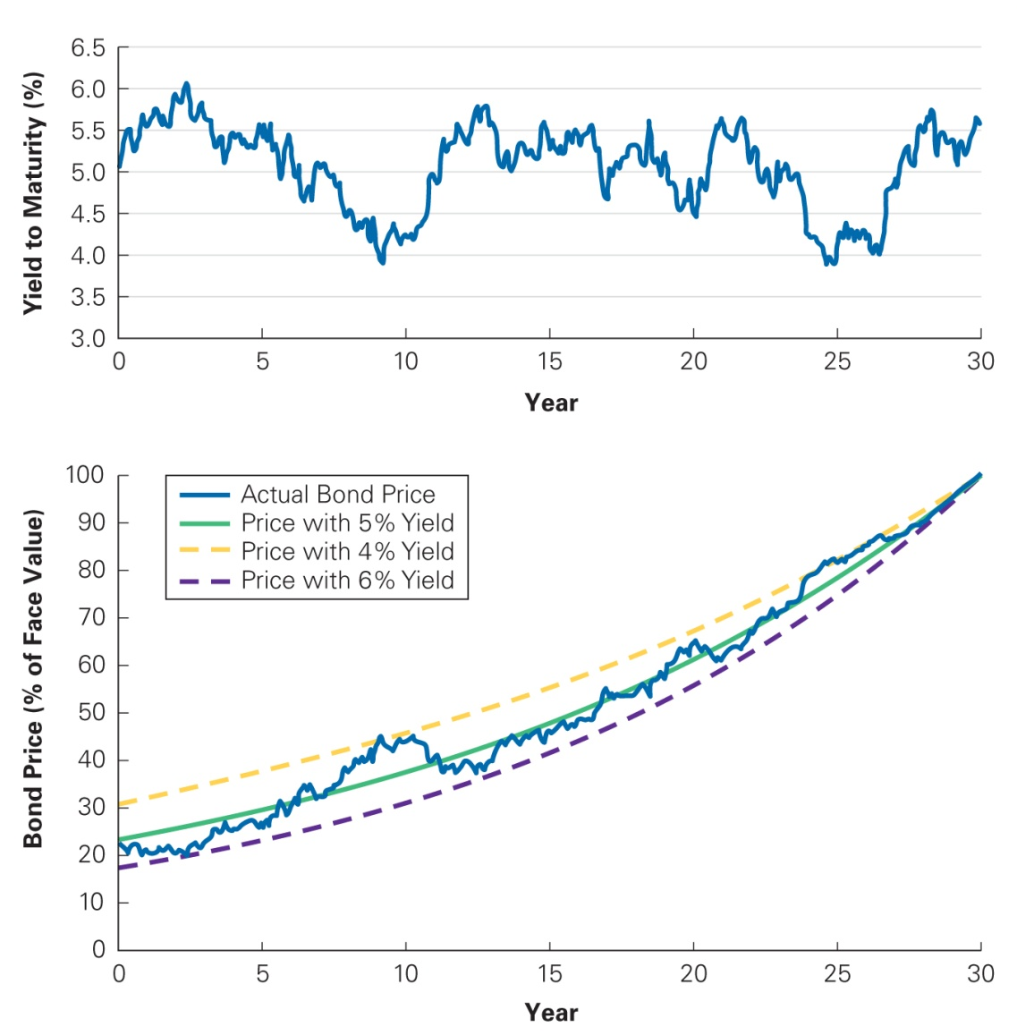
Figure 6.2 Yield to Maturity and Bond Price Fluctuations Over Time

Slide 63
6.3 The Yield Curve and Bond Arbitrage
Using the Law of One Price and the yields of default-free zero-coupon bonds, one can determine the price and yield of any other default-free bond.
The yield curve provides sufficient information to evaluate all such bonds.

Slide 64
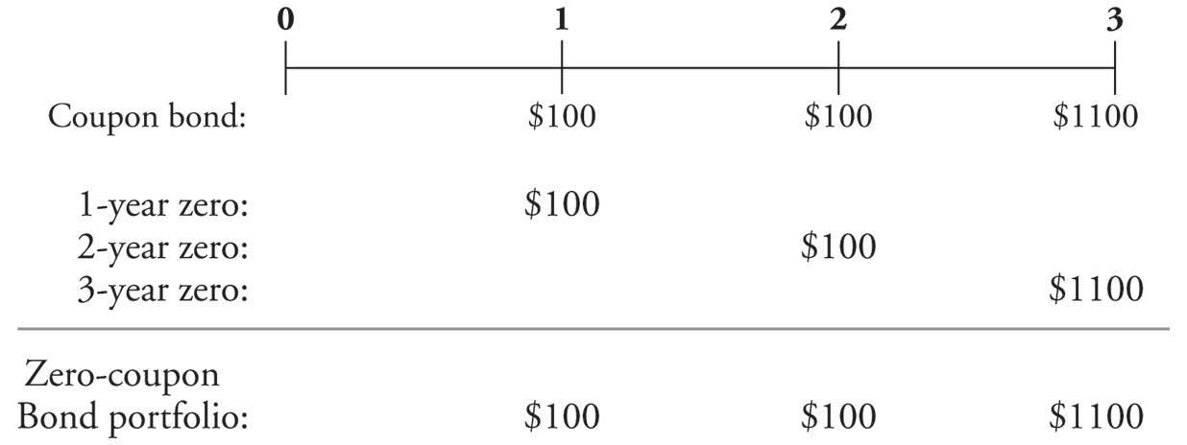
Replicating a Coupon Bond
Replicating a three-year $1000 bond that pays 10% annual coupon using three zero-coupon bonds:

Slide 65
Replicating a Coupon Bond (cont'd)
Yields and Prices (per $100 Face Value) for Zero Coupon Bonds
Table 6.2 Yields and Prices (per $100 Face Value) for Zero-Coupon Bonds

Slide 66
Replicating a Coupon Bond (cont'd)
By the Law of One Price, the three-year coupon bond must trade for a price of $1153.

Slide 67
Valuing a Coupon Bond Using Zero-Coupon Yields
The price of a coupon bond must equal the present value of its coupon payments and face value.
Price of a Coupon Bond

Slide 68
Coupon Bond Yields
Given the yields for zero-coupon bonds, we can price a coupon bond.

Slide 69
Financial Calculator Solution

Slide 70
Textbook Example 6.8

Slide 71
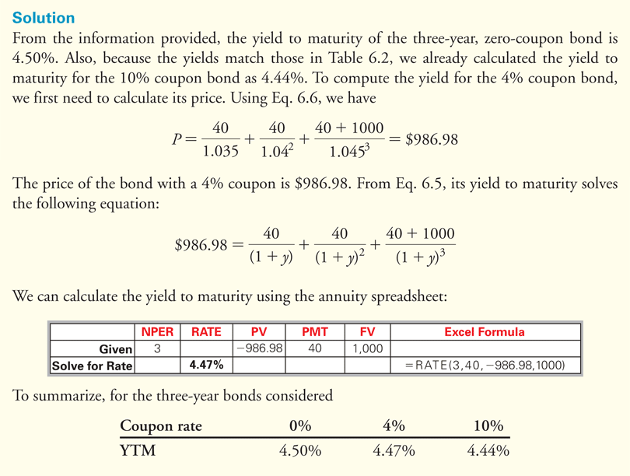
Textbook Example 6.8 (cont'd)

Slide 72
Financial Calculator Solution

Slide 73
Treasury Yield Curves
Treasury Coupon-Paying Yield Curve
Often referred to as “the yield curve”
On-the-Run Bonds
Most recently issued bonds
The yield curve is often a plot of the yields on these bonds.

Slide 74
6.4 Corporate Bonds
Corporate Bonds
Issued by corporations
Credit Risk
Risk of default

Slide 75
Corporate Bond Yields
Investors pay less for bonds with credit risk than they would for an otherwise identical default-free bond.
The yield of bonds with credit risk will be higher than that of otherwise identical default-free bonds.

Slide 76
Corporate Bond Yields (cont'd)
No Default
Consider a 1-year, zero coupon Treasury Bill with a YTM of 4%.
What is the price?

Slide 77
Corporate Bond Yields (cont'd)
Certain Default
Suppose now bond issuer will pay 90% of the obligation.
What is the price?

Slide 78
Corporate Bond Yields (cont'd)
Certain Default
When computing the yield to maturity for a bond with certain default, the promised rather than the actual cash flows are used.

Slide 79
Corporate Bond Yields (cont'd)
Certain Default
The yield to maturity of a certain default bond is not equal to the expected return of investing in the bond. The yield to maturity will always be higher than the expected return of investing in the bond.

Slide 80
Corporate Bond Yields (cont'd)
Risk of Default
Consider a one-year, $1000, zero-coupon bond issued. Assume that the bond payoffs are uncertain.
There is a 50% chance that the bond will repay its face value in full and a 50% chance that the bond will default and you will receive $900. Thus, you would expect to receive $950.
Because of the uncertainty, the discount rate is 5.1%.

Slide 81
Corporate Bond Yields (cont'd)
Risk of Default
The price of the bond will be
The yield to maturity will be

Slide 82
Corporate Bond Yields (cont'd)
Risk of Default
A bond’s expected return will be less than the yield to maturity if there is a risk of default.
A higher yield to maturity does not necessarily imply that a bond’s expected return is higher.

Slide 83
Corporate Bond Yields (cont'd)
Table 6.3 Price, Expected Return, and Yield to Maturity of a One-Year, Zero-Coupon Avant Bond with Different Likelihoods of Default

Slide 84
Bond Ratings
Investment Grade Bonds
Speculative Bonds
Also known as Junk Bonds or High-Yield Bonds

Slide 85
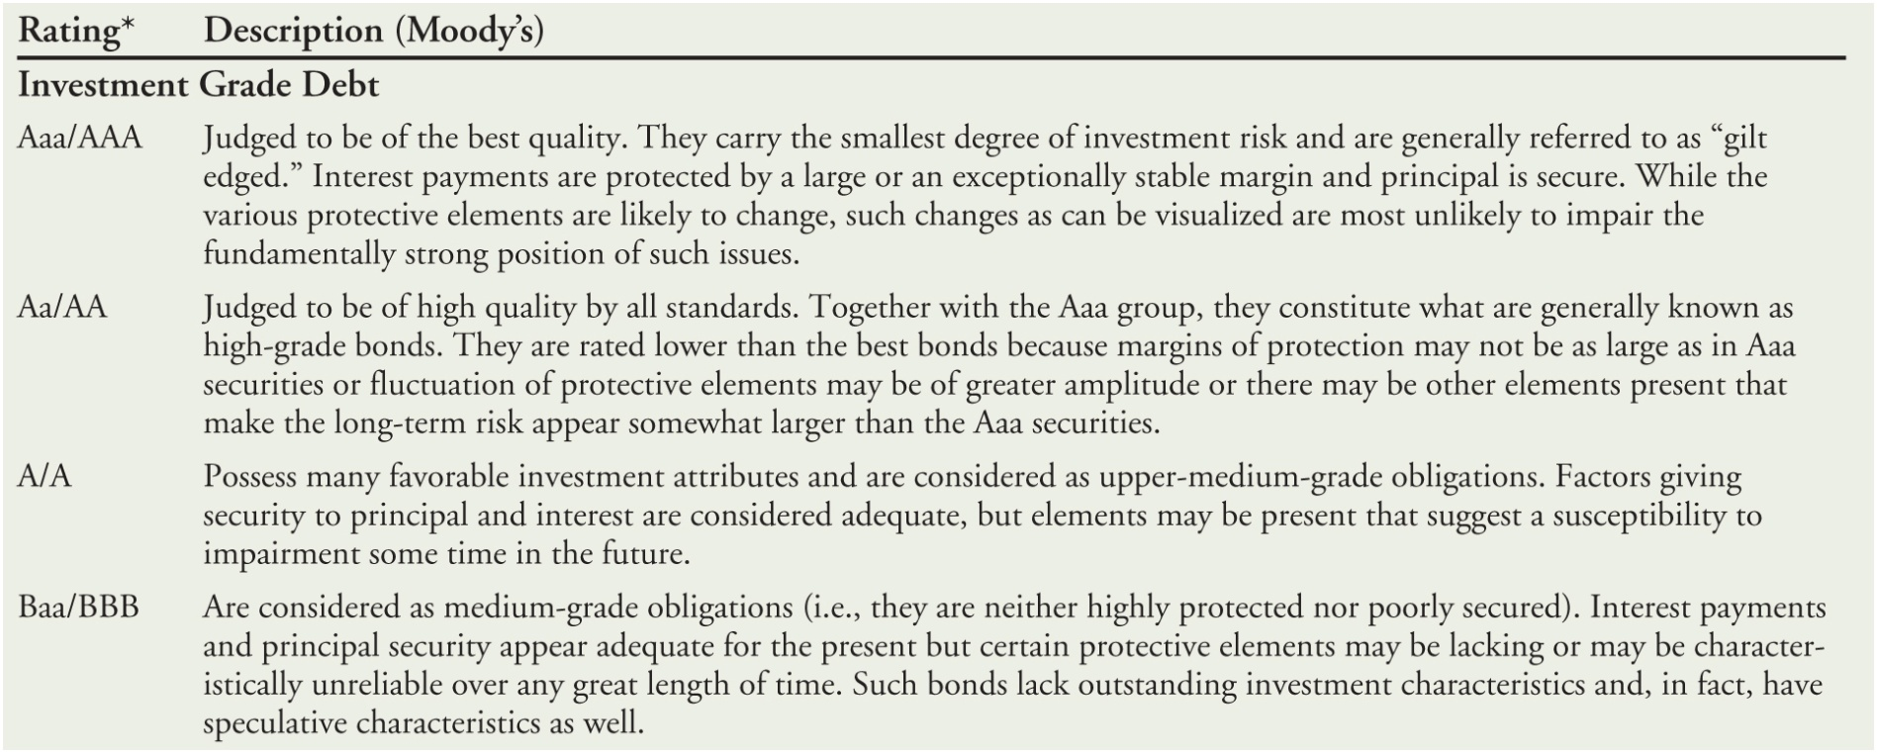
Table 6.4 Bond Ratings

Slide 86
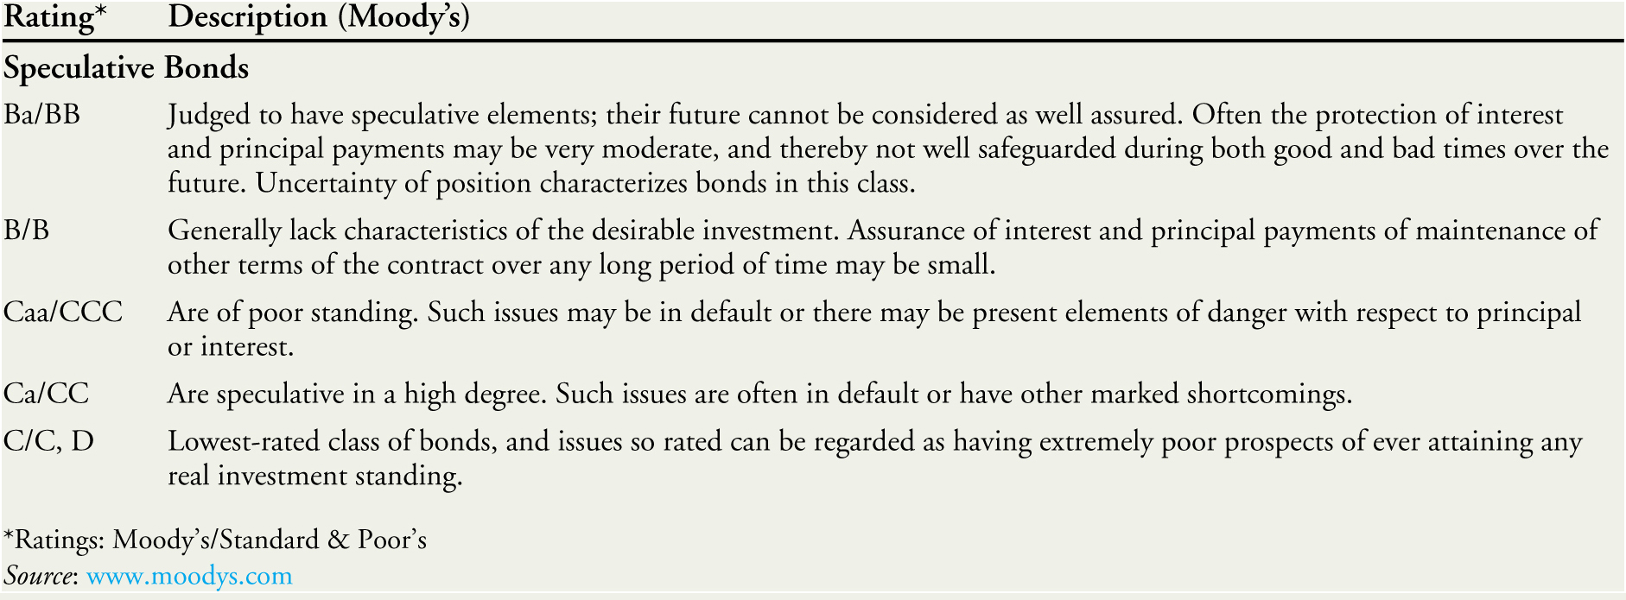
Table 6.4 Bond Ratings (cont’d)
Notes:
86

Slide 87
Corporate Yield Curves
Default Spread
Also known as Credit Spread
The difference between the yield on corporate bonds and Treasury yields

Slide 88
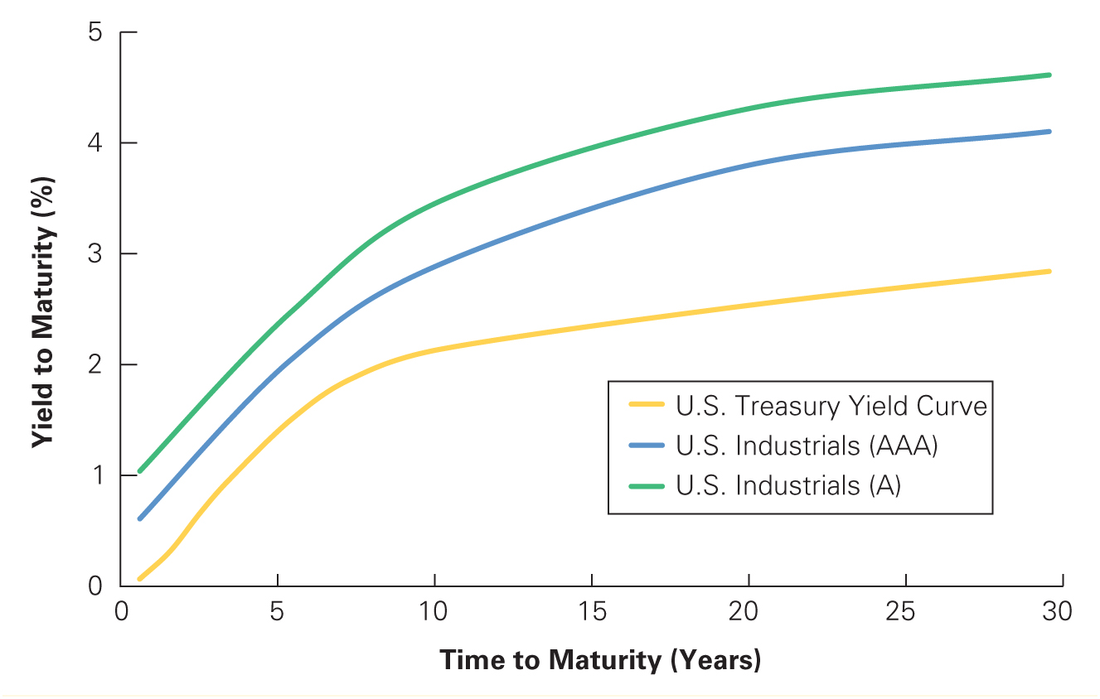
Figure 6.3 Corporate Yield Curves for Various Ratings, August 2015
Source: Yahoo! Finance

Slide 89
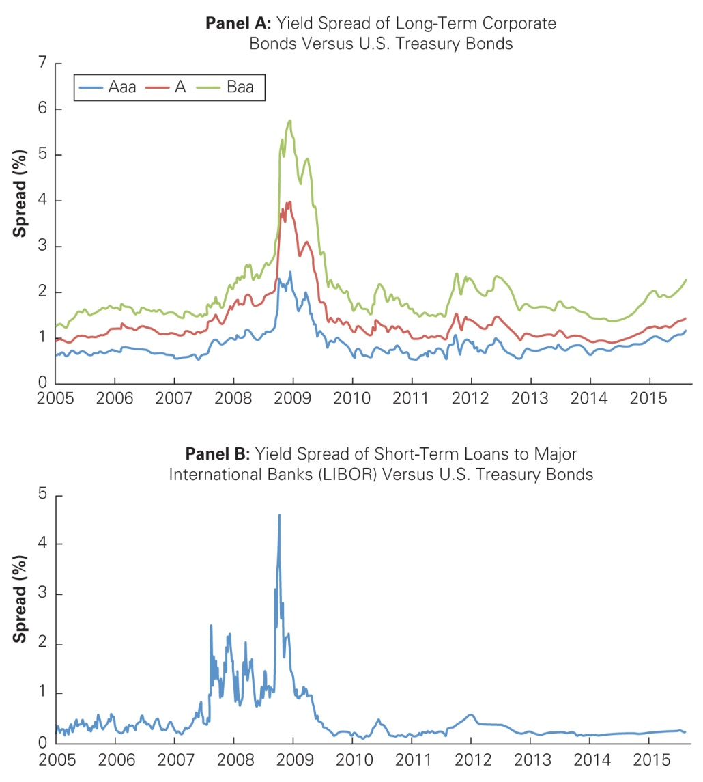
Figure 6.4 Yield Spreads and the Financial Crisis
Source: Bloomberg.com

Slide 90
6.5 Sovereign Bonds
Bonds issued by national governments
U.S. Treasury securities are generally considered to be default free.
All sovereign bonds are not default free,
e.g. Greece defaulted on its outstanding debt in 2012.
Importance of inflation expectations
Potential to “inflate away” the debt
European sovereign debt, the EMU, and the ECB

Slide 91
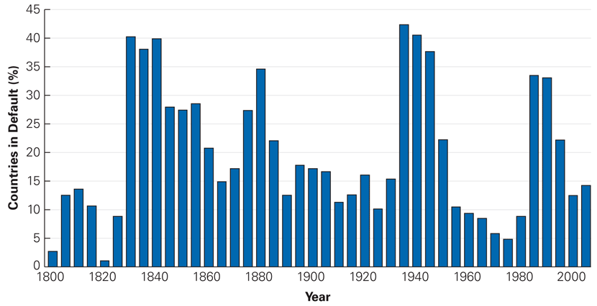
Figure 6.5 Percent of Debtor Countries in Default or Restructuring Debt, 1800–2006
Source: Data from This Time Is Different, Carmen Reinhart and Kenneth Rogoff, Princeton University Press, 2009.

Slide 92
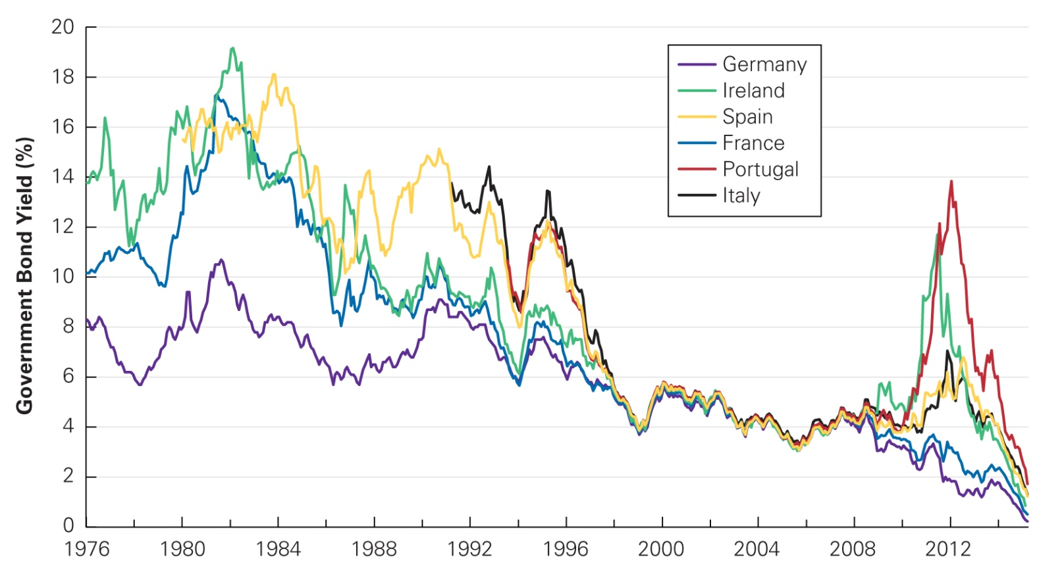
Figure 6.6 European Government Bond Yields, 1976–2015
Source: Federal Reserve Economic Data, research.stlouisfed.org/fred2.

Slide 93
Discussion of Data Case Key Topic
Look at the Financial Industry Regulatory Authority’s website. What bond issues does Sirius Satellite Radio (ticker: SIRI) currently have outstanding? What are their yields? What are their ratings?
Source: FINRA

Slide 94
Chapter Quiz
What is the relationship between a bond’s price and its yield to maturity?
If a bond’s yield to maturity does not change, how does its cash price change between coupon payments?
How does a bond’s coupon rate affect its duration – the bond price’s sensitivity to interest rate changes?
Explain why two coupon bonds with the same maturity may each have a different yield to maturity.
There are two reasons the yield of a defaultable bond exceeds the yield of an otherwise identical default-free bond. What are they?

Slide 95
Chapter 6
Appendix

Slide 96
Forward Interest Rates
6A.1 Computing Forward Rates
A forward interest rate (or forward rate) is an interest rate that we can guarantee today for a loan or investment that will occur in the future.
In this chapter, we consider interest rate forward contracts for one-year investments, so the forward rate for year 5 means the rate available today on a one-year investment that begins four years from today.

Slide 97
Computing Forward Rates
By the Law of one price, the forward rate for year 1 is equivalent to an investment in a one-year, zero-coupon bond.

Slide 98
Computing Forward Rates
Consider a two-year forward rate.
Suppose the one-year, zero-coupon yield is 5.5% and the two-year, zero-coupon yield is 7.0%.
We can invest in the two-year, zero-coupon bond at 7.0% and earn $(1.07)² after two years.
Or, we can invest in the one-year bond and earn $1.055 at the end of the year. We can simultaneously enter into a one-year interest rate forward contract for year 2 at a rate of f₂.

Slide 99
Computing Forward Rates
At then end of two years, we will have $(1.055)(1+f₂).
Since both strategies are risk free, by the Law of One Price they should have the same return:

Slide 100
Computing Forward Rates
Rearranging, we have
The forward rate for year 2 is f₂=8.52%.

Slide 101
Computing Forward Rates
In general,
Rearranging, we get the general formula for the forward interest rate:

Slide 102
Textbook Example 6A.1

Slide 103
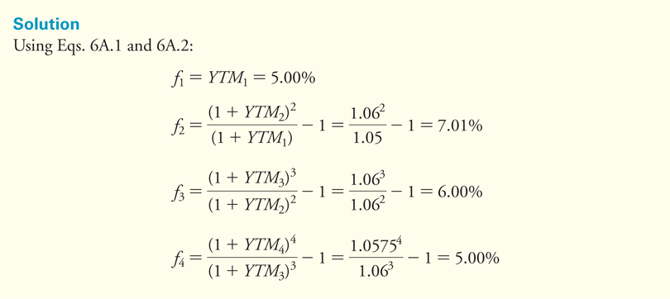
Textbook Example 6A.1 (cont’d)

Slide 104
Alternative Example 6.A1
Problem
At the end of 2015, yields on Canadian government bonds were
Base on this yield curve, what is ? ?
Maturity | 1 Year | 2 Year | 3 Year | 4 Year | 5 Year | 6 Year | 7 Year | 8 Year | 9 Year | 10 Year
Yield | 0.51% | 0.47% | 0.54% | 0.67% | 0.82% | 0.97% | 1.13% | 1.28% | 1.42% | 1.55%
Notes:
104

Slide 105
Alternative Example 6.A1
Solution
Notes:
105

Slide 106
6A.2 Computing Bond Yields from Forward Rates
It is also possible to compute the zero-coupon yields from the forward interest rates:
For example, using the forward rates from Example 8A.1, the four-year zero-coupon yield is

Slide 107
6A.3 Forward Rates and Future Interest Rates
How does the forward rate compare to the interest rate that will actually prevail in the future?
It is a good predictor only when investors do not care about risk.

Slide 108
Textbook Example 6A.2

Slide 109
Textbook Example 6A.2 (cont’d)

Slide 110
Forward Rates and Future Interest Rates
We can think of the forward rate as a break-even rate.
Since investors do care about risk,
Expected Future Spot Interest Rate =
Forward Interest Rate + Risk Premium

