Slide 1
4
Mutual Funds and Other Investment Companies
Bodie, Kane, and Marcus
Essentials of Investments Tenth Edition

Slide 2
4.1 Investment Companies
Functions
Record keeping and administration
Diversification and divisibility
Professional management
Lower transaction costs
Definitions
Investment company: Financial intermediaries
Net asset value (NAV): Assets minus liabilities per share

Slide 3
4.2 Types of Investment Companies
Unit Investment Trusts
Money pooled from many investors is invested in portfolio fixed for life of fund
Managed Investment Companies
A professional investment firm that manages a portfolio for an annual fee
Load: Sales commission charged on mutual fund
Open-end or Closed-end fund

Slide 4
4.2 Types of Investment Companies: Open vs. Closed
 | Open-End Funds | Closed-End Funds
Shares Outstanding | Change when new shares are sold or old shares are redeemed | No change unless new stock is offered
Pricing | Fund Share Price = Net Asset Value (NAV) | Fund Share Price may trade at a premium or discount to NAV

Slide 5
4.2 Types of Investment Companies: Other
Investment Organization | Characteristics
Commingled Funds | Partnership of investors pooling funds; designed for trusts/larger retirement accounts to get professional management for a fee
Real Estate Investment Trust (REITs) | Similar to closed-end funds; invests in real estate/real estate loans
Hedge Funds | Private investment pools; exempt from SEC regulation. Can be speculative in nature

Slide 6
4.3 Mutual Funds: Investment Policies
Investment Policy | Characteristics
Money Market Mutual Fund (MMMF) | Commercial Paper, Repurchase Agreements, CDs
Equity Funds | Stocks, Some fixed-income or other securities
Equity Sector Funds | Stocks concentrated in a particular industry
Bond Funds | Specialize in fixed-income (bond) sector
Global Funds | World wide securities, including the U.S.A.
International Funds | World wide securities, excluding the U.S.A.
International Regional Funds | Foreign securities concentrated in certain regions
Emerging Markets Funds | Securities from developing nations

Slide 7
4.3 Mutual Funds: Investment Policies Continued
Investment Policy | Characteristics
Balanced Fund: | Hold both equities and fixed-income securities
Life Cycle Fund: Static Allocation | Hold both equities and fixed-income securities stable proportions
Life Cycle Fund: Targeted-Maturity | Targeted maturity funds become more conservative as investor ages
Asset Allocation/Flexible Funds | Hold both equities and fixed-income securities—proportion varies according to market forecast (market timing)
Index Funds | Try to match performance of broad market index; Buy shares in proportion to security’s representation in index
Fund of Funds | Mutual funds that primarily invest in other mutual funds

Slide 8
Table 4.1 U.S. Mutual Funds by Investment Classification
 |  | Assets: ($ bil.) | Percent of Total Assets | Number of Funds
Equity Funds
 | Capital appreciation focus | $1,725 | 11.5% | 1,329
 | World/international | 2,034 | 13.5% | 1,345
 | Total return | 4,004 | 26.7% | 1,866
 | Total equity funds | $7,764 | 51.7% | 4,540
Bond Funds
 | Investment grade | $1,451 | 9.7% | 594
 | High yield | 412 | 2.7% | 225
 | World | 339 | 2.3% | 270
 | Government | 239 | 1.6% | 214
 | Multisector | 327 | 2.2% | 143
 | Single-state municipal | 145 | 1.0% | 331
 | National municipal | 353 | 2.4% | 229
 | Total bond funds | $3,265 | 21.7% | 2,006
Hybrid (bond/stock) funds |  | $1,270 | 8.5% | 606
Money market funds
 | Taxable | $2,448 | 16.3% | 382
 | Tax-exempt | 271 | 1.8% | 173
 | Total money market funds | $2,718 | 18.1% | 555
Total |  | $15,018 | 100.0% | 7,707
Source: 2014 Mutual Fund Fact Book

Slide 9
4.4 Costs of Investing in Mutual Funds: Fee Structure
Fee Structure | Definition
Operating Expenses | Costs incurred by mutual fund in operating portfolio
Front-end Load | Commission or sales charge paid when purchasing shares
Back-end load | “Exit” fee incurred when shares
12b-1 charges | Annual fees charged by mutual fund to pay for marketing/distribution costs

Slide 10
4.4 Costs of Investing in Mutual Funds
Fees, Loads, and Performance
Gross performance of load funds is statistically identical to gross performance of no-load funds
Funds with high expenses tend to be poorer performers
12b-1 charges should be added to expense ratios
Compare costs with Morningstar

Slide 11
4.4 Costs of Investing in Mutual Funds HERE
NAV and Effective Load
Cost to initially purchase one share of load fund = NAV + Front-end load (%) (if any)
Stated loads typically range from 0 to 8.5%
Load is designed to offset expenses of marketing the fund; it goes to broker who sells fund to investor
Effective load greater than stated load

Slide 12
4.4 Costs of Investing in Mutual Funds
Fees and Mutual Fund Returns
Soft dollars: Value of research services brokerage house provides “free of charge” in exchange for business

Slide 13
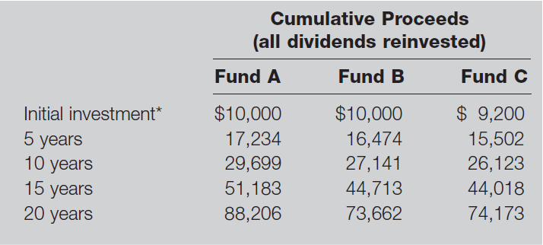
Table 4.2 Costs on Investment Performance: Example
Fund A is no-load with .5% expense ratio, Fund B is no-load with 1.5% total expense ratio, and Fund C has an 8% load on purchases and a 1% expense ratio. Gross return on all funds is 12% per year before expenses.
* After front-end load, if any.

Slide 14
4.5 Taxation of Mutual Fund Income
General Tax Rules
Fund not taxed if diversified and income distributed
Investor taxed on capital gain and dividend distributions
Turnover: Ratio of trading activity to assets of portfolio
Portfolio turnover may affect investor’s tax liability

Slide 15
4.5 Taxation of Mutual Fund Income
Implications of Fund Turnover
Fund pays commission costs on portfolio purchases and sales—charged against NAV
Turnover rate measured as annual total asset value bought or sold in a year divided by average total asset value

Slide 16
4.6 Exchange-Traded Funds
Exchange-Traded Funds: Offshoots of mutual funds that allow investor to trade index portfolios
Potential Advantages | Potential Disadvantages
Trade Continuously throughout the day | Small deviations from NAV possible
Can be sold or purchased on margin | Brokerage commission to buy ETF
Potentially lower tax rates
Lower costs (no marketing, lower fund expenses)

Slide 17
Figure 4.2 Assets in ETFs
Source: Investment Company Institute, 2010-2014 Investment Company Fact Books

Slide 18
Figure 4.3 Investment Company Assets under Management, 2013 ($ Billion)
Source: Investment Company Institute, 2014 Investment Company Fact Book

Slide 19
4.7 Mutual Fund Investment Performance: Figure 4.4
On average, mutual fund performance less than broad market performance

Slide 20
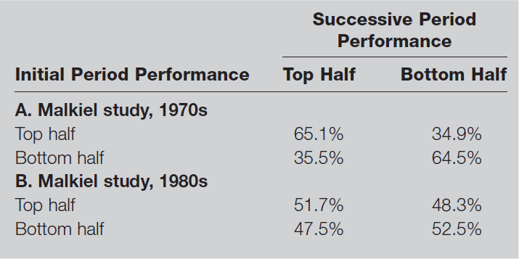
4.7 Mutual Fund Investment Performance Persistence
Evidence suggests some persistence in positive performance over certain horizons

Slide 21
4.8 Information on Mutual Funds
Sources of Information on Mutual Funds
Morningstar (www.morningstar.com)
Fund prospectus
Yahoo!
The Wall Street Journal
Investment Company Institute (www.ici.org)
American Institute of Individual Investors
Brokers

