Slide 1
15
Options Markets
Bodie, Kane, and Marcus
Essentials of Investments Tenth Edition

Slide 2
15.1 Option Contracts
Call Option
Right to buy asset at specified exercise price on or before specified expiration date
Strike Price
Price set for calling/putting asset
Premium
Purchase price of option

Slide 3
15.1 Option Contracts
Put Option
Right to sell asset at specified exercise price on or before specified expiration date
In the Money
Exercise would generate positive cash flow
Out of the Money
Exercise would generate negative cash flow
At the Money
Exercise price equals asset price

Slide 4
15.1 Option Contracts
Options Trading
Most trading occurs on organized exchanges
Ease of trading
Liquid secondary market
Standardized by allowable expiration date and exercise price
Limited, uniform set of securities
Results in more competitive market

Slide 5
15.1 Option Contracts
American Option
Can be exercised on or before expiration
European Option
Can be exercised only at expiration

Slide 6
15.1 Option Contracts
Option Clearing Corporation
Jointly owned by exchanges
Arranges exercised options through member firms
Requires option writers to post margin

Slide 7
15.1 Option Contracts
Other Listed Options
Index options
Call/put based on stock market index
Futures options
Give holders right to buy/sell futures contract using exercise price as futures price

Slide 8
15.1 Option Contracts
Other Listed Options
Foreign currency options
Offers right to buy/sell foreign currency for specified amount of domestic currency
Interest rate options
Options on Treasury notes/bonds/bills and other countries’ government bonds

Slide 9
15.2 Values of Options at Expiration
Call Options
Payoff to call holder at expiration
$S_{T}−X if S_{T}>X;0 if S_{T}≤X$
Payoff to call writer
$−\left(S_{T}−X\right) if S_{T}>X; 0 if S_{T}≤X$
Put Options
Payoff to put holder
$0 if S_{T}≥X; X−S_{T} if S_{T}<X$

Slide 10
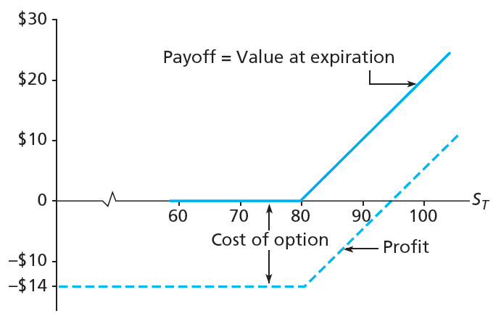
Figure 15.2 Payoff, Profit to Call Option at Expiration

Slide 11
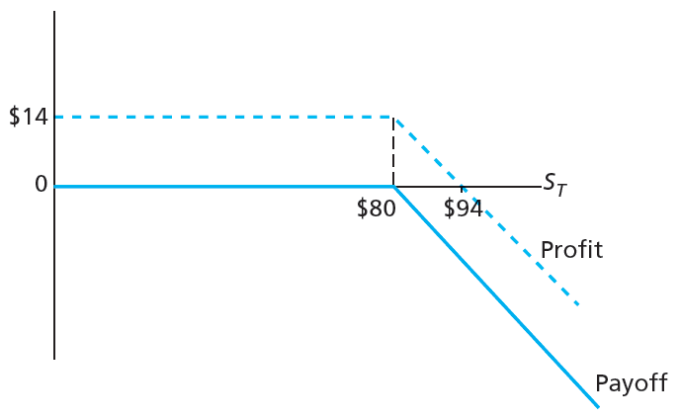
Figure 15.3 Payoff, Profit to Call Writers at Expiration

Slide 12
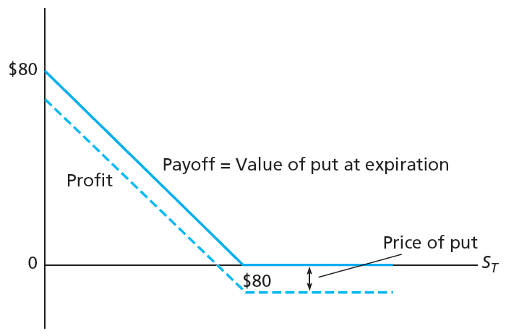
Figure 15.4 Payoff, Profit to Put Option at Expiration

Slide 13
15.2 Values of Options at Expiration
Options versus Stock Investment
Strategies
Invest entirely in stock, 100 shares for $90 each
Invest entirely in at-the-money options; buy 900 calls, each selling at $10
Buy 100 call options for $1,000; invest remaining $8,000 in 6-month T-bills at 2% interest

Slide 14
15.2 Values of Options at Expiration
Stock price
RoR

Slide 15
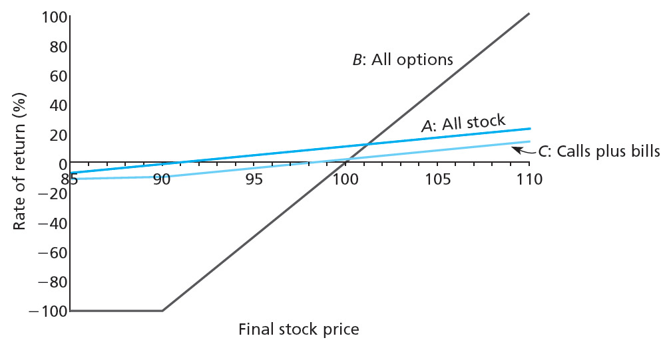
Figure 15.5 RoR to Three Strategies

Slide 16
15.2 Values of Options at Expiration
Option Strategies
Protective put
Asset combined with put option that guarantees minimum proceeds equal to put’s exercise price
Risk management
Strategies to limit risk of portfolio
Covered call
Writing call on asset together with buying asset

Slide 17
15.2 Values of Options at Expiration
Option Strategies
Straddle
Combination of call and put, each with same exercise price and expiration date
Spread
Combination of two or more call options/put options on same asset with differing exercise prices/times to expiration
Collar
Options strategy that brackets value of portfolio between two bonds

Slide 18
Table 15.1 Payoff to Protective Put Strategy

Slide 19
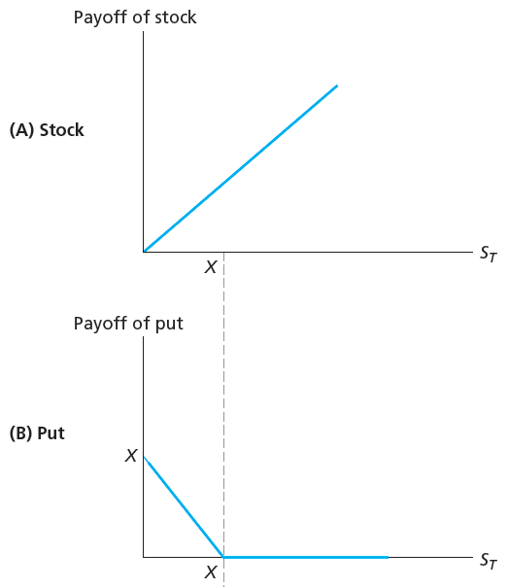
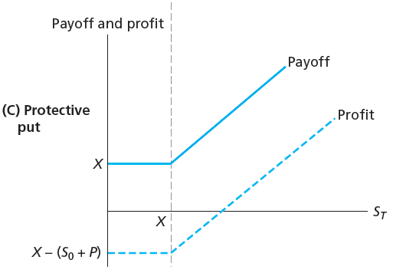
Figure 15.6 Value of Protective Put Position at Expiration

Slide 20
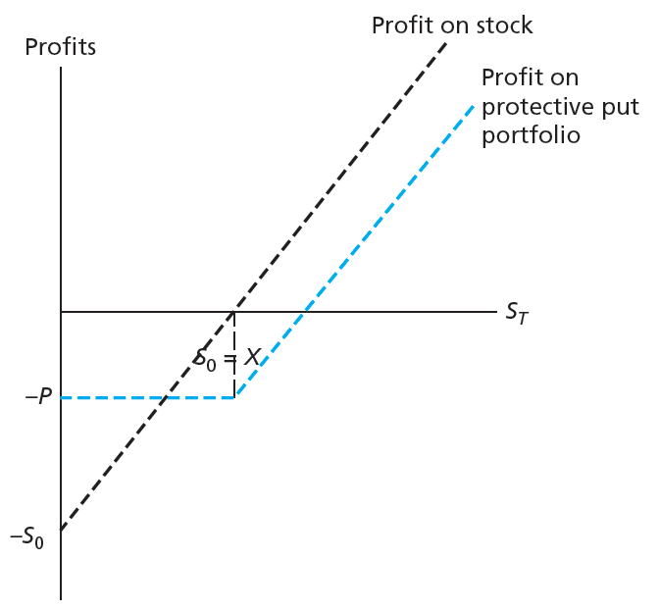
Figure 15.7 Protective Put versus Stock Investment

Slide 21
Table 15.2 Payoff to Covered Call

Slide 22
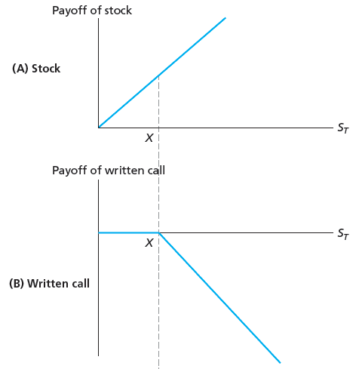
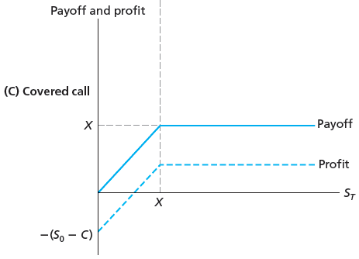
Figure 15.8 Value of Covered Call Position at Expiration

Slide 23
Table 15.3 Payoff to Straddle

Slide 24
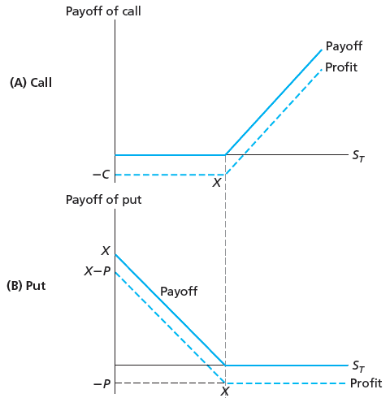
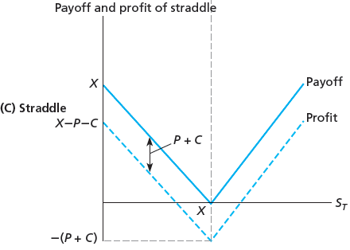
Figure 15.9 Payoff and Profit on Straddle at Expiration

Slide 25
Table 15.4 Payoff to Bullish Spread

Slide 26
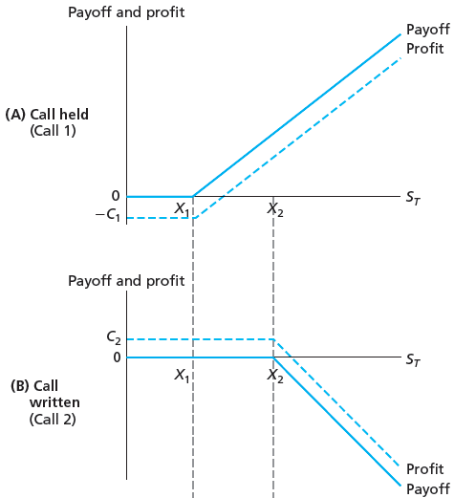
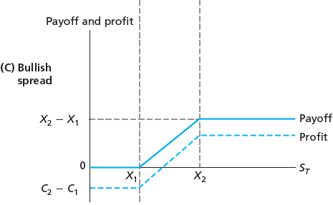
Figure 15.10 Value of Bullish Spread Position at Expiration

Slide 27
Figure 15.3 Optionlike Securities
Callable Bonds
Issued with coupon rate higher than on straight debt
Investor’s compensation for call option retained by issuer
Usually includes call protection period

Slide 28
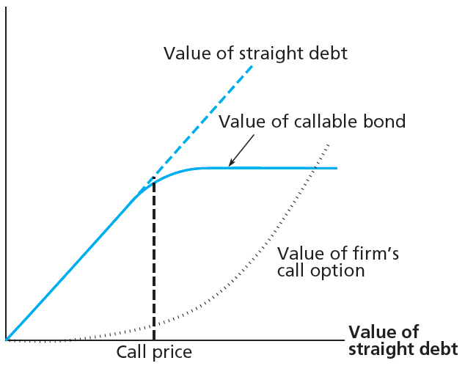
Figure 15.11 Values of Callable Bond Compared with Straight Bond

Slide 29
15.3 Optionlike Securities
Convertible Securities
Convey options to holder rather than issuer
Typically give holder right to exchange for common stock, regardless of market price

Slide 30
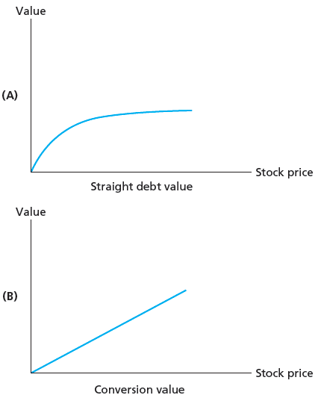
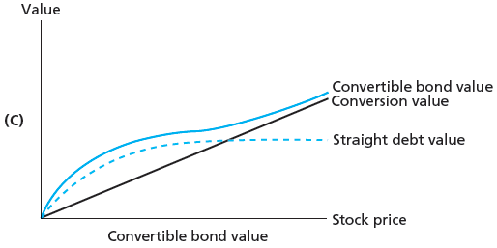
Figure 15.12 Value of Convertible Bond as Function of Stock Price

Slide 31
15.3 Optionlike Securities
Warrants
Option issued by firm to purchase shares of firm’s stock
Collateralized Loans
Nonrecourse loan
No recourse beyond right to collateral

Slide 32
15.3 Optionlike Securities
Collateralized Loans
Three views
Gives implicit call option to borrower
Borrower turns collateral over and retains right to reclaim it by paying off loan
Borrower will repay L dollars and can sell collateral to leaders for L dollars, even if $S_{T}$ is less than L

Slide 33
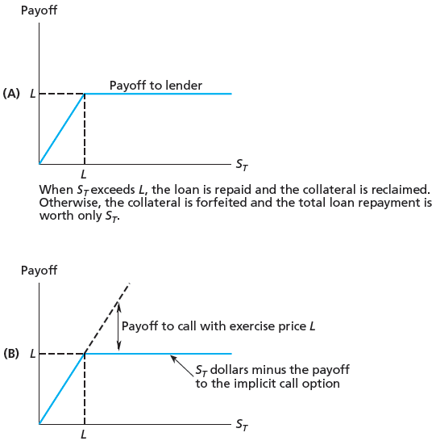
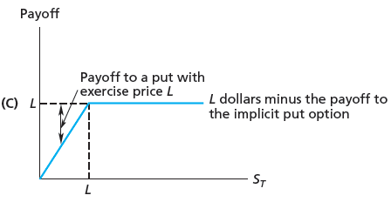
Figure 15.13 Collateralized Loan

Slide 34
15.3 Optionlike Securities
Leveraged Equity and Risky Debt
Any time corporation borrows money, maximum possible collateral for loan is total of firm’s assets

Slide 35
15.4 Exotic Options
Asian Options
Options with payoffs that depend on average price of underlying asset during portion of option life
Currency-Translated Options
Have either asset or exercise price denominated in foreign currency
Digital Options
Have fixed payoffs that depend on price of underlying asset

