Slide 1
13
Equity Valuation
Bodie, Kane, and Marcus
Essentials of Investments Tenth Edition

Slide 2
13.1 Equity Valuation
Book Value
Net worth of common equity according to a firm’s balance sheet
Limitations of Book Value
Liquidation value: Net amount realized by selling assets of firm and paying off debt
Replacement cost: Cost to replace firm’s assets
Tobin’s q: Ratio of firm’s market value to replacement cost

Slide 3
Table 13.1 Microsoft Financial Highlights, Oct 2014
Price per share | $45.95
Common shares outstanding (billion) | 8.24
Market capitalization ($ billion) | 378.64
Latest 12 Months
Sales ($ billion) | 91.5
EBITDA ($ billion) | 33.26
Net income ($ billion) | 21.37
Earnings per share | $2.55
Valuation | Microsoft | Industry Avg
P/E ratio | 18.0 | 19.4
Price/Book | 4.2 | 7.0
Price/Sales | 4.2
Price/Cash flow | 11.7
PEG | 2.6
Profitability
ROE (%) | 24.9 | 21.8
ROA (%) | 11.4
Operating profit margin (%) | 31.2
Net profit margin (%) | 23.4 | 20.5

Slide 4
13.2 Intrinsic Value versus Market Price
= expected dividend per share
= current share price
= expected end-of-year price
Example: Suppose you purchased a share of DAR Inc. for $40 in January. You expect to sell it for $42 in December and expect to receive a dividend of $2.40 during that year. What is your expected HPR?

Slide 5
13.2 Intrinsic Value versus Market Price
Intrinsic Value
Present value of firm’s expected future net cash flows discounted by required RoR
Market Capitalization Rate
Market-consensus estimate of appropriate discount rate for firm’s cash flows

Slide 6
13.2 Intrinsic Value versus Market Price
Intrinsic Value
$V_{0}=\frac{E\left(D_{1}\right)+E(P_{1})}{1+k}$
For holding period H
$V_{0}=\frac{D_{1}}{1+k}+\frac{D_{2}}{{(1+k)}^{2}}+…+\frac{D_{H}+P_{H}}{{(1+k)}^{H}}$
Dividend Discount Model (DDM)
Formula for intrinsic value of firm equal to present value of all expected future dividends

Slide 7
13.3 Dividend Discount Models
Constant-Growth DDM
Form of DDM that assumes dividends will grow at constant rate
$V_{0}=\frac{D_{1}}{k−g}$
Implies stock’s value greater if:
Larger dividend per share
Lower market capitalization rate, k
Higher expected growth rate of dividends

Slide 8
13.3 Dividend Discount Models
For stock with market price = intrinsic value, expected holding period return
$E\left(r\right)=Dividend yield+Capital gains yield$
$\frac{D_{1}}{P_{o}}+\frac{P_{1}−P_{0}}{P_{0}}=\frac{D_{1}}{P_{0}}+g$

Slide 9
13.3 Dividend Discount Models
Stock Prices and Investment Opportunities
Dividend payout ratio
Percentage of earnings paid as dividends
Plowback ratio/earnings retention ratio
Proportion of firm’s earnings reinvested in business
Present value of growth opportunities (PVGO)
Price = No-growth value per share + PVGO
$P_{0}=\frac{E_{1}}{k}+PVGO$

Slide 10
13.3 Dividend Discount Models
Life Cycles and Multistage Growth Models
Two-stage DDM
DDM in which dividend growth assumed to level off only at future date
Multistage Growth Models
Allow dividends per share to grow at several different rates as firm matures

Slide 11
13.3 Dividend Discount Models: Two Stage Example
Consider the following information:
The firm’s dividends are expected to grow at g = 20% until t = 3 yrs.
At the start of year four, growth slows to g_{s}= 5%.
The stock just paid a dividend Div₀ = $1.00
Assume a market capitalization rate of k = 12%
What is the price, P₀, of this stock?

Slide 12
13.4 Price-Earnings Ratios
Price Earnings Ratio and Growth Opportunities
Price-earnings multiple
Ratio of stock’s price to earnings per share
Determinant of P/E ratio
$\frac{P_{0}}{E_{1}}=\frac{1}{k}\left[\frac{PVGO}{\frac{E_{1}}{k}}\right]$

Slide 13
13.4 Price-Earnings Ratios
P/E Ratio for Firm Growing at Long-Run Sustainable Pace
$\frac{P_{0}}{E_{1}}=\frac{1−b}{k−(ROE×b)}$
PEG Ratio
Ratio of P/E multiple to earnings growth rate

Slide 14
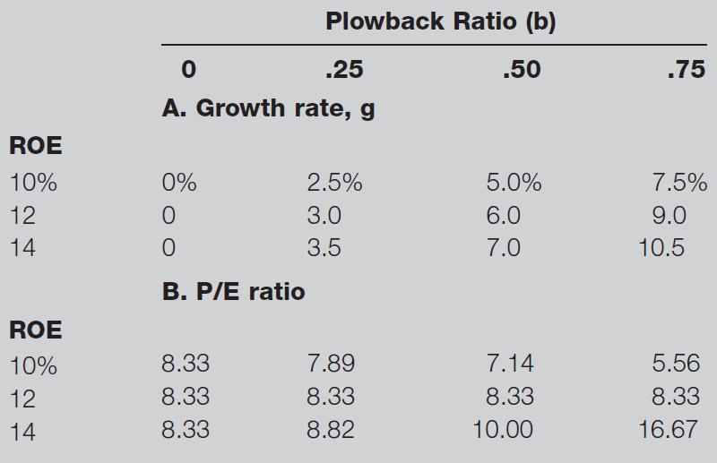
Table 13.3 Effect of ROE and Plowback on Growth and P/E Ratio

Slide 15
13.4 Price-Earnings Ratios
P/E Ratios and Stock
$\frac{P}{E}=\frac{1−b}{k−g}$
All else equal, riskier stocks have lower P/E multiples, higher required RoR, k

Slide 16
Figure 13.3 P/E Ratio and Inflation

Slide 17
13.4 Price-Earnings Ratios
Pitfalls in P/E Analysis
Earnings Management
Practice of using flexibility in accounting rules to improve apparent profitability of firm
Large amount of discretion in managing earnings

Slide 18
Figure 13.4 Earnings Growth for Two Companies

Slide 19
Figure 13.5 Price-Earnings Ratios

Slide 20
Figure 13.6 P/E Ratios

Slide 21
13.4 Price-Earnings Ratios
Combining P/E Analysis and the DDM
Estimates stock price at horizon date
Other Comparative Valuation Ratios
Price-to-book: Indicates how aggressively market values firm
Price-to-cash-flow: Cash flow less affected by accounting decisions than earnings
Price-to-sales: For start-ups with no earnings

Slide 22
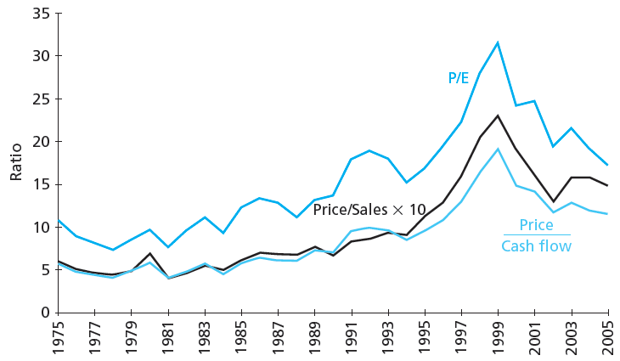
Figure 13.7 Valuation Ratios for S&P 500

Slide 23
13.5 Free Cash Flow Valuation Approaches
Free Cash Flow for Firm (FCFF)
$FCFF= EBIT\left(1−t_{c}\right)+Depreciation−Capital expenditures−Increase in NWC$
EBIT = Earnings before interest and taxes
$t_{c}$ = Corporate tax rate
NWC = Net working capital
Free Cash Flow to Equity Holders (FCFE)
$FCFE=FCFF−Interest expense×\left(1−t_{c}\right)+Increases in net debt$

Slide 24
13.5 Free Cash Flow Valuation Approaches
Estimating Terminal Value using Constant Growth Model
$Firm value=\sum_{t=1}^{T}{\frac{1+{FCFF}_{t}}{{(1+WACC)}^{t}}}+\frac{P_{T}}{{(1+WACC)}^{T}}$
$P_{T}=\frac{{FCFF}_{T+1}}{WACC−g}$
WACC = Weighted average cost of capital

Slide 25
13.5 FCF Valuation Approaches: FCFF Example
Suppose FCFF = $1 mil for years 1-4 and then is expected to grow at a rate of 3%. Assume WACC = 15%
$\text{If}\text{ 500,000 }\text{shares} \text{are} \text{outstanding}\text{, }\text{what} \text{is} \text{the} \text{predicted} \text{price} \text{of} \text{this} \text{stock} \text{if} \text{the} \text{firm} \text{has}\text{ \$5,000,000 }\text{of} \text{debt}\text{?}$

Slide 26
13.5 Free Cash Flow Valuation Approaches
Market Value of Equity
$Market value of equity=\sum_{t=1}^{T}{\frac{{FCFE}_{t}}{{{(1+k}_{E})}^{t}}+\frac{P_{T}}{{{(1+k}_{E})}^{T}}}$
$P_{T}=\frac{{FCFE}_{T+1}}{k_{E}−g}$

Slide 27
13.5 FCF Valuation Approaches: FCFE Example
Suppose FCFE = $900,000 for years 1-4 and then is expected to grow at a rate of 3%. Assume k_{e} = 18%
$\text{If} \text{there} \text{are}\text{ 500,000 }\text{shares} \text{outstanding}\text{, }\text{what} \text{is} \text{the} \text{predicted} \text{price} \text{of} \text{this} \text{stock}\text{? }\text{W}\text{hy} \text{can} \text{debt} \text{be} \text{ignored}\text{?}$

Slide 28
Spreadsheet 13.2: FCF
 |  |  |  |  |  |  | Terminal value
FCFF |  |  | -521.0 | 5200.3 | 5444.8 | 5689.4 | 106504.6
FCFE |  |  | 1160.0 | 2760.1 | 3050.2 | 3340.3 | 85210.4 |  | assumes fixed debt ratio after 2015
C. Discount rate calculations
Current beta | 0.9 |  |  |  |  |  |  |  | from Value Line
Unlevered beta | 0.686 |  |  |  |  |  |  |  | current beta /[1 + (1-tax)*debt/equity)]
terminal growth | 0.025
tax_rate | 0.35 |  |  |  |  |  |  |  | from Value Line
r_debt | 0.042 |  |  |  |  |  |  |  | YTM in 2012 on A+ rated LT debt
risk-free rate | 0.029
market risk prem | 0.08
MV equity |  | 57420 |  |  |  | 100940 |  |  | Row 3 x Row 11
Debt/Value |  | 0.32 | 0.29 | 0.26 | 0.23 | 0.20 |  |  | linear trend from initial to final value
Levered beta |  | 0.900 | 0.871 | 0.844 | 0.819 | 0.797 |  |  | unlevered beta x [1 + (1-tax)*debt/equity]
k_equity |  | 0.101 | 0.099 | 0.097 | 0.095 | 0.093 | 0.093 |  | from CAPM and levered beta
WACC |  | 0.077 | 0.078 | 0.078 | 0.079 | 0.080 | 0.080 |  | (1-t)*r_debt*D/V + k_equity*(1-D/V)
PV factor for FCFF |  | 1.000 | 0.928 | 0.860 | 0.797 | 0.738 | 0.738 |  | Discount each year at WACC
PV factor for FCFE |  | 1.000 | 0.910 | 0.830 | 0.758 | 0.694 | 0.694 |  | Discount each year at k_equity
D. Present values |  |  |  |  |  |  |  |  | Intrinsic val | Equity val | Intrin/share
PV(FCFF) |  |  | -483 | 4474 | 4341 | 4201 | 78641 |  | 91174 | 63674 | 35.37
PV(FCFE) |  |  | 1056 | 2291 | 2313 | 2318 | 59136 |  | 67114 | 67114 | 37.29

Slide 29
13.5 Free Cash Flow Valuation Approaches
Comparing Valuation Models
Model values differ in practice
Differences stem from simplifying assumptions
Problems with DCF Models
DCF estimates are always somewhat imprecise
Investors employ hierarchy of valuation
Real estate, plant, equipment
Economic profit on assets in place
Growth opportunities

Slide 30
13.6 The Aggregate Stock Market
Forecasting Aggregate Stock Market
Earnings multiplier applied at aggregate level
Forecast corporate profits for period
Derive estimate of aggregate P/E ratio based on long-term interest rates
Some analysts use aggregate DDM

Slide 31
Figure 13.8 Earnings Yield of S&P 500 versus 10-Year Treasury Bond Yield

Slide 32
Table 13.4 S&P 500 Forecasts
 | Pessimistic Scenario | Most Likely Scenario | Optimistic Scenario
Treasury bond yield | 3.3% | 2.8% | 2.3%
Earnings yield | 6.5% | 6.0% | 5.5%
Resulting P/E ratio | 15.4 | 16.7 | 18.2
EPS forecast | 134 | 134 | 134
Forecast for S&P 500 | 2,062 | 2,233 | 2,436

