Slide 1
Chapter 3 Working With Financial Statements
3-1
Notes:
Digital Equipment’s CEO stated: “Make your numbers or I’m sure your successor will.”

Slide 2
Key Concepts and Skills
Understand sources and uses of cash and the Statement of Cash Flows
Know how to standardize financial statements for comparison purposes
Know how to compute and interpret important financial ratios
Be able to compute and interpret the Du Pont Identity
Understand the problems and pitfalls in financial statement analysis
3-2
Notes:
Digital Equipment’s CEO stated: “Make your numbers or I’m sure your successor will.”

Slide 3
Topics
Cash Flow and Financial Statements
Standardized Financial Statements
Ratio Analysis
The Du Pont Identity
Using Financial Statement Information
3-3

Slide 4
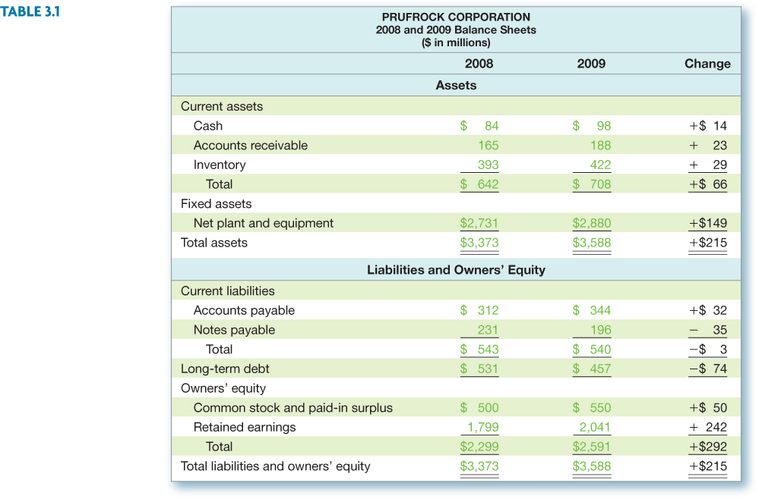
Sample Balance Sheet
Numbers in millions of dollars
3-4
Notes:
The opening Lecture Tip in the IM explains the relevance of accounting data, even given its potential downfalls. The subsequent Tip is designed to help students understand that in increase in the cash account is a use of funds.

Slide 5
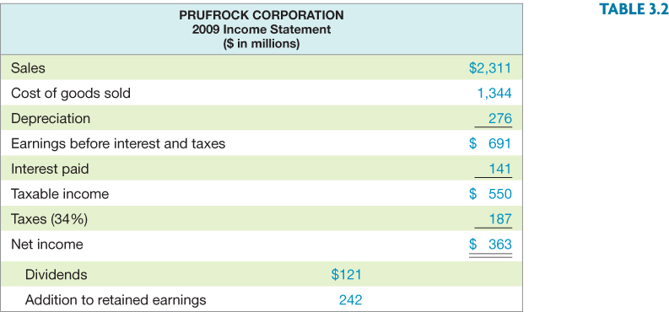
Income Statement
3-5
Notes:
The net income figure and EPS are based on income from continuing operations. There are 190.9 million shares outstanding.

Slide 6
Sources and Uses
Sources
Cash inflow – occurs when we “sell” something
Decrease in asset account
Accounts receivable, inventory, and net fixed assets
Increase in liability or equity account
Accounts payable, other current liabilities, and common stock
Uses
Cash outflow – occurs when we “buy” something
Increase in asset account
Cash and other current assets
Decrease in liability or equity account
Notes payable and long-term debt
3-6
Notes:
Click on Sample B/S to go to the Balance Sheet to illustrate the accounts that are sources and uses, On the B/S Click on the small green arrow to return to this slide.

Slide 7
Source and Uses of Cash

Slide 8
Statement of Cash Flows
Statement that summarizes the sources and uses of cash
Changes divided into three major categories
Operating Activity – includes net income and changes in most current accounts
Investment Activity – includes changes in fixed assets
Financing Activity – includes changes in notes payable, long-term debt, and equity accounts, as well as dividends
3-8

Slide 9
Statement of Cash Flows
Prufrock Corporation | 2009
Statement of Cash Flow
1. Operating Activity
Net Income | $363
Depreciation | $276
Increase in AP | $32
Increase in AR | -$23
Increase in Inv. | -$29
Net Cash from Operating Activity | $619
2. Investment Activity
Fixed asset acquisitions
NFA + Dep. | $(425)
Net cash from investment | $(425)
3. Financing Activity
Decrease in NP | $(35)
Decrease in LTD | $(74)
Increase in Com. Stock | $ 50
Dividends paid | $(121)
Net cash from financing activity | $(180)
Net Increase (decrease) in cash | $14
Beg. Cash (2008) | $84
Cash end year (2009) | $98
3-9
Notes:
Investment activity: change in net fixed assets + depreciation (have to add back depreciation because it was deducted from the fixed asset account to get the net fixed asset figure). If the number is positive, then we acquired fixed assets; if it’s negative, then we sold fixed assets.
3138 – 3358 + 116 = -104 so we sold 104 million worth of fixed assets
Remind students that part of the increase in the C/S account shown on the balance sheet is the increase in Retained Earnings. That is already incorporated in the net income under operating activity.
Dividends paid = 190.9*1.08 = 206 million
Additions to RE = 689 – 206 = 483
Change in C/S = 2556 – 2167 – 483 = -94

Slide 10
Standardized Financial Statements
Common-Size Balance Sheets
Compute all accounts as a percent of total assets
Common-Size Income Statements
Compute all line items as a percent of sales
Standardized statements make it easier to compare financial information, particularly as the company grows
They are also useful for comparing companies of different sizes, particularly within the same industry
3-10

Slide 11
Standardized Financial Statements

Slide 12
Standardized Financial Statements

Slide 13
Ratio Analysis
Ratios allow for better comparison through time or between companies
As we look at each ratio, ask yourself what the ratio is trying to measure and why that information is important
Ratios are used both internally and externally
3-13
Notes:
Lecture Tip: Be sure that your students understand that “real-world” financial statements are not as straightforward as the simplified ones presented in the textbook. Actually reviewing some financial statements of companies with which they are familiar may help.

Slide 14
Categories of Financial Ratios
Short-term solvency or liquidity ratios
Long-term solvency or financial leverage ratios
Asset management or turnover ratios
Profitability ratios
Market value ratios
3-14
Notes:
The ratios in the following slides will be computed using the 2007 information from the Sample Balance Sheet and Income Statement.
Lecture Tip: Remind students that the point of the analysis is not simply the ability to compute the ratios, but rather the ability to interpret them.

Slide 15
Categories of Financial Ratios

Slide 16
Computing Liquidity Ratios
Current Ratio = CA / CL = 1.31 times
Quick Ratio = (CA – Inventory) / CL =0.53 times
Cash Ratio = Cash / CL =0.18
NWC to Total Assets = NWC / TA =0.05=5%
3-16
Notes:
The firm is just barely able to cover current liabilities with its current assets. A short-term creditor might find this a bit disconcerting and may reduce the likelihood that they would lend money to the company. The ratio should be compared to the industry – it’s possible that this industry has a substantial amount of cash flow and that they can meet their current liabilities out of cash flow instead of relying solely on the liquidation of current assets that are on the books. Also, the CR for 2008 was .94, so the company has improved from the previous year.
The quick ratio is quite a bit lower than the current ratio, so inventory seems to be an important component of current assets.
This company carries a low cash balance, although the cash ratio has increased substantially from the previous year (.03 in 2008). This may be an indication that they are aggressively investing in assets that will provide higher returns. We need to make sure that we have enough cash to meet our obligations, but too much cash reduces the return earned by the company.
The NWC to TA measure seems relatively low, but is consistent with the current ratio.
The Interval Measure indicates that the company can meet average daily expenses with current assets for almost 220 days. The Lecture Tip in the IM discusses the importance of this measure for entrepreneurs.
Lecture Tip: Remind students that a high current ratio may actually be a negative, as current assets generally produce a lower return than fixed assets. To build on this understanding, make students evaluate the interaction among ratios. For example, suggest a scenario in which the current ratio exhibits no change over a two- or three-year period, while the quick ratio experiences a steady decline. How could this occur?

Slide 17
Computing Long-term Solvency Ratios
Total Debt Ratio = (TA – TE) / TA
(5,394 – 2,556) / 5,394 = 52.61%
Debt/Equity = TD / TE
(5,394 – 2,556) / 2,556 = 1.11 times
Equity Multiplier = TA / TE = 1 + D/E
1 + 1.11 = 2.11
Long-term debt ratio = LTD / (LTD + TE)
843 / (843 + 2,556) = 24.80%
3-17
Notes:
Note that these are often called leverage ratios. Following the Lecture Tip in the IM, note that this group of ratios measures two aspects of leverage: level of indebtedness and the ability to service this debt.
TE = total equity, and TA = total assets. The numerator in the total debt ratio could also be found by adding all of the current and long-term liabilities.
The firm finances almost 53% of its assets with debt. This is down from about 57% from the previous year.
Another way to compute the D/E ratio if you already have the total debt ratio:
D/E = Total debt ratio / (1 – total debt ratio) = .5261 / (1 - .5261) = 1.11
The EM is one of the ratios that is used in the Du Pont Identity as a measure of the firm’s financial leverage.
The Long-term debt ratio is down from 33.49% in 2008.

Slide 18
Computing Coverage Ratios
Times Interest Earned = EBIT / Interest=4.9 times
Cash Coverage = (EBIT + Depreciation) / Interest =6.9 times
3-18
Notes:
Even though the company is financed with over 64% debt, they have a substantial amount of operating income available to cover the required interest payments.
Remember that depreciation is a non-cash deduction. A better indication of a firm’s ability to meet interest payments may be to add back the depreciation to get an estimate of cash flow before taxes.
Lecture Tip: The importance of coverage ratios is sometimes overlooked, particularly when one considers their importance to all types of creditors.

Slide 19
Computing Inventory Ratios
Inventory Turnover = Cost of Goods Sold / Inventory =3.2 times
Days’ Sales in Inventory = 365 / Inventory Turnover = 114 days
3-19
Notes:
Inventory turnover can be computed using either ending inventory or average inventory when you have both beginning and ending figures. It is important to be consistent with whatever benchmark you are using to analyze the company’s strengths or weaknesses.
It is also important to consider seasonality in sales. If the balance sheet is prepared at a time when there is a large inventory build-up to meet seasonal demand, then the inventory turnover will be understated and you might believe that the company is not performing as well as it is. On the other hand, if the balance sheet is prepared when inventory has been drawn down due to seasonal sales, then the inventory turnover would be overstated and the company may appear to be doing better than it really is. Averages using annual data may not fix this problem. If a company has seasonal sales, you may want to look at quarterly averages to get a better indication of turnover.
Lecture Tip: You may wish to mention that there may be significant inconsistencies in the methods used to compute ratios by financial advisory firms. When using ratios supplied by others, it is important to be aware of the exact financial items used. A manufacturer would typically consider inventory at cost, and thus, relate inventory to cost of goods sold. However, a retailer might maintain its inventory level based on retail price. In the latter case, inventory should be related to sales to compute inventory turnover. The markup would cancel in the numerator and denominator and give an accurate indication of turnover based on cost. Furthermore, some analysts use average inventory over some period instead of ending inventory. The same is true for the other assets used in the various turnover ratios.

Slide 20
Computing Receivables Ratios
Receivables Turnover = Sales / Accounts Receivable =12.3 times
Days’ Sales in Receivables = 365 / Receivables Turnover=30 days
3-20
Notes:
Technically, the sales figure should be credit sales. This is often difficult to determine from the income statements provided in annual reports. If you use total sales instead of credit sales, you will overstate your turnover level. You need to recognize this bias when credit sales are unavailable, particularly if a large portion of the sales are cash sales.
As with inventory turnover, you can use either ending receivables or an average of beginning and ending.
You also run into the same seasonal issues as discussed with inventory.
Probably the best benchmark for days’ sales in receivables is the company’s credit terms. If the company offers a discount (1/10 net 30), then you would like to see days’ sales in receivables less than 30. If the company does not offer a discount (net 30), then you would like to see days’ sales in receivables close to the net terms. If days’ sales in receivables is substantially larger than the net terms, then you first need to look for biases, such as seasonality in sales. If this does not provide an explanation for the difference, then the company may need to take another look at its credit policy (who it grants credit to and its collection procedures).
Lecture Tip: Be sure to remind students that ratio analysis is a means to an end, not an end in itself. The results of the analysis provide us with red flags or items for additional investigation.
Lecture Tip: Students also need to realize that comparisons across industries can be problematic.

Slide 21
Computing Total Asset Turnover
Total Asset Turnover = Sales / Total Assets= 0.64
It is not unusual for TAT < 1, especially if a firm has a large amount of fixed assets
NWC Turnover = Sales / NWC = 13.8 times
Fixed Asset Turnover = Sales / NFA =0.8 times
3-21
Notes:
Having a TAT of less than one is not a problem for most firms. Fixed assets are expensive and are meant to provide sales over a long period of time. This is why the matching principle indicates that they should be depreciated instead of immediately expensed.
This is one of the ratios that will be used in the Du Pont identity.

Slide 22
Computing Profitability Measures
Profit Margin = Net Income / Sales=15.7%
Return on Assets (ROA) = Net Income / Total Assets =10.12%
Return on Equity (ROE) = Net Income / Total Equity =14%
3-22
Notes:
You can also compute the gross profit margin and the operating profit margin.
GPM = (Sales – COGS) / Sales = (5,000 – 2,006) / 5,000 = 59.88%
OPM = EBIT / Sales = 1,138 / 5,000 = 22.76%
Profit margin is one of the components of the Du Pont identity and is a measure of operating efficiency. It measures how well the firm controls the costs required to generate the revenues. It tells how much the firm earns for every dollar in sales. In the example, the firm earns almost $0.14 for each dollar in sales.
Note that the ROA and ROE are returns on accounting numbers. As such, they are not directly comparable with returns found in the marketplace. ROA is sometimes referred to as ROI (return on investment). As with many of the ratios, there are variations in how they can be computed. The most important thing is to make sure that you are computing them the same way as the benchmark you are using.
ROE will always be higher (in absolute terms) than ROA as long as the firm has debt. The greater the leverage the larger the difference will be. ROE is often used as a measure of how well management is attaining the goal of owner wealth maximization. The Du Pont identity is used to identify factors that affect the ROE.
A Lecture Tip in the IM discusses Economic Value Added and its relevance to ratio analysis.

Slide 23
Computing Market Value Measures
Market Price = $88 per share
Shares outstanding = 33 million
PE Ratio = Price per share / Earnings per share
88 / 11 = 8 times
Market-to-book ratio = market value per share / book value per share
88 / (2591 / 33) = 1.12 times
3-23
Notes:
Lecture Tip: It is good for students to understand that average is not always best. Further, average levels may vary through time with the economy, and this is particularly relevant for market value measures. Further, comparisons across countries may be difficult due to differences in accounting and reporting standards.
A good discussion may be asking the question: “does a market-to-book ratio below one indicate a good investment?” It may be an indication of undervaluation; however, such a ratio may also indicate negative consensus regarding the future viability of the firm.

Slide 24
Deriving the Du Pont Identity
ROE = NI / TE
Multiply by 1 (TA/TA) and then rearrange
ROE = (NI / TE) (TA / TA)
ROE = (NI / TA) (TA / TE) = ROA * EM
Multiply by 1 (Sales/Sales) again and then rearrange
ROE = (NI / TA) (TA / TE) (Sales / Sales)
ROE = (NI / Sales) (Sales / TA) (TA / TE)
ROE = PM * TAT * EM
3-24

Slide 25
Using the Du Pont Identity
ROE = PM * TAT * EM
Profit margin is a measure of the firm’s operating efficiency – how well it controls costs
Total asset turnover is a measure of the firm’s asset use efficiency – how well does it manage its assets
Equity multiplier is a measure of the firm’s financial leverage
3-25
Notes:
Improving our operating efficiency or our asset use efficiency will improve our return on equity. If the TAT is low compared to our benchmark, then we can break it down into more detail by looking at inventory turnover and receivables turnover. If those areas are strong, then we can look at fixed asset turnover and cash management.
We can also improve our ROE by increasing our leverage – up to a point. Debt affects a lot of other factors, including profit margin, so we have to be a little careful here. We want to make sure we have enough debt to utilize our interest tax credit effectively, but we don’t want to overdo it. The choice of leverage is discussed in more detail in chapter 13.

Slide 26
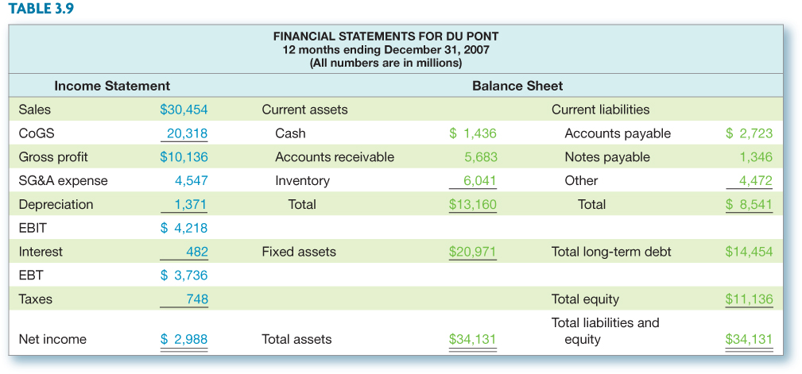
Expanded Du Pont Analysis – Du Pont Data
3-26

Slide 27
Why Evaluate Financial Statements?
Internal uses
Performance evaluation – compensation and comparison between divisions
Planning for the future – guide in estimating future cash flows
External uses
Creditors
Suppliers
Customers
Stockholders
3-27
Notes:
Lecture Tip: Discuss with students that the ratios that are most important to a firm are those that best represent their business. So, whereas inventory turnover may be relevant for a retailer or manufacturer, it is less important for a service firm. The best ratios may be those that are uniquely developed for the business under review.

Slide 28
Benchmarking
Ratios are not very helpful by themselves; they need to be compared to something
Time-Trend Analysis
Used to see how the firm’s performance is changing through time
Internal and external uses
Peer Group Analysis
Compare to similar companies or within industries
SIC and NAICS codes
3-28
Notes:
SIC codes have been used many years to identify industries and allow for comparison with industry average ratios. The SIC codes are limited, however, and have not kept pace with a rapidly changing environment. Consequently, the North American Industry Classification System was introduced in 1997 to alleviate some of the problems with SIC codes.
www: Click on the web surfer to go the NAICS home page. It provides information on the change to the NAICS and conversion between SIC and NAICS codes.

Slide 29
Potential Problems
There is no underlying theory, so there is no way to know which ratios are most relevant
Benchmarking is difficult for diversified firms
Globalization and international competition makes comparison more difficult because of differences in accounting regulations
Varying accounting procedures, i.e. FIFO vs. LIFO
Different fiscal years
Extraordinary events
3-29

Slide 30
Work the Web Example
The Internet makes ratio analysis much easier than it has been in the past
Click on the web surfer to go to www.reuters.com
Click on Stocks, then choose a company and enter its ticker symbol
Click on Ratios to see what information is available
3-30
Notes:
Lecture Tip: An interesting discussion revolves around the benefits and disadvantages of the easy availibility of information. The advantages are apparent, but the downside includes an ability for trades to take advantage of efficiency by quickly and widely disseminating false information.

Slide 31
Quick Quiz
What is the Statement of Cash Flows and how do you determine sources and uses of cash?
How do you standardize balance sheets and income statements and why is standardization useful?
What are the major categories of ratios and how do you compute specific ratios within each category?
What are some of the problems associated with financial statement analysis?
3-31

Slide 32
Ethics Issues
Should financial analysts be held liable for their opinions regarding the financial health of firms?
How closely should ratings agencies work with the firms they are reviewing? I.e., what level of independence is appropriate?
3-32

Slide 33
Comprehensive Problem
XYZ Corporation has the following financial information for the previous year:
Sales: $8M, PM = 8%, CA = $2M, FA = $6M, NWC = $1M, LTD = $3M
Compute the ROE using the DuPont Analysis.
3-33
Notes:
Total assets = CA + FA = $2M + $6M = $8M
TAT = Sales / TA = $8M / $8M = 1
NWC = CA – CL CL = CA – NWC = $2M - $1M = $1M
Total liabs. = CL + LTD = $1M + $3M = $4M
Total equity = total assets – total liabs. = $8M - $4M = $4M
EM = assets / equity = $8M / $4M = 2
ROE = PM X TAT X EM = 8% X 1 X 2 = 16%
Without using DuPont, ROE = NI / total equity = PM * sales / total equity = 8% X $8M / 4M = 16%

Slide 34
End of Chapter
3-34

