Slide 1
Introduction To Financial Statement Analysis

Slide 2
Topics Outline
Firms’ Disclosure of Financial Information
The Balance Sheet
The Income Statement
The Statement of Cash Flows
Other Financial Statement Information
Financial Statement Analysis
Financial Reporting in Practice

Slide 3
Learning Objectives
Know why the disclosure of financial information through financial statements is critical to investors
Understand the function of the balance sheet
Understand how the income statement is used
Interpret a statement of cash flows
Understand the management’s discussion and analysis and the statement of stockholders equity
Analyze a firm through its financial statements, including using the DuPont Identity
Understand the main purpose and aspects of the Sarbanes-Oxley reforms following Enron and other financial scandals

Slide 4
Firms’ Disclosure of Financial Information
Financial statements are accounting reports issued periodically to present past performance and a snapshot of the firm’s assets and the financing of those assets
Investors, financial analysts, managers, and other interested parties such as creditors rely on financial statements to obtain reliable information about a corporation

Slide 5
Firms’ Disclosure of Financial Information
Public companies must file financial results with the Securities and Exchange Commission (SEC)
On a quarterly basis (10-Q)
An annual basis (10-K)
The annual report with financial statements must be sent to their shareholders every year

Slide 6
Firms’ Disclosure of Financial Information
Preparation of Financial Statements
Generally Accepted Accounting Principles (GAAP)
Set by the Financial Accounting Standards Board (FASB) to provide a common set of rules and a standard format for public companies’ reports
Corporations are required to hire an auditor to
Check the annual financial statements
Ensure they are prepared according to GAAP
Provide evidence that the information is reliable

Slide 7
Firms’ Disclosure of Financial Information
Preparation of Financial Statements
International Financial Reporting Standards
International Accounting Standards Board (IASB)
Established in 2001 by representatives from 10 countries, including the U.S.
Since 2005 all publicly traded European Union companies are required to follow IFRS
Used by many other countries, including Australia, several countries in Latin America and Africa
Accepted by all major stock exchanges around the world except U.S. and Japan

Slide 8
Firms’ Disclosure of Financial Information
Preparation of Financial Statements
Convergence to IFRS in the United States is likely in the near future
The Sarbanes-Oxley Act of 2002 included a provision that U.S. accounting standards move toward international convergence
As of mid-2012, the SEC continues to deliberate as to whether and how to incorporate IFRS into U.S. GAAP

Slide 9
The Balance Sheet
Also called “Statement of Financial Position”
Lists the firm’s assets and liabilities
Provides a snapshot of the firm’s financial position at a given point in time

Slide 10
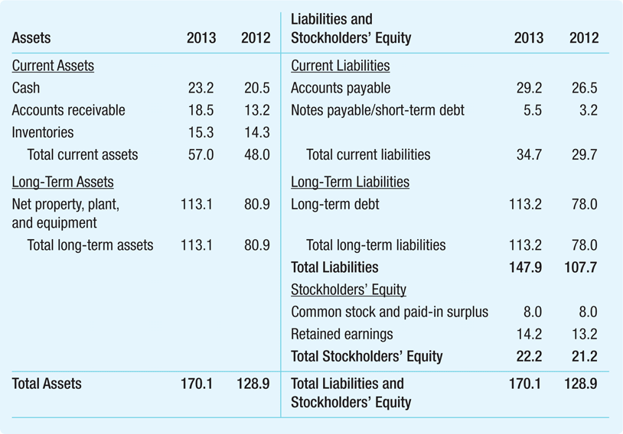
Global Corporation Balance Sheet for 2012 and 2013

Slide 11
The Balance Sheet
The Balance Sheet Identity
The two sides of the balance sheet must balance

Slide 12
The Balance Sheet
Current Assets
Cash and other marketable securities
Short-term, low-risk investments
Easily sold and converted to cash
Accounts receivable
Amounts owed to the firm by customers who have purchased on credit
Inventories
Raw materials, work-in-progress and finished goods;
Other current assets
Includes items such as prepaid expenses

Slide 13
The Balance Sheet
Long-Term Assets
Assets that produce benefits for more than one year
Reduced through a yearly deduction called depreciation according to a schedule that depends on an asset’s life
Depreciation is not an actual cash expense, but a way of recognizing that fixed assets wear out and become less valuable as they get older

Slide 14
The Balance Sheet
Long-Term Assets
The book value of an asset is its acquisition cost less its accumulated depreciation
Other long-term assets can include such items as property not used in business operations, start-up costs in connection with a new business, trademarks and patents, and property held for sale

Slide 15
The Balance Sheet
Liabilities
Current Liabilities
Accounts payable
The amounts owed to suppliers purchases made on credit
Notes payable and short-term debt
Loans that must be repaid in the next year
Repayment of long-term debt that will occur within the next year
Accrual items
Items such as salary or taxes that are owed but have not yet been paid, and deferred or unearned revenue

Slide 16
The Balance Sheet
Liabilities
Net working capital
The capital available in the short term to run the business:

Slide 17
The Balance Sheet
Liabilities
Long-Term Liabilities
Long-term debt
A loan or debt obligation maturing in more than a year

Slide 18
The Balance Sheet
Stockholders’ Equity
Market Value Versus Book Value
Book value of equity
Net worth from an accounting perspective
Assets – Liabilities = Equity
True value of assets may be different from book value
Market capitalization
Market price per share times number of shares
Does not depend on historical cost of assets

Slide 19
Example 1 Market versus Book Value
Problem:
If Global has 3.6 million shares outstanding, and these shares are trading for a price of $10 per share, what is Global’s market capitalization?
How does the market capitalization compare to Global’s book value of equity?
Global’s market capitalization is:
(3.6 million shares) × ($10/share) = $36 million
This market capitalization is significantly higher than Global’s book value of equity: $22.2 million

Slide 20
Example 1 Market versus Book Value (cont’d)
Evaluate:
Global must have sources of value that do not appear on the balance sheet
These include
Opportunities for growth
The quality of the management team
Relationships with suppliers and customers, etc.

Slide 21
Example 2 Market versus Book Value
Problem:
In October, 2013, Campbell Soup Co. (CPB) had 313.5 million shares outstanding, trading for a price of $42.65 per share
What was Campbell’s market capitalization?
How does the market capitalization compare to Campbell’s book value of equity?
Campbell’s market capitalization is:
(313.5 million shares) × ($42.65/share) = $13,371 million
This market capitalization is significantly higher than Campbell’s book value of equity:
$1,217 million

Slide 22
Example 2 Market versus Book Value (cont’d)
Evaluate:
Campbell’s must have sources of value that do not appear on the balance sheet.
These include
Opportunities for growth
The quality of the management team
Relationships with suppliers and customers, etc.

Slide 23
The Balance Sheet
Market to Book Ratio
The ratio of a firm’s market capitalization to the book value of stockholders’ equity:
Also called Price-to-Book ratio
Sometimes used to classify firms as value (low M/B) or growth (high M/B)
Global M/B = 36/22.2 =1.62
Campbell M/B = 13,371/1227 =11

Slide 24
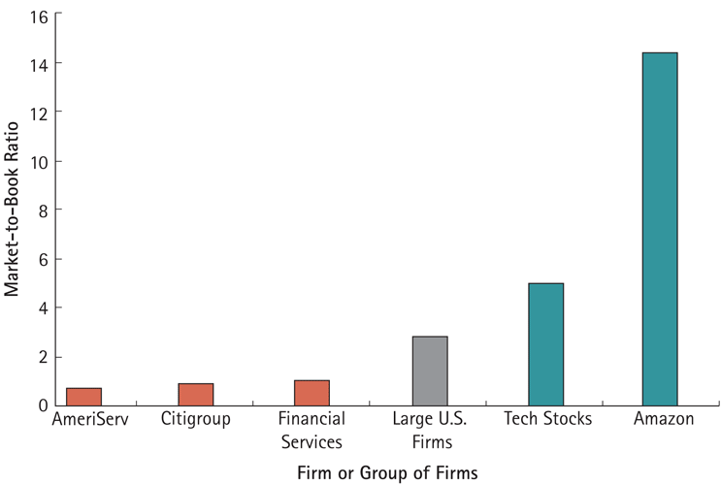
Figure 1 Market-to-Book Ratios in 2013

Slide 25
The Balance Sheet
Enterprise Value
The value of the underlying business assets, unencumbered by debt and separate from any cash and marketable securities
Enterprise Value = Market Value of Equity + Debt - Cash

Slide 26
Example 3 Computing Enterprise Value
In June 2013, H.J. Heinz Co. (HNZ) had a share price of $72.36, a market-to-book ratio of 7.66, a book value of debt of $4,984 million, and cash of $1,100.7 million
What was Heinz’s market capitalization (its market value of equity)?
What was its enterprise value?
Enterprise Value = Market Value of Equity + Debt - Cash
Market Value of Equity= $72.36 × 320.7 million shares = $23.21 billion
Thus, Heinz’s enterprise value was
EV= 23.21+ 4.98 – 1.1 = $27.09 billion

Slide 27
Example 3 Computing Enterprise Value
Problem:
As of July, 2013, Campbell’s Soup Co. (CPB) had a share price of $2.65 and 313.5 million shares outstanding
At that time, the company had $7,106 million in total debt and $333 million in cash
What was Campbell’s enterprise value?
Campbell’s Enterprise Value =
$13,371 + $7,106 – $333.0 = $20,144 million

Slide 28
The Income Statement
The income statement lists the firm’s revenues and expenses over a period of time
Sometimes called the profit and loss statement, or “P&L”
The last or “bottom” line of the income statement shows net income
A measure of its profitability during the period
Also referred to as the firm’s earnings

Slide 29
The Income Statement
Earnings Calculations
Gross Profit
Revenues (Net Sales) - Cost of Sales = Gross Profit
Operating Expenses
Gross Profit – Operating Expenses = Operating Income
Earnings Before Interest and Taxes (EBIT)
Operating Income +/- Other Income = Earnings Before Interest and Taxes
Pretax and Net Income
EBIT +/- Interest income (Expense) = Pretax Income
Pretax Income – Taxes = Net Income

Slide 30
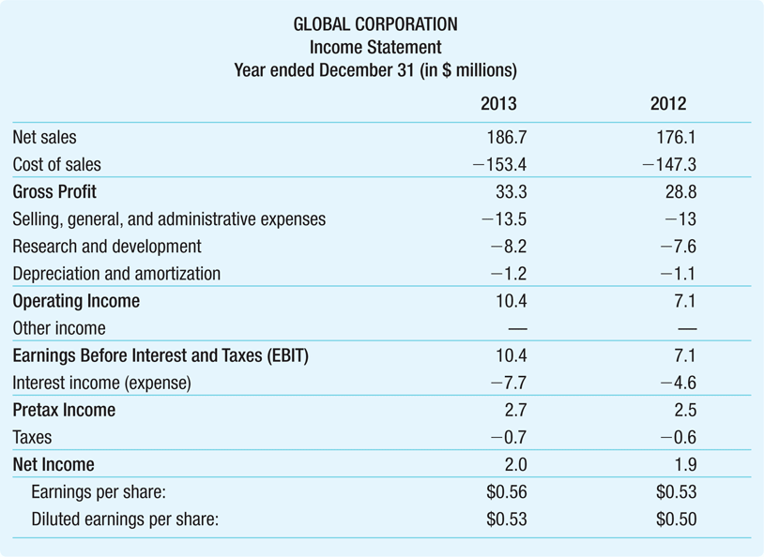
Global Corporation’s Income Statement Sheet for 2013 and 2012

Slide 31
The Income Statement
Earnings Per Share
Net income reported on a per-share basis

Slide 32
The Income Statement
Earnings Per Share
Fully diluted EPS increases number of shares by:
Stock options issued to employees
The right to buy a certain number of shares by a specific date at a specific price
Shares issued due to conversion of convertible bonds
Convertible bonds are corporate bonds with a provision that gives the bondholder an option to convert each bond into a fixed number of shares of common stock

Slide 33
Income Statement Analysis
EBITDA
Financial analysts often compute a firm’s earnings before interest, taxes, depreciation, and amortization, or EBITDA
Because depreciation and amortization are not cash flows, this subtotal reflects the cash a firm has earned from operations

Slide 34
The Statement of Cash Flows
The firm’s statement of cash flows uses the information from the income statement and balance sheet to determine:
How much cash the firm has generated
How that cash has been allocated during a set period
Cash is important because it is needed to pay bills and maintain operations and is the source of any return of investment for investors

Slide 35
The Statement of Cash Flows
The statement of cash flows is divided into three sections which roughly correspond to the three major jobs of the financial manager:
Operating activities
Investment activities
Financing activities

Slide 36
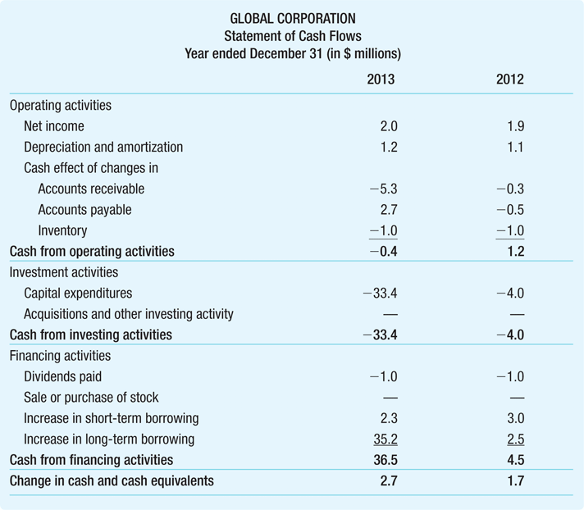
Table 3 Global Corporation’s Statement of Cash Flows for 2013 and 2012

Slide 37
The Statement of Cash Flows
Operating Activity
Use the following guidelines to adjust for changes in working capital:
Accounts receivable:
Adjust the cash flows by deducting the increases in accounts receivable
This increase represents additional lending by the firm to its customers and it reduces the cash available to the firm

Slide 38
The Statement of Cash Flows
Operating Activity
Accounts payable:
Similarly, we add increases in accounts payable
Accounts payable represents borrowing by the firm from its suppliers
This borrowing increases the cash available to the firm

Slide 39
The Statement of Cash Flows
Operating Activity
Inventory:
Finally, we deduct increases to inventory
Increases to inventory are not recorded as an expense and do not contribute to net income
However, the cost of increasing inventory is a cash expense for the firm and must be deducted
We also add depreciation to net income, since it is not a cash outflow

Slide 40
The Statement of Cash Flows
Investment Activity
Subtract the actual capital expenditure that the firm made
Also deduct other assets purchased or investments made by the firm, such as acquisitions

Slide 41
The Statement of Cash Flows
Financing Activity
The last section of the statement of cash flows shows the cash flows from financing activities
Dividends paid
Cash received from sale of stock or spent repurchasing its own stock
Changes to short-term and long-term borrowing

Slide 42
The Statement of Cash Flows
Financing Activity
Payout Ratio and Retained Earnings
Retained Earnings = Net Income – Dividends

Slide 43
The Statement of Cash Flows
The last line of the Statement of Cash Flows combines the cash flows from these three activities to calculate the overall change in the firm’s cash balance over the time period

Slide 44
Example 4 The Impact of Depreciation on Cash Flow
Problem:
Suppose Global had an additional $1 million depreciation expense in 2013
If Global’s tax rate on pretax income is 26%, what would be the impact of this expense on Global’s earnings?
How would it impact Global’s cash at the end of the year?
Depreciation is an operating expense, so Global’s operating income, EBIT, and pretax income would be affected.
With a tax rate of 26%, Global’s tax bill will decrease by 26 cents for every dollar that pretax income is reduced
Global’s operating income, EBIT, and pretax income would fall by $1 million because of the $1 million in additional operating expense due to depreciation
This $1 million decrease in pretax income would reduce Global’s tax bill by 26% × $1 million = $0.26 million
Therefore, net income would fall by 1 – 0.26 = $0.74 million

Slide 45
Example 4 The Impact of Depreciation on Cash Flow (cont’d)
Execute (cont’d):
On the statement of cash flows, net income would fall by $0.74 million, but we would add back the additional depreciation of $1 million because it is not a cash expense
Thus, cash from operating activities would rise by –0.74 + 1 = $0.26 million
Thus, Global’s cash balance at the end of the year would increase by $0.26 million, the amount of the tax savings that resulted from the additional depreciation deduction

Slide 46
Example 4 The Impact of Depreciation on Cash Flow (cont’d)
Evaluate:
The increase in cash balance comes completely from the reduction in taxes
Because Global pays $0.26 million less in taxes even though its cash expenses have not increased, it has $0.26 million more in cash at the end of the year

Slide 47
Other Financial Statement Information
Statement of Stockholders’ Equity
Change in Stockholders’ Equity
= Retained Earnings + Net Sales of Stock
= Net Income – Dividends + Sales of Stock – Repurchases of stock
Management Discussion and Analysis
Notes to the Financial Statements

Slide 48
Financial Statement Analysis
Investors often use accounting statements to:
Compare the firm with itself by analyzing how the firm has changed over time
Compare the firm to other similar firms using a common set of financial ratios

Slide 49
Financial Statement Analysis
Profitability Ratios
Gross Margin
How much a company earns from each dollar of sales after paying for the items sold

Slide 50
Financial Statement Analysis
Profitability Ratios
Operating Margin
How much a company earns before interest and taxes from each dollar of sales

Slide 51
Financial Statement Analysis
Profitability Ratios
Net Profit Margin
The fraction of each dollar in revenues that is available to equity holders after the firm pays interest and taxes

Slide 52
Financial Statement Analysis
Liquidity Ratios
Current Ratio
The ratio of current assets to current liabilities

Slide 53
Financial Statement Analysis
Liquidity Ratios
Quick Ratio
The ratio of current assets other than inventory to current liabilities

Slide 54
Financial Statement Analysis
Liquidity Ratios
Cash Ratio
The most stringent liquidity ratio:

Slide 55
Financial Statement Analysis
Asset Efficiency
Asset Turnover
A first broad measure of efficiency is asset turnover

Slide 56
Financial Statement Analysis
Asset Efficiency
Fixed Asset Turnover
Since total assets include assets that are not directly involved in generating sales, a manager might also look at fixed asset turnover

Slide 57
Financial Statement Analysis
Working Capital Ratios
Accounts Receivable Days
The firm’s accounts receivable in terms of the number of days’ worth of sales that it represents

Slide 58
Financial Statement Analysis
Working Capital Ratios
Inventory Days and Inventory Turnover
Inventory Days is the number of days’ cost of goods sold represented by inventory
Inventory Turnover tells how efficiently a company turns its inventory into sales

Slide 59
Example 5 Computing Working Capital Ratios
Problem:
Compute Global’s accounts payable days, inventory days and inventory turnover for 2013

Slide 60
Example 5 Computing Working Capital Ratios (cont’d)
Solution:
Plan and Organize:
Working capital ratios require information from both the balance sheet and the income statement
For these ratios, we need inventory and accounts payable from the balance sheet and cost of goods sold from the income statement (often listed as cost of sales)
Inventory= 15.3
Accounts payable = 29.2
Cost of goods sold (cost of sales) = 153.4

Slide 61
Example 5 Computing Working Capital Ratios (cont’d)

Slide 62
Example 5 Computing Working Capital Ratios (cont’d)
Evaluate:
Assuming that Global’s accounts payable at year-end on its balance sheet is representative of the normal amount during the year, Global is able, on average, to take about 69.5 days to pay its suppliers
This compares with the 27.5 days we calculated that it waits on average to be paid (its accounts receivable days)
Global typically takes 36 days to sell its inventory
Note that inventory turnover and inventory days tell us the same thing in different ways – if it takes Global about 36 days to sell its inventory, then it turns over its inventory about 10 times per 365-day year

Slide 63
Financial Statement Analysis
Interest Coverage Ratios
Also known as times interest earned (TIE)
TIE = Earnings divided by interest
Can define earnings as operating income, EBIT, or EBITDA
Assesses how easily a firm is able to cover its interest payments

Slide 64
Example 6 Computing Interest Coverage Ratios
Assess Global’s ability to meet its interest obligations by calculating interest coverage ratios using both EBIT and EBITDA

Slide 65
Financial Statement Analysis
Leverage Ratios
Debt-Equity Ratio
The debt-equity ratio is a common ratio used to assess a firm’s leverage
This ratio can be calculated using book or market values

Slide 66
Financial Statement Analysis
Leverage Ratios
Debt-to-Capital Ratio
The debt-to-capital ratio calculates the fraction of the firm financed by debt:
This ratio can also be calculated using book or market values

Slide 67
Financial Statement Analysis
Leverage Ratios
Net Debt
While leverage increases risk to equity holders, firms may also hold cash reserves in order to reduce risk
Another useful measure is net debt

Slide 68
Financial Statement Analysis
Leverage Ratios
Debt-to-Enterprise Value Ratio

Slide 69
Financial Statement Analysis
Leverage Ratios
Equity Multiplier
Total Assets/Book Value of Equity

Slide 70
Financial Statement Analysis
Valuation Ratios
Analysts and investors use a number of ratios to gauge the market value of the firm
The most important is the firm’s price-earnings ratio (P/E)
The P/E ratio is used to assess whether a stock is over- or under-valued based on the idea that the value of a stock should be proportional to the earnings it can generate

Slide 71
Financial Statement Analysis
Valuation Ratios
PEG Ratio
P/E ratios can vary widely across industries and tend to be higher for industries with higher growth rates
One way to capture the idea that a higher P/E ratio can be justified by higher expected earnings growth
It is the ratio of the firm’s P/E to its expected earnings growth rate
The higher the PEG ratio, the higher the price relative to growth, so some investors avoid companies with PEG ratios over 1

Slide 72
Example 6 Computing Profitability and Valuation Ratios
Problem:
Consider the following data from 2012 for Wal-Mart Stores and Target Corporation ($ billions):
Compare Wal-Mart and Target’s operating margin, net profit margin, P/E ratio, and the ratio of enterprise value to operating income and sales
 | Wal-Mart Stores (WMT) | Target Corporation (TGT)
Sales | 469 | 73
Operating Income | 28 | 5
Net Income | 17 | 3
Market Capitalization | 222 | 38
Cash | 8 | 1
Debt | 54 | 18

Slide 73
Example 6 Computing Profitability and Valuation Ratios (cont’d)
Solution
Plan:
The table contains all of the raw data, but we need to compute the ratios using the inputs in the table.
Operating Margin = Operating Income / Sales
Net Profit Margin = Net Income / Sales
P/E Ratio = Price / Earnings
Enterprise Value to Operating Income = Enterprise Value / Operating Income
Enterprise Value to Sales = Enterprise Value / Sales

Slide 74
Example 6 Computing Profitability and Valuation Ratios (cont’d)
Execute:
Wal-Mart had
An operating margin of 28/469=6.0%
A net profit margin of 17/469=3.6%
A P/E ratio of 222/17=13.1
Its enterprise value was 222 + 54 - 8 = 268 billion:
A ratio of 268/28=9.6 to operating income
A ratio of 268/469=0.57 to sales

Slide 75
Example 6 Computing Profitability and Valuation Ratios (cont’d)
Execute (cont’d):
Target had
An operating margin of 5/73 = 6.8%
A net profit margin of 3/73=4.1%
A P/E ratio of 38/3=12.7.
Its enterprise value was 38 + 18 – 1 = $55 billion:
A ratio of 55/5 = 11 to operating income
A ratio of 55/73 = 0.75 to sales.

Slide 76
Example 6 Computing Profitability and Valuation Ratios (cont’d)
Evaluate:
Target has a slightly higher overall profit margin and enterprise value ratios, but a slightly lower P/E ratio
This suggests that the market expects similar growth rates from Target and Wal-Mart, despite large differences in size

Slide 77
Example 7 Computing Profitability and Valuation Ratios
Problem:
Consider the following data from 2013 for Campbell Soup Co. and General Mills, Inc. ($ millions):
Compare Campbell’s and Heinz’s operating margin, net profit margin, P/E ratio, and the ratio of enterprise value to operating income and sales
 | Campbell’s Soup Co. (CPB) | General Mills, Inc. (GIS)
Sales | 8,052.0 | 17,774.1
Operating Income | 1,080.0 | 2,851.8
Net Income | 458.0 | 1,855.2
Market Capitalization | 13.371.0 | 31,660.0
Cash | 333.0 | 741.4
Debt | 7,106.0 | 15,018.3

Slide 78
Example 7 Computing Profitability and Valuation Ratios (cont’d)
Solution
Plan:
The table contains all of the raw data, but we need to compute the ratios using the inputs in the table.
Operating Margin = Operating Income / Sales
Net Profit Margin = Net Income / Sales
P/E ratio = Price / Earnings
Enterprise value to operating income = Enterprise Value / Operating Income
Enterprise value to sales = Enterprise Value / Sales

Slide 79
Example 8: Computing Profitability and Valuation Ratios (cont’d)
Execute:
Ratio | Campbell’s | General Mills
Operating Margin | 1,080/8,052=13.4% | 2,851.8/17,774.1 = 16.0%
Net Profit Margin | 458/8,052=5.7% | 1,855.2/17,774.1 = 10.4%
P/E Ratio | 13,371/458 = 29.19 | 31,660.0/1,855.2 = 17.07
Enterprise Value | 13,371.0+7,106.0-333.0 = 20,144.0 | 31,660.0+15,018.3 – 741.4 = 45,946.9
Enterprise Value to Operating Income | 20,144.0/1,080.0 = 18.65 | 45,936.9/2,851.0 = 16.11
Enterprise Value to Sales | 20,144.0/8,052.0 = 2.50 | 45,936.9/17,774.1 = 2.58

Slide 80
Example 8 Computing Profitability and Valuation Ratios (cont’d)
Evaluate:
Note that Campbell’s operating and net profit margins are quite a bit lower than General Mill’s
Campbell’s had a larger P/E ratio, which can be explained in part by their greater use of leverage as seen later in Example 2.8a
However, the ratios of enterprise value to sales were almost the same for the two firms

Slide 81
Financial Statement Analysis
Operating Returns
Return on Equity
Evaluating the firm’s return on investment by comparing its income to its investment

Slide 82
Financial Statement Analysis
Operating Returns
Return on Assets
Evaluating the firm’s return on investment by comparing its income to its assets

Slide 83
Financial Statement Analysis
Operating Returns
Return on Invested Capital
After-tax profit generated by the business, excluding interest, compared to capital raised that has already been deployed

Slide 84
Example 9 Computing Operating Returns
Problem:
Assess how Global’s ability to use its assets effectively has changed in the last year by computing the change in its return on assets

Slide 85
Example 9 Computing Operating Returns (cont’d)
Solution
Plan and Organize:
In order to compute ROA, we need net income, interest expense, and total assets
 | 2012 | 2013
Net Income | 1.9 | 2.0
Interest Expense | 4.6 | 7.7
Total Assets | 128.9 | 170.1

Slide 86
Example 9 Computing Operating Returns (cont’d)
Execute:
In 2013, Global’s ROA was (2.0+7.7)/170.1 = 5.7%, compared to an ROA in 2012 of (1.9+4.6)/128.9 = 5.0%

Slide 87
Example 9 Computing Operating Returns (cont’d)
Evaluate:
The improvement in Global’s ROA from 2012 to 2013 suggests that Global was able to use its assets more effectively and increase its return over the period

Slide 88
Financial Statement Analysis
The DuPont Identity
This expression says that ROE can be thought of as net income per dollar of sales (profit margin) times the amount of sales per dollar of equity

Slide 89
Financial Statement Analysis
The DuPont Identity
This final expression says that ROE is equal to
Net income per dollar of sales (profit margin) times
Sales per dollar of assets (asset turnover) times
Assets per dollar of equity (equity multiplier)

Slide 90
Example 10 DuPont Analysis
Problem:
The following table contains information about Wal-Mart (WMT) and Nordstrom (JWN)
Compute their respective ROEs and then determine how much Wal-Mart would need to increase its profit margin in order to match Nordstrom’s ROE
 | Profit Margin | Asset Turnover | Equity Multiplier
Wal-Mart | 3.6% | 2.3 | 2.7
Nordstrom | 6.1% | 1.5 | 4.2

Slide 91
Example 10 DuPont Analysis (cont’d)
Solution:
Plan and Organize:
The table contains all the relevant information to use the DuPont identity to compute the ROE
We can compute the ROE of each company by multiplying its profit margin, asset turnover, and equity multiplier
In order to determine how much Wal-Mart would need to increase its profit margin to match Nordstrom’s ROE, we can set Wal-Mart’s ROE equal to Nordstrom’s, keep its turnover and equity multiplier fixed, and solve for the profit margin

Slide 92
Example 10 DuPont Analysis (cont’d)
Execute:
Using the DuPont Identity, we have:
ROE_{WMT} = 3.6% x 2.3 x 2.7 = 22.3%
ROE_{JWN} = 6.1% x 1.5 x 4.2 = 38.4%
Now, using Nordstrom’s ROE, but Wal-Mart’s asset turnover and equity multiplier, we can solve for the margin that Wal-Mart needs to achieve Nordstrom’s ROE:
38.4% = Margin x 2.3 x 2.7
Margin = 38.4% / 6.21 = 6.2%

Slide 93
Example 10 DuPont Analysis (cont’d)
Evaluate:
Wal-Mart would have to increase its profit margin from 3.6% to 6.2% in order to match Nordstrom’s ROE
It would be able to achieve Nordstrom’s ROE even with around the same profit margin as Nordstrom (6.2% vs. 6.1%) because of its higher turnover

Slide 94
Example 11 DuPont Analysis
Problem:
The following table contains information about Campbell’s (CPB) and General Mills (GIS)
Compute their respective ROEs and then determine how much General Mills would need to increase its equity multiplier in order to match Campbell’s ROE
 | Profit Margin | Asset Turnover | Equity Multiplier
Campbell’s | 5.7% | 0.97 | 6.84
General Mills | 10.4% | 0.78 | 2.97

Slide 95
Example 11 DuPont Analysis (cont’d)
Solution:
Plan:
We can compute the ROE of each company by multiplying together its profit margin, asset turnover, and equity multiplier
In order to determine how much General Mills would need to increase its equity multiplier to match Campbell’s ROE, we can set General Mills’ ROE equal to Campbell’s, keep its profit margin and turnover fixed, and solve for the equity multiplier

Slide 96
Example 11 DuPont Analysis (cont’d)
Execute:
Using the DuPont Identity, we have:
ROE_{CPB} = 5.7% x 0.97 x 6.84 = 37.6%
ROE_{GIS} = 10.4% x 0.78 x 2.97 = 24.3%
Now, using Campbell’s ROE, but General Mills’ profit margin and asset turnover, we can solve for the equity multiplier that General Mills needs to achieve Campbell’s ROE:
37.6% = 10.4% x 0.78 x Equity Multiplier
Equity Multiplier = 37.6% / 8.2% = 4.59

Slide 97
Example 11 DuPont Analysis (cont’d)
Evaluate:
General Mills would have to increase its equity multiplier from 2.97 to 4.59 in order to match Campbell’s ROE
This large increase in equity multiplier is required because of its lower asset turnover (0.78 vs. 0.97) (lower efficiency), despite its higher profit margin (10.4% vs. 5.7%)

Slide 98
Example 11 DuPont Analysis
Problem:
The following table contains information about Campbell’s (CPB) and General Mills (GIS)
Compute their respective ROEs and then determine how much General Mills would need to increase its asset turnover in order to match Campbell’s ROE
 | Profit Margin | Asset Turnover | Equity Multiplier
Campbell’s | 5.7% | 0.97 | 6.84
General Mills | 10.4% | 0.78 | 2.97

Slide 99
Example 11 DuPont Analysis (cont’d)
Solution:
Plan:
We can compute the ROE of each company by multiplying together its profit margin, asset turnover, and equity multiplier
In order to determine how much General Mills would need to increase its asset turnover to match Campbell’s ROE, we can set General Mills’ ROE equal to Campbell’s, keep its profit margin and equity multiplier fixed, and solve for the asset turnover

Slide 100
Example 11 DuPont Analysis (cont’d)
Execute:
Using the DuPont Identity, we have:
ROE_{CPB} = 5.7% x 0.97 x 6.84 = 37.6%
ROE_{GIS} = 10.4% x 0.78 x 2.97 = 24.3%
Now, using Campbell’s ROE, but General Mills’ profit margin and asset turnover, we can solve for the equity multiplier that General Mills needs to achieve Campbell’s ROE:
37.6% = 10.4% x Asset Turnover x 2.97
Asset Turnover = 37.6% / 31.0% = 1.22

Slide 101
Example 11 DuPont Analysis (cont’d)
Evaluate:
General Mills would have to increase its asset turnover from 0.78 to 1.22 in order to match Campbell’s ROE
This large increase in asset turnover is required because of its lower equity multiplier (2.97 vs. 6.84) (lower leverage), despite its higher profit margin (10.4% vs. 5.7%)

Slide 102
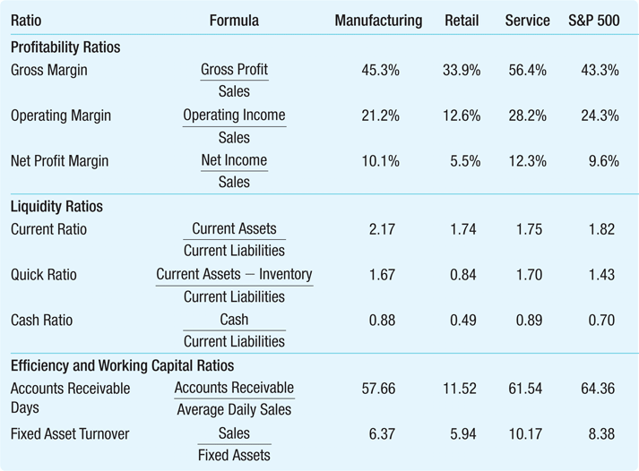
Table 5 A Summary of Key Financial Ratios

Slide 103
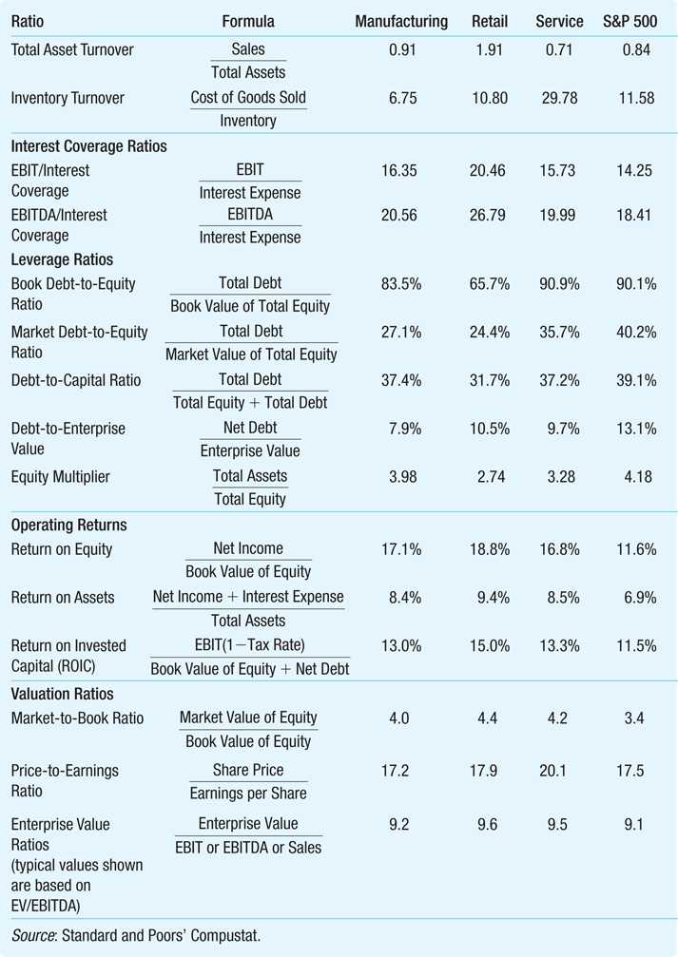
Table 5 Summary of Key Financial Ratios (cont.)

Slide 104
Financial Reporting in Practice
Even with safeguards such as GAAP and auditors, though, financial reporting abuses unfortunately do take place
Enron
One of the most infamous recent examples of fraud

Slide 105
Financial Reporting in Practice
The Sarbanes-Oxley Act
In 2002, Congress passed the Sarbanes-Oxley Act (SOX)
While SOX contains many provisions, the overall intent of the legislation was to improve the accuracy of information given to both boards and to shareholders

Slide 106
Financial Reporting in Practice
The Sarbanes-Oxley Act
SOX attempted to achieve this goal in three ways:
Overhauling incentives and independence in the auditing process
Stiffening penalties for providing false information
Forcing companies to validate their internal financial control processes

Slide 107
Financial Reporting in Practice
Dodd-Frank Act
The Dodd-Frank Wall Street Reform and Consumer Protection Act was passed in 2010:
To mitigate compliance burden on small firms
Exempts firms with less than $75 million in publicly held shares from the SOX Section 404 requirements
Requires SEC to study how it might reduce cost for medium-sized firms with public float of less than $250 million
Broadened the whistle-blower provisions of SOX

